Slide 1
Journal Searching Using Pubmed
Nancy B. Clark, M.Ed.
Director of Medical Informatics Education
FSU College of Medicine
Spring 2014
All recourses are available online in Medical Informatics site
under Topics: Research

Slide 2
My Goal
All faculty and students will correctly cite all copyrighted resources (images, articles, videos, etc.) in their:
Presentations
Posters
Papers –Annotated Bibliography, Health Topic Brief, and Surgery Research Paper

Slide 3
Objectives
Attendees will be able to
Use Pubmed to search the medical journals
Find full text peer-reviewed journal articles
Find online health stats
Cite appropriately in a specified style
Use Endnote Web to manage citations and references for papers, posters and presentations

Slide 4
Tutorials Available
Tutorials at Pubmed
Searching PubMed
Using Mesh Terms
Using My NCBI
Tutorials at EndnoteWeb.com

Slide 5
Supportive Materials
Policy Brief Instructions
Examples of AMA style citations

Slide 6
Essential Software
MSWord 2010
Endnote Web Cite While you Write plugin
http://www.myendnoteweb.com
Stedman’s Medical Spellchecker

Slide 7
Find the Journals

Slide 8
Levels of References
Primary: Peer Reviewed journal articles
Secondary: Not peer reviewed
Primary
Secondary
Notes:
When someone says Primary Literature, they usually mean something that is peer reviewed, like a journal article published in a peer reviewed journal or a textbook from a highly respected author who quotes from and cites peer reviewed articles.
The secondary level of references or literature refers to things like newspaper articles, authoritative web sites, and such that are usually opinions or reports of occurrences, news, surveys, and such. Also included in secondary sites are databases like the ones at the CDC which are statistics collected from state and local agencies.

Slide 9
Levels of Peer Reviewed Information
Tertiary: textbooks, summaries
Secondary: review articles
Primary: original research
Tertiary
Secondary
Primary
Notes:
Primary Information Source:
Articles in scientific journals that report the findings from research studies and experiments are considered "primary" information sources, because they are "first hand" accounts of the actual research and the results, i.e. the original scientific evidence. Papers about original empirical research must conform to acceptable scientific standards for conducting and reporting such research, and must pass peer-review to be published as articles in a scientific journal
Secondary Information Source:
The various original scientific studies described above generate a wealth of "primary evidence" that periodically needs to be gathered, organized, and assessed by the clinical and scientific communities to give us a sense of the current "state of the science" on a given topic. These types of research "Review" articles are considered a secondary source because they are "second-hand" accounts which integrate the scientific evidence from a number of original research studies. However, such scientific "Review" articles must also conform to scientifically acceptable methodologic standards for gathering, synthesizing, and reporting the available evidence, and also must be peer-reviewed before being published in a reputable scientific journal.
Tertiary Information Sources:
Textbooks offer an example of a usually reliable source of information, that may or may not be peer-reviewed. The more accurate and reliable textbooks will contain information that is drawn only from the evidence from primary and secondary source articles that have been published in the peer-reviewed scientific literature, and that conform to scientific standards for summarizing and interpreting that information. For instance, the author(s) of an accurate and reliable textbook will appropriately and objectively summarize all information available on a topic, and not just "pick and choose" certain evidence or interpret the selected evidence in a biased manner.
In accredited institutions, textbooks are reviewed and approved by the faculty of the institution, which provides another level of "peer-review" of the information in the textbook. Textbooks in wide use by a number of accredited institutions may give a further indication of the extent to which educators, clinicians, and scientists consider the book a credible and legitimate source of accurate and complete information
http://www.chiroweb.com/vaccinfo/authoritative_sources.html

Slide 10
Clarification for Assignment
Primary means original research on topic
Secondary means everything else
Need original research if available

Slide 11
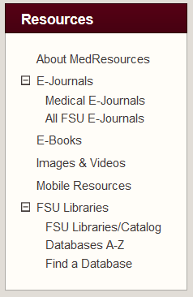
Periodical Databases
See FSU Libraries > Databases A-Z or Databases By Subject
ERIC (education journals)
Lexis-Nexis Academic Universe (business, government, medical, legal...)
Access World News (major newspapers)
PsychINFO (social sciences)
Web of Knowledge/Science (science, social science, arts and literature citations)
MEDLINE (medicine)
Notes:
Depending on your topic, you may need to search a variety of periodicals other than just medical. We have a number of databases of citations from other types of publications. These can be found using the FSU Databases A-Z on the Library web page. Some of there include the:
ERIC database of educational peer reviewed journals. Sponsored by the U.S. Department of Education to provide extensive access to educational-related literature. The ERIC database corresponds to two printed journals: Resources in Education (RIE) and Current Index to Journals in Education (CIJE). Coverage from 1966 -
Lexis-Nexis academic universe which has full-text coverage of general news, business, legal, governmental and other topics.
The Newspaper Abstracts which contains the abstracts from 25 major newspapers including the New York Times, Wall Street Journal, Washing Post, etc.
PsychINFO is the online version of Psychological Abstracts, 1887 to present. Covers journal articles, book chapters, books, technical reports, and dissertations, in psychology and psychological aspects of related disciplines. Some links to full text.
Web of Knowledge (ISI) Includes Science Citation Index, Social Science Citation Index, and Arts & Humanities Citation Index. Links to some full text. Now part of the Web of Knowledge.

Slide 12
What is MEDLINE?
produced by the National Library of Medicine
electronic version of Index Medicus, International Nursing Index, International Dental Literature
1966 – present
4,000+ international biomedical journals
includes journal articles, reviews, letters, editorials, comments, some conference proceedings and books

Slide 13
MEDLINE Fields
Author
Title
Date
Type of publication
Journal, Volume, Issue
Page numbers
Abstract
Institution
MeSH Headings
A lot of cataloging numbers

Slide 14
Where is MEDLINE?
Pubmed (NLM)
Google Scholar
MDConsult
Medscape
Links to
Full text journal articles
Books
EBM databases
Save Searches and citations
Notes:
Yes, it is true. MEDLINE is all over the place. Selecting the search engine to go with the search topic is an important decision. OVID provides a powerful search engine, allowing for quick access to MeSH, command searching, cross-file searching with EBM databases, and links to MEDLINE in context to references and other full-text articles within the OVID selection of 82 electronic journals. MD Consult provides one-stop shopping with reference and text books, current articles patients are reading, web resources, and over 40 electronic journals. (The search engine for MD Consult is not as good as OVID’s search engine.) Pubmed includes Biomed Central journals and a feature called Linkout. Once activated at FSU, approximately 1,000 electronic journal titles will be linked to specific references. Science Direct links MEDLINE references to a large group of FSU-subscribed e-journals published by Elsevier. Cambridge Scientific is another FSU-subscribed vendor but I can’t recommend it for MEDLINE searching. Medscape is a very popular Internet site with a broad range of free literature, although much of the full-text information is not peer reviewed. I could go on. I won’t!

Slide 15
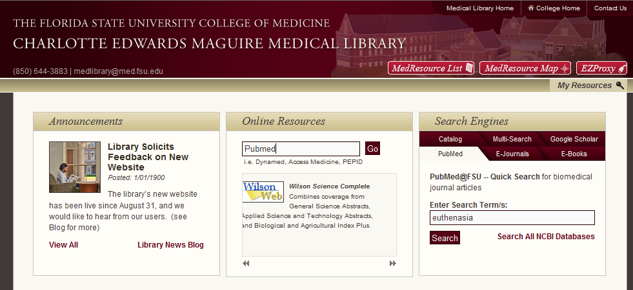
Getting To PubMed From Library
Use Search Engines PubMed Box or
Use MedResources List or Map
Type PubMed into Online Resources search
ID is built into links

Slide 16
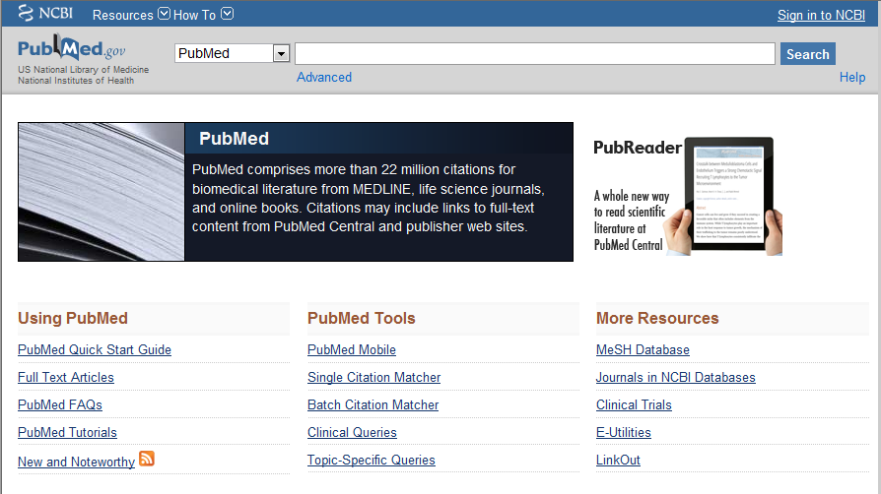
PubMed MEDLINE Entering PubMed
Type search terms
Tutorials
Save searches in NCBI

Slide 17
Why get NCBI Account?
Save searches
Save citations in My Bibliography
Automatically update and e-mail search results from your saved searches
Filter search results
Highlighting search terms

Slide 18
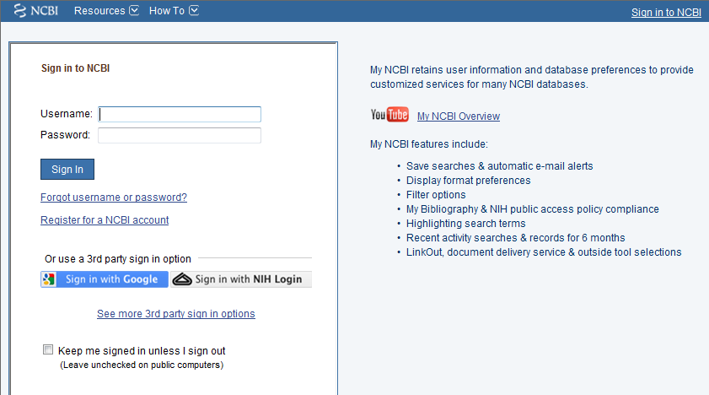
NCBI Sign In Page

Slide 19
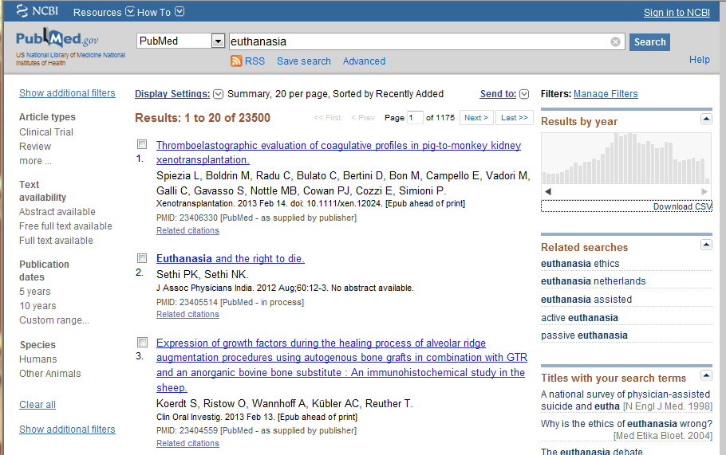
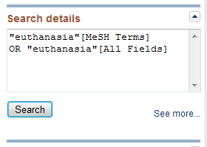
PubMed MEDLINE Preliminary Results
Large number of hits.
Scroll down to ‘Details’ to show how PubMed translated the search. (You can modify the search by typing in the text box.)

Slide 20
Boolean Operators
AND
OR
NOT
Parenthesis
*
quotes
“medication errors” AND “quality improvement” NOT (ambulatory OR “nursing home”)
Notes:
Notice that the Search Details contain Boolean Operators which Pubmed has assigned intuitively from your search. The more words in your search, the fewer numbers you will get and the more data in the search details.

Slide 21
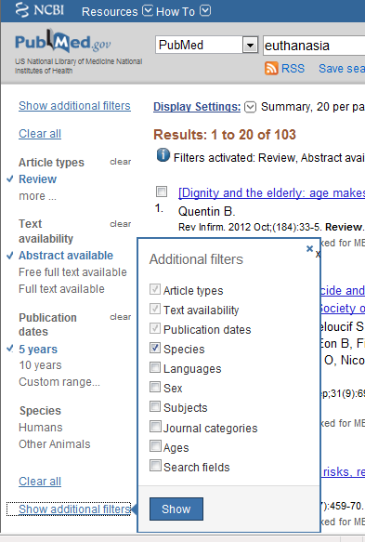
PubMed MEDLINE Filter (Limit) Results
Left Side
Filter by
Article Type
Text Availability
Publication date
Species
Type research
Language

Slide 22
Types of Articles
Editorials
Letters
Review Articles
Meta-Analysis
Systematic reviews
Clinical Guidelines
Original Research
Case Studies
Case Control
Time Series
Cross sectional
Cohort
Control trials
Randomized Control Trials
Notes:
Before we get to searching, there are some prerequisite definitions you need to be reminded of. To do good searches, you need to know what kind of article you are looking for. Let’s review the various types of articles. Open any journal and you will find some of each of these types presented: editorials, letters to the editor, review articles of varying quality, high quality meta-analysis and systematic reviews of the literature (Cochrane), clinical practice guidelines, medical news, etc. Then there is the primary research. Within the research articles there is a pecking order of quality and respectability, starting with the lowest level case presentations, going up to the highest level represented by large scale randomized control trials. Knowing the type of article that you want can really speed up a literature search, no matter what interface you are using.

Slide 23
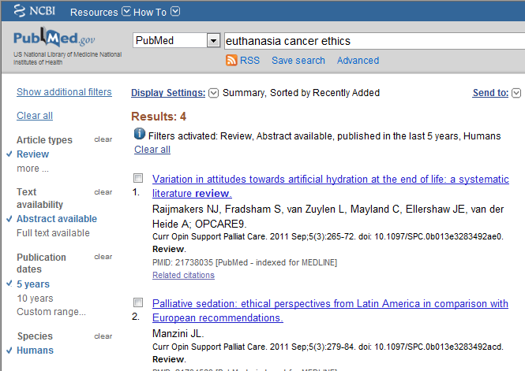
PubMed MEDLINE Refined Results
Add terms to the search like cancer, ethics
Notes:
If you add terms like cancer to the search, you can get this search down to a few articles.

Slide 24
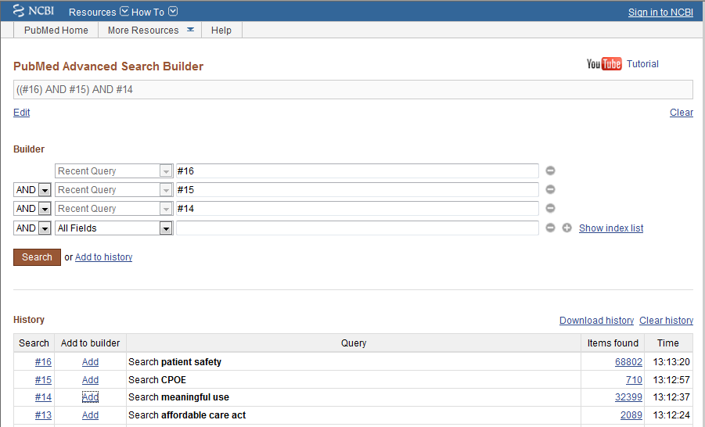
PubMed MEDLINE
Multiple Terms:
Use Advanced Search
History
#2 AND #3
Click on number of hits to see results
Combining Searches

Slide 25
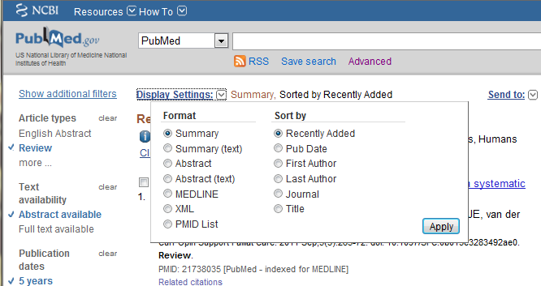
Getting the articles
Display Settings:
Select ‘Abstract’ view and click on ‘Apply’
Click on FSU icon to link to full text.

Slide 26
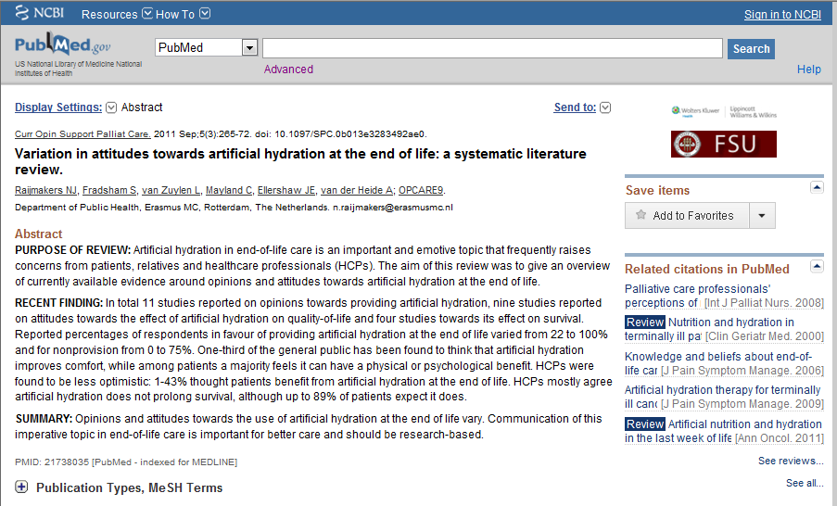
Click on Article Title: Abstract View
Link to full text FSU subscriptions
Related Citations
Notes:
Use the Abstract View of an individual article to find the link to the full text article. Also to find Related articles which are articles with the same or most of the same MeSH Headings.

Slide 27
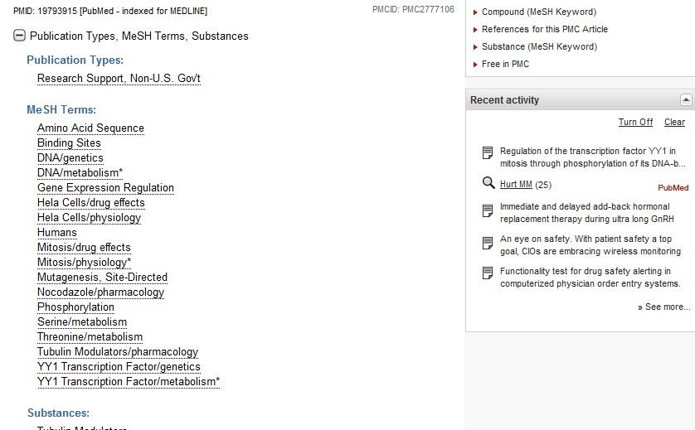
MeSH Terms
Use MeSH terms to find search terms.
Notes:
Scroll down on any abstract view of the article and you can explode MeSH terms on this article to use to find more articles on similar topics.

Slide 28
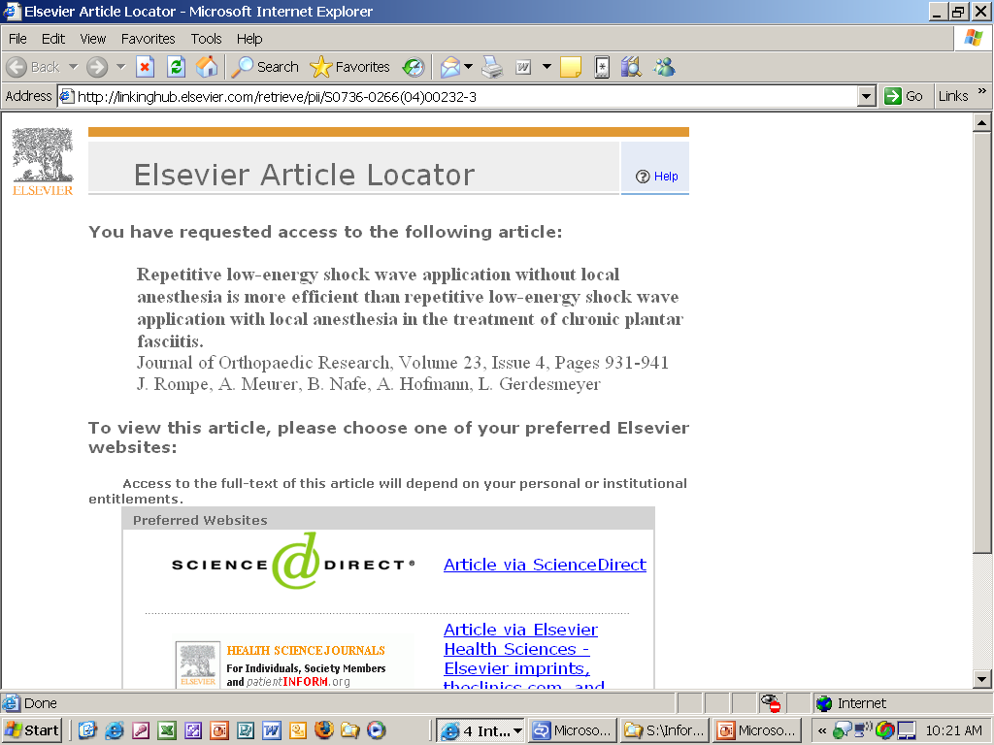
Notes:
Since the University has a site license to nearly all of the Elsevier journals, you may locate many Elsevier Science Direct articles and so it is important to know what to do when you get to this screen.
Click on the first link “Article via ScienceDirect.”

Slide 29
When the pretty red button isn’t there….

Slide 30
Identify the Full Journal Title, Issue and Article Title
Hover cursor over Journal name
Notes:
Item #6 in the above search does not have a link indicating that this journal is available from FSU. Therefore, using your mouse hover over the title and view the entire name of the journal.
Once you know the name of the journal, click on the Medical Library “e-journal” link and look for this journal.

Slide 31
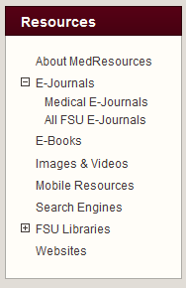
4 Steps - Finding Full Text Articles
Pubmed Linked to full text? No…
Search Google Scholar for the article title.
Medical E-Journals list from library webpage? Not listed…
FSU E-Journals from library webpage. In electronic format? No...
Interlibrary loan for titles not owned by FSU

Slide 32
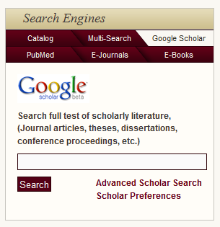
Step 1: Google Scholar
Searches Pubmed, some of our content, links to full text
In Search Engines box
Search for article title
Click on Title or
“Find @FSU”
If off campus, EZProxy
Notes:
Google scholar is another good way to find one article, if you know the name of the article. It searches Pubmed along with some other scholarly databases, and does contain links to Find at FSU. If you log into EXProxy before starting the search of GS from the library Search box, it helps get direct access to the articles.

Slide 33
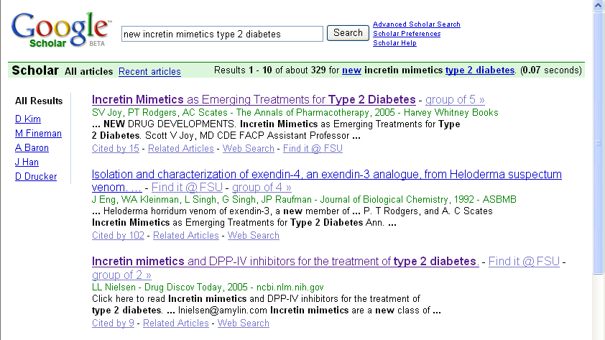
Notes:
If the Maguire Medical Library has paid for a subscription to the resource, or has access via a consortial arrangement with another library that has paid for a subscription, then frequently you can click on the title and be taken directly to full text .
Make sure you have logged into EZProxy first.

Slide 34
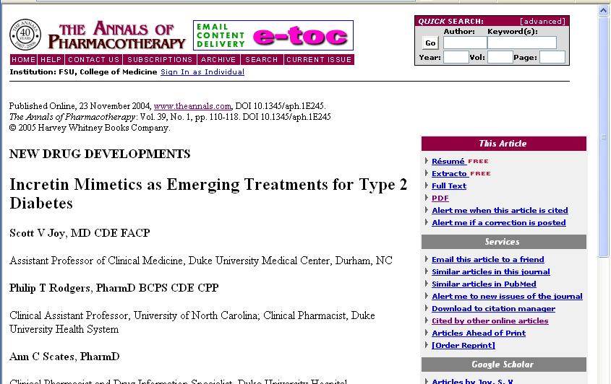
Saving Articles
Notes:
Most people prefer to keep a copy of the article in electronic format. Some like to print the article out. It is best to use the PDF version of the article for either of these purposes as it looks just like the article in the paper journal when viewed or printed out. In most journal publisher’s web sites, the article will come up in web page format, but there is a link on the right to the PDF (Adobe Acrobat) version of the article that looks just like the journal.

Slide 35
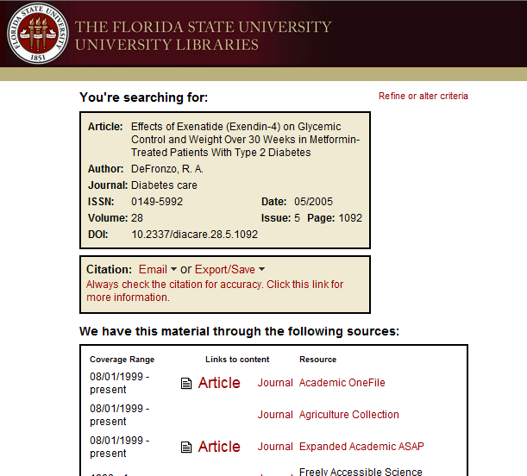
Find it @ FSU
Notes:
Clicking on “Find it @ FSU” will provide links to other possibilities for full text. There is always a link to Serials Solutions and the Online Catalog.

Slide 36
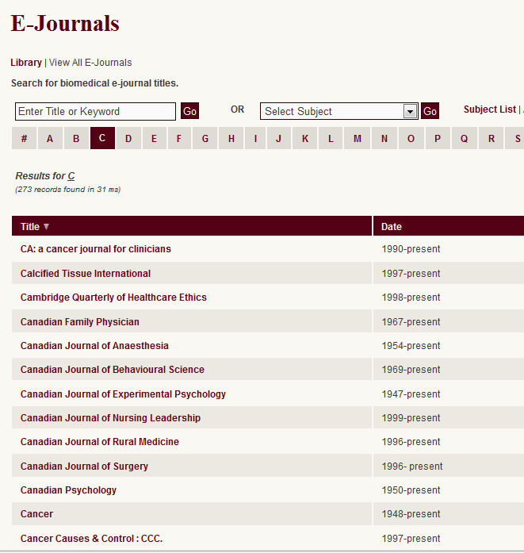
STEP 2: Look for Journal in Medical E-Journals List
In electronic less than 12~ years
Each journal different
Digitizing old issues slowly

Slide 37
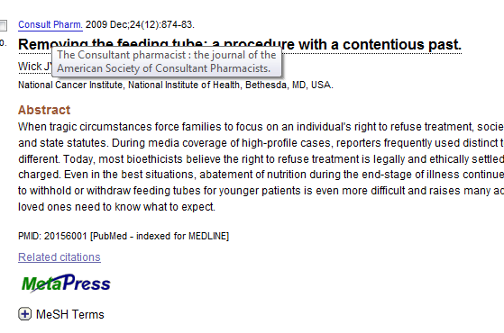
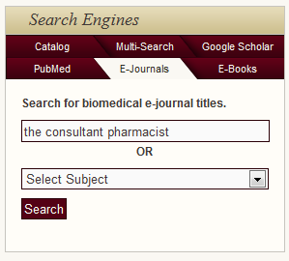
STEP 2: or Search E-Journal Titles
If there is no FSU icon, there are other options:
Search E-Journal Titles for the journal name

Slide 38
If not found….

Slide 39
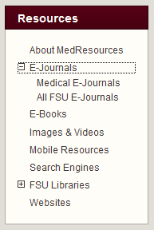
STEP 3: Look for Journal in All FSU E-Journals
Under Resources
Expand E-Journals
Click on All FSU E-Journals
Notes:
This particular journal is not on our list. Next, go to Serials Solutions (a link from the Medical Library e-journals page but also a link from the Medical Library homepage).

Slide 40
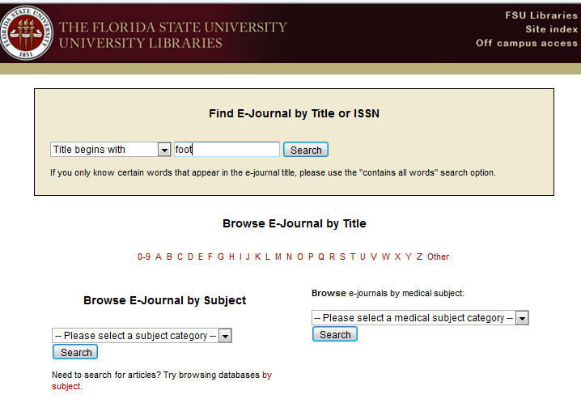
FSU Libraries E-Journals Results
Notes:
Type the journal name or even the first unique word or two from the journal title and click search. You will be presented with a list of journals beginning with those words.
Again, no luck.
Finally, request the article via interlibrary loan. The link for interlibrary loans is in the top, middle section of the Medical Library homepage.
Before we leave this page, there may be a few instances when you do not see an icon and you will locate the journal either from the Medical Library e-journals page or from the Serials Solutions page. You will need the PubMed reference because once you click on the link in Serials Solutions (or from the Medical Library e-journals page), you will need the year, month and/or issue, volume and page numbers. With this information, you will quickly locate the full article.

Slide 41
FSU E-Journals
Check dates
Example: Consultant Pharmacist only up to 2000

Slide 42
If not found….

Slide 43
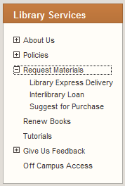
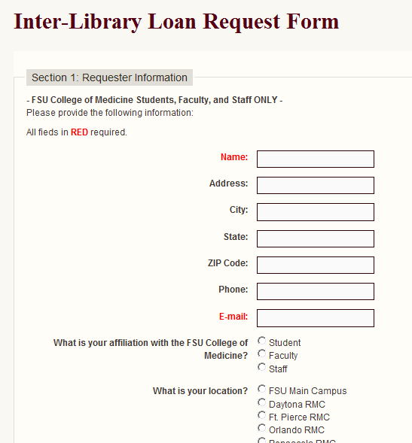
STEP 4: Request Article via Interlibrary Loan
Interlibrary Loan:
Sign into EZProxy
Fill out form
Copy and Paste info from PubMed Citation into Section 2
Get PMID #
Notes:
You will need your userID and password, because clicking on this link pulls up the sign in screen to confirm you are with the CoM. Please complete all sections and let us know when you need the article if there is a date by which it will no longer be useful. Our turnaround time is very good and you should receive the article within 1-3 days.

Slide 44
Other Journal Options

Slide 45
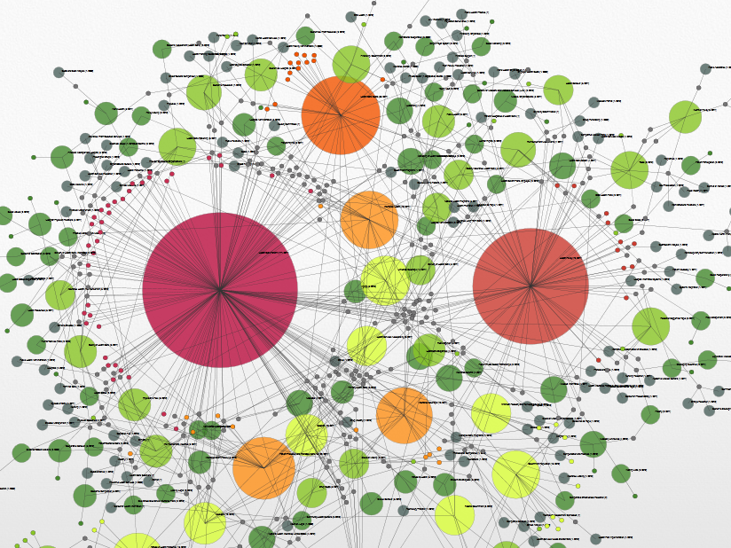
Interesting New Tool: knalij.com
Use Chrome Browser (FireFox second choice)
Open Library site and open Pubmed
In another tab, open knalij.com
Types of Searches
Journal Cluster Map (default)
Co-author Map
Impact of funding Map
Notes:
Knowledge Demo knalij.com
Use Chrome Browser (FireFox second choice)
Open Library site and open Pubmed
In another tab, open knalij.com
1st Search
“meaningful use”
Point out clusters, largest circles has most number of articles
Move cursor around look at cluster information
Tap a cluster circle to get menu to view articles in this cluster
Point out Cluster Information list at left
Filter by another term found in cluster name like “record”
Tools on screen
Grid Panel
Time Machine
PDF
Navigation Buttons (or use cursor to grab and move screen and roller to zoom in and out)
Click on Articles (tiny circles)
Popup, to read abstract
Follow links to article on Pubmed if no free PDF available
If Pubmed opens there should be a red button if we have it.
Clusters
Click on a cluster name in the list and the cluster circle will flash
Click on Cluster circle, menu comes up
Chose Focus Cluster… Click again and opacity
Click Show Articles in in cluster
Click on article in Cluster information pane
Advanced Search
Search builder by type of term
Medline fields
MeSH Terms or Major subject Heading
New Search using Search Builder
MeSH Term smoking cessation Add
MeSH Term social support Add
Search
Take out social network and put in Health Policy as MeSH Term
Types of Searches
Co-author Map
Journal Cluster Map
Impact of funding Map
Have audience pick their general topic and do a search. This tool is best for brainstorming paper or research question topics, so start at a high level and focus down.

Slide 46
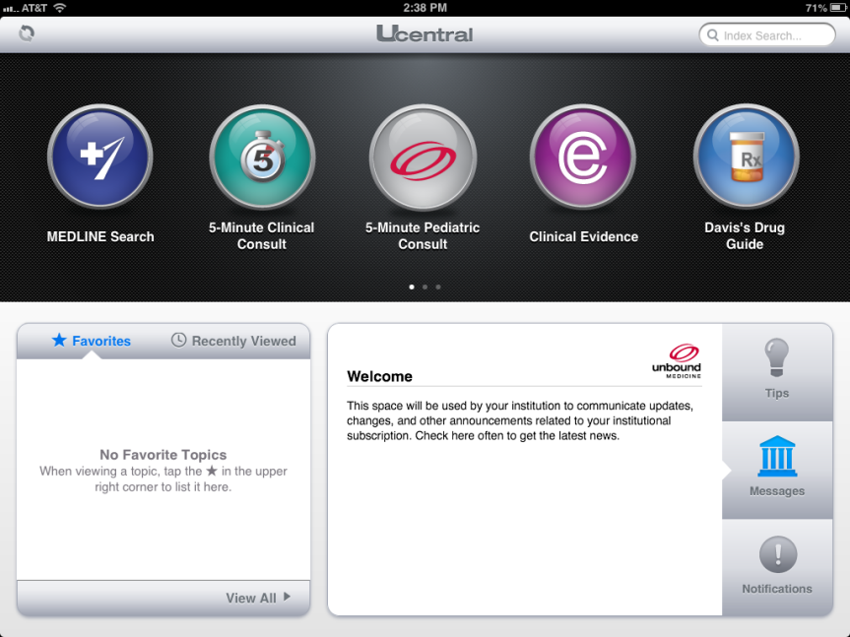
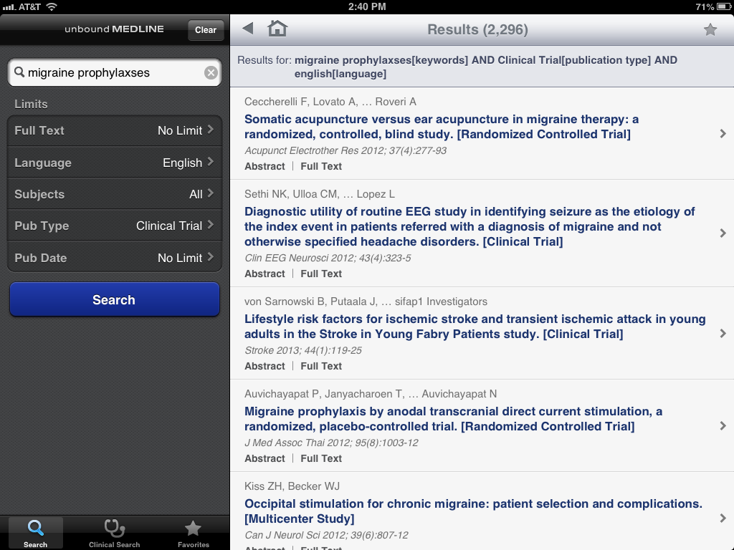
MEDLINE Search in uCentral iPad
Notes:
You can search Pubmed using the uCentral Medline search on an iPad or Android tablet. However, while it is supposed to be connected to the FSU library holdings, the functionality is clunky.

Slide 47
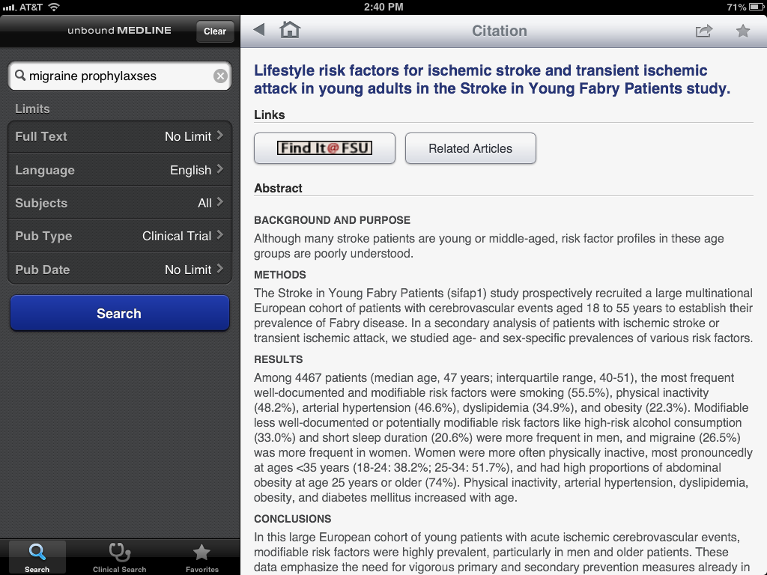
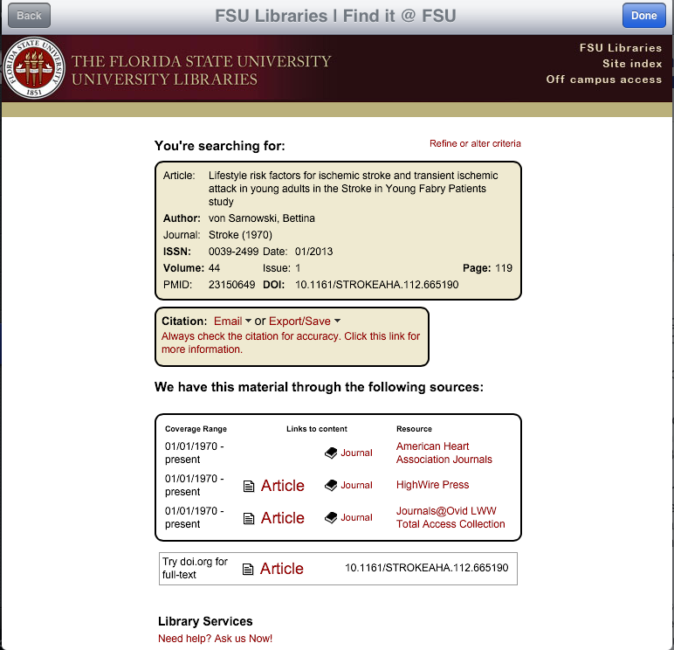
Notes:
Before you start, click on Off Campus Access and Log into EZProxy. Then you can follow the links to the article.
You can’t save the article, only read it.

Slide 48
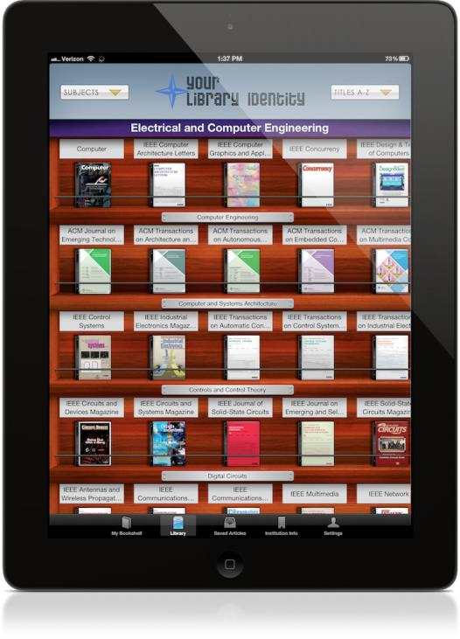
Browzine (Tablets Only)
Journal e-reader
Select most FSU COM Journals to read
Look like journals
Alert you to new articles
Allows saving articles to read offline
Notes:
We have a new resource that is also available for tablets (iPad or Android tablets). Browzine allows you to select the journals you wish to read regularly from the CoM library subscriptions and add them to your bookshelf, then read or save any article you wish. You can set it to alert you to new articles. There is a handout about how to set it up.

Slide 49
Follow Links to Articles in Dynamed
In your default browser, Open the Medical Library
Log into EZProxy
Open Pubmed
Minimize
In another tab, open Dynamed.
Links will take to Pubmed with buttons.
Notes:
The default browser is the browser (Internet Explorer, Firefox, Chrome or Safari) that starts automatically when you click on a hyperlink in any other program. Most Windows machines set IE as the default browser. If you plan to follow links to articles in Dynamed, go to the library web page and log into EZProxy, then open Pubmed from the link in the MedResources list. You can minimize this. Then go back to the library and open Dynamed. The links will take you to Pubmed and the big red buttons will be there.

Slide 50
