Slide 1
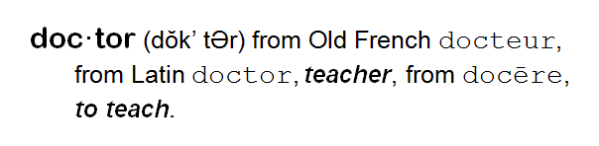
Patient Education Wrap-up
Nancy B. Clark, M.Ed.
Doctoring 202
Spring 2014
Notes:
doc·tor (dŏk’ tƏr) from Old French docteur, from Latin doctor, teacher, from docēre, to teach.

Slide 2
Thanks
Curt Stine for his patient education slides and suggestions.
Kendall Campbell
Alice Pomidor

Slide 3
Objectives
COMPETENCY: Counsel and educate patients and their families (Patient Care)
  Assess a patient’s health literacy: understanding of instructions, explanations of health problems, risk, treatment options, and ability to perform skills (i.e. self-injections, use of nebulizers, use of blood glucose monitor)
  Provide effective one-on-one instruction to educate a patient.
  Document patient education activities.

Slide 4
Objectives
COMPETENCY: Use information technology to support patient education (Patient Care)
  Use appropriate applications at the point of care to supplement verbal instructions.
  Assess a patient’s access to and ability to find and use technology to gain health information.
  Select appropriate methods/materials to further educate the patient: handouts, models, videos, web sites, mobile apps, social media, support groups.

Slide 5
Definition
“Patient education can be defined as the process of influencing patient behavior and producing the changes in knowledge, attitudes and skills necessary to maintain or improve health (AAFP Reprint No 284).”
The outcome of effective patient education is a change in the patient—his/her behaviors, knowledge, attitudes and skills and reduction in anxiety and improved disease outcomes.

Slide 6
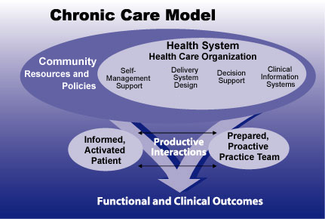
Promotion of Self-Care
“A central aspect of the Chronic Care Model is to Empower and prepare patients to manage their health and
health care.
Patient education
is central to
this concept.”
Notes:
A central aspect of the Chronic Care Model is to Empower and prepare patients to manage their health and health care. Patient education is central to this concept.
“Effective self-management support means more than telling patients what to do. It means acknowledging the patients' central role in their care, one that fosters a sense of responsibility for their own health. It includes the use of proven programs that provide basic information, emotional support, and strategies for living with chronic illness. Self-management support can't begin and end with a class. Using a collaborative approach, providers and patients work together to define problems, set priorities, establish goals, create treatment plans and solve problems along the way.”

Slide 7
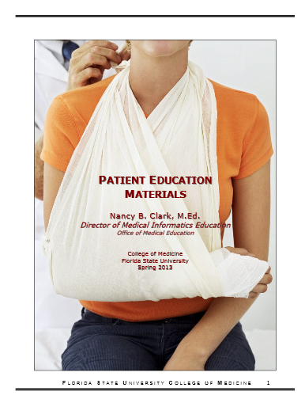
Preparation for Class
Watch: "Health literacy and patient safety: Help patients understand"
Watch: “House MD - Do I Look Like An Idiot?”
Watch “Achieving Adherence in Chronic Disease Management Part 2.”
Notes:
Because you have had several assignments that dealt with this field, I am going to skip things like how to translate a handout, and just review the high points of finding and using handouts, and spend more time with one-on-one patient ed and new technologies in support of patient education.

Slide 8

Face-to-Face
Patient Education

Slide 9
Stages of the Pt Ed Process
Diagnose the education needs of the patient.
Develop an education plan.
Implement a personalized education plan.
Assess effectiveness of the plan.

Slide 10
Diagnose the education needs of the patient
“What does the patient need next?”
Possible education needs of patients:
  To acquire new knowledge.
  To learn a new skill.
  To counter a negative attitude, belief or emotion.
  To overcome environmental or social barriers.

Slide 11
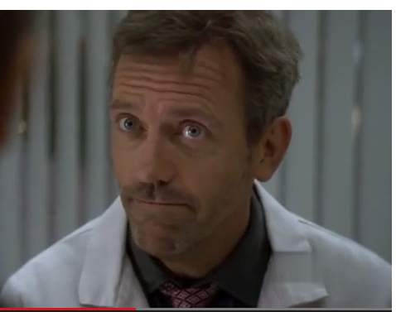

Diagnosing an Education Need
Ask open ended questions
  “Tell me what you know about asthma.”
  “What should you do
  when you have difficulty
  breathing?”
  “Show me how you use
  your inhaler.”
http://www.youtube.com/watch?v=dMAS2S51bM8

Slide 12
Health Literacy
According to the National Assessment of Adult Literacy:
Only 12% of adults have Proficient health literacy.
9 out of 10 adults may lack the skills needed to manage their health and prevent disease.
14% of adults (30 million people) have Below Basic health literacy.
Notes:
Bottom line, never assume your patient is understanding what you are telling them.

Slide 13
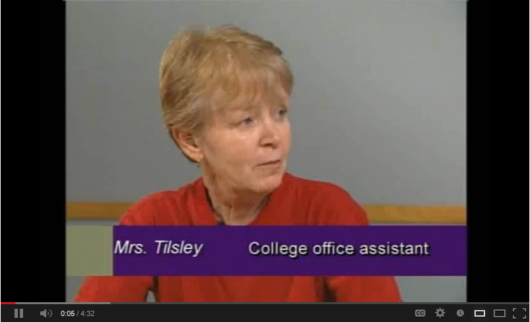
Health Literacy
Excerpts from "Health literacy and patient safety: Help patients understand“ by AMA. At http://www.youtube.com/watch?v=cGtTZ_vxjyA
Notes:
Hyperlink to video is http://www.youtube.com/watch?v=BgTuD7l7LG8

Slide 14
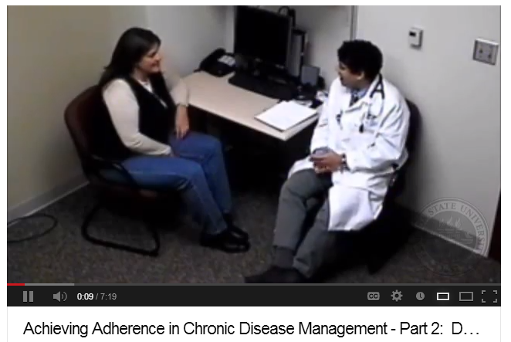
Asking Questions to Assess Knowledge Gaps
http://www.youtube.com/watch?v=7_VNSGB7pgo

Slide 15
Patient’s Education Needs
In video…
What was the main factor in patient’s data that identified a problem?
What were the patient’s misconceptions?
How were these needs determined?
Notes:
The main factor was the patient’s HbA1c in spite of the patient’s insistence that she was taking her meds and dieting. The patient’s misconceptions were her lack of understanding about her meds, specifically confusion about Metformin having the same side effects as Insulin which her mother took. She also did not know the Sugar content of orange juice and Gatorade, thinking them healthy. Difference between glucose test and HbA1c. These needs were determined by questioning, having the patient describe her day.

Slide 16
Address Knowledge Deficit
Relate new information to existing information.
Use analogies.
Be brief
Use language understandable to patient.
Use simple printed materials (5th grade literacy level).

Slide 17
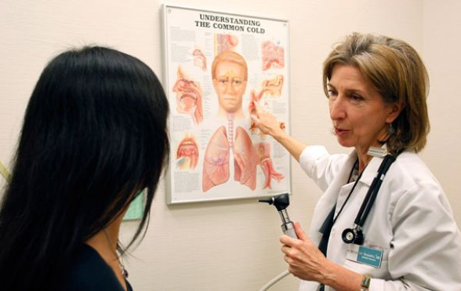

Address Knowledge Deficit
Use audiovisual aids, including diagrams.
Ask and encourage questions.
Summarize key points.
Notes:
Being brief. Relating new information to existing information.

Slide 18
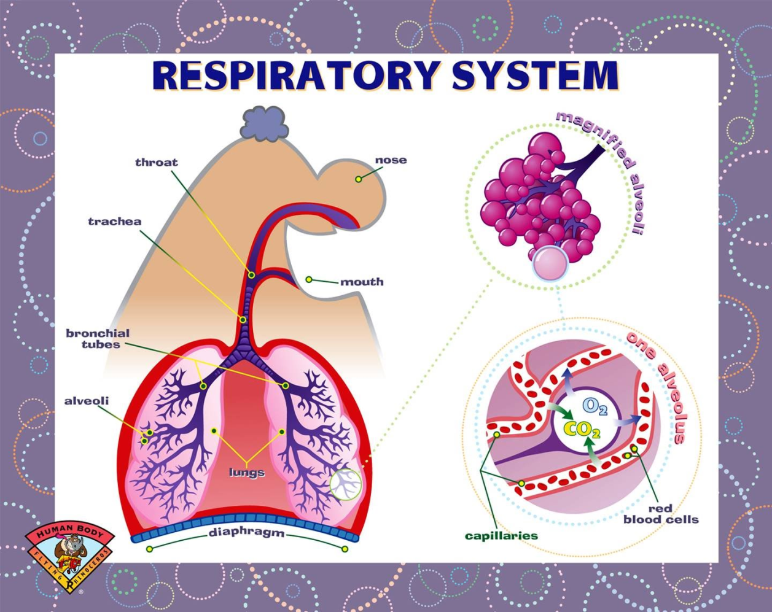
Notes:
Let’s try to explain asthma to a new patient using the suggestions before and this chart.
How would you start the conversation?
Let’s say a 12 yo says they have a friend with asthma and he has to use an inhaler all the time, but can’t tell you what is really happening in the body.
Describing the disease what analogies might you use.

Slide 19
Avoid Medical Terminology
“According to your IADL, PPS and MMSE scores, you ...” Not appropriate. Only suitable for referrals, Objective part of note.
Avoid acronyms
Translate into plain common language
If no simple words work, define terms you use
Notes:
We spend the first two years of medical school teaching you doctor speak, and sometimes forget to tell you to NOT use it with patients. Patients are impressed more by your ability to communicate than your fancy vocabulary. Remember the Health Literacy issue. Non-medical people do not understand medical jargon, no matter how many episodes of ER, House, Gray’s Anatomy, etc. they have watched.

Slide 20
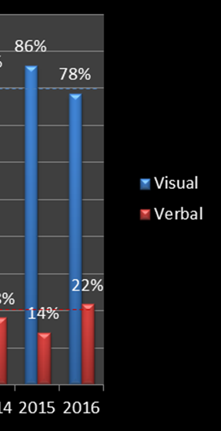
Visual vs Verbal Reiteration
86% of you are visual learners
You need pictures or written words to help remember and understand procedures and concepts
Patients are your students
Do more than tell patients what to do

Slide 21
Assess effectiveness
Ask questions to assess the effectiveness of an information transfer intervention:
  “When your spouse asks what we talked about, what are you going to tell her?”
  “Given all this information, what is it that you are going to do now?”
  “Could you please tell me our plan for today so I can check my notes and make sure I didn’t forget anything?”

Slide 22
Which of the following statements will best assess a patient’s ability to carry out your instructions?
“Do you see any problem in carrying out this procedure, routine, etc.?”
“Will you have difficulty getting this medicine?”
“So, tell me in your own words what I just told you.”
“Will you have difficulty remembering to take this medicine? ”
“Do you think this treatment plan might cause you any problems at home or at work?”
Notes:
3. It is the only question up there that is not answered with a Yes or No.

Slide 23
Questioning
Avoid questions with Yes or No answers.
Ask open ended questions.
Instead of “Will you have difficulty remembering to take this medicine? ”
Ask “How do you manage your medicines?” or “What do you do to help you take your medicines at the appropriate time?”

Slide 24
Addressing Skills Training
Techniques :
  Demonstrating or modeling skills. Watch a video
  Practicing skills in simplified/simulated environment.
  Practicing skills in a supervised, realistic environment.
  Providing feedback re: performance.
  Encouraging patient self-evaluation.
  Follow-up to ensure mastery and maintenance of skill.

Slide 25
Assess effectiveness
Observe the patient performing a skill to assess the effectiveness of a skills acquisition intervention:
  “Let me watch you draw
  up and give yourself
  your insulin.”

Slide 26
Group Visits – Old idea, good results
Patients with common chronic illnesses
Address patient education needs – share ideas, experiences, etc.
Support patient self-management
Improved standards of care
Increased quality of life
Cost effective – billed as nursing visit
Brennan, J, et al. Group visits and chronic disease management in adults: a review. American Journal of Lifestyle Medicine. 2011. 5;69.

Slide 27
Using Technology to Support Patient Education
Caution: Digital Divide creates disparity

Slide 28
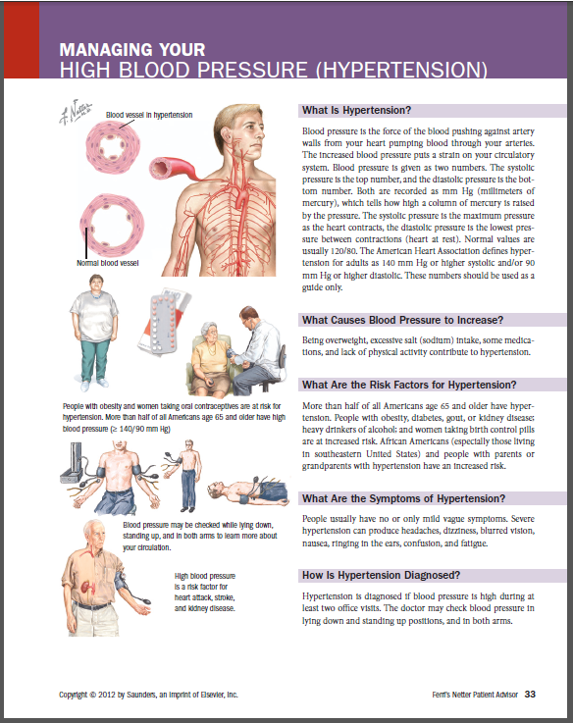
Handouts
Sample Ferri’s Netter handout from MDConsult
Notes:
This is just the highlights. Read the handout for the indepth information.

Slide 29
Why Handouts?
Memory (Memory Test)
Anxiety
Hearing
Demand management
Communication
Complexity
Notes:
Memory — If there are a number of issues to be related to a patient, it is best to write them down or provide a handout. The average person can only retain 2 or 3 items in a set of instructions if presented with these verbally. Providing written instructions and explanations as well as verbal, can greatly increase their understanding and retention of multiple facts or instructions. MEMORY TEST: in their packet is a worksheet for writing 20 things they see. Have them pull it out and get ready. Start the test. It self times.
Anxiety — The memory capacity of patients is reduced by the general anxiety experienced by any patient during a doctor’s visit. Add to this “bad news” or a new condition with which they are unfamiliar, and their capacity for understanding and retaining decreases significantly.
Hearing — Many of your patients may have hearing loss, especially if they are older. Some will nod knowingly to all you say to them, while not hearing or understanding half of what you are telling them.
Demand management — This is what physicians do when they communicate to their patients “when to call.” “If your temperature gets higher than 102º….” “If your incision does not stop draining after 2 weeks…” Many times, especially post op or with chronic disease management, these options can be numerous and should be provided in written format as well as verbally.
Communication — The reason teachers use visual stimulation (PowerPoint) while giving lectures is that we recognize the improvement in communication and retention of facts when accompanied by written words. A handout can guide an encounter, and can be used to facilitate communication and assess understanding if used properly.
Complexity — The more complex a patient’s problems are, the more likely handouts of some sort can help them understand and manage their conditions. Consider the patient with multiple chronic problems, poly-pharmacy, and pre-senile dementia. A grid-like schedule of when to take their medications can be vital for achieving their compliance with your treatment plan. If they need to do a series of steps daily to say care for a surgical site, those are best provided in a step by step handout.

Slide 30
Handout Considerations
Reading level
  5th to 7th Grade
  Never assume someone reads at same level as their education
Language/Ethnicity/Cultural (translate)
Design
  Large font (over 40yo)
  1-2 pages best
Illustrations
  helpful
Patient Education Handouts
Notes:
consider these things when selecting an appropriate handout.
Reading level. Newspapers and other commonly read materials are written on the sixth-grade to eighth-grade level. Even patients who read at a much higher level generally appreciate information that is simple and to the point -- as long as the tone isn't. Assume people read below their level of achieved education.
Design. The type should be big enough to be easily read. Fancy typefaces and long stretches of text in italic type or all in capital letters should be avoided. White space (generous margins, blank lines between sections, etc.) and subheadings enhance readability. A ragged right margin is generally more readable than an even one.
Illustrations. Illustrations aid comprehension for those with poor reading skills and are generally easier to remember than text. But a bad illustration can wreck an otherwise excellent patient education handout. The illustration must match the words and be understandable without text accompanying it. Illustrations should be simple; a detailed anatomical diagram may not be as effective as a simple line drawing. Illustrations of patients should be representative of your target audience.

Slide 31
Considerations
Content
  Accurate, objective, up-to-date, less is more.
Demand-management value
  When to call physician or go to ER
  When NOT to call
Source
  unbiased
Generation
  15 yr olds versus 75 yr olds
Patient Education Handouts
Notes:
Content. Above all, the information needs to be accurate, up-to-date and consistent with what you would teach the patient. Also ask yourself these questions: Is the benefit of the information clear to the reader? Is too much detail provided, or too little? Ask yourself whether the content respects diverse cultural and religious views and avoids bias. Does it present information about treatment objectively, address both sides of controversial issues and explain positive and negative aspects of procedures?
Demand-management value. Look for handouts that include specific advice to help patients understand when they should (and should not) seek your attention. For example, a patient education handout about the flu and colds would include a list of symptoms that should prompt the patient to call you. Article on demand management: http://www.aafp.org/fpm/1998/0900/p65.html
Source. Finally, consider how the content of the material might have been affected by its source. Determine who funded the piece, who endorsed it and whether these organizations have a commercial interest in its content. If the information isn't copyrighted, you can adapt the content to suit your purposes.
Generation. Are we talking about a 15 year old, 35 yr old, 55, or 75 yr old. A 15 year old might pull up a web site you recommend on his/her iPhone in the exam room and look at a video!

Slide 32
Characteristics of Good Handouts
To conduct your own quick assessment of readability a handout, look for:
  one or two syllables per word
  one idea per sentence
  one concept per paragraph
  no more than five key points per handout
  No medical terminology --should be avoided whenever possible
  One or two pages at most
Notes:
Medical terminology should be avoided whenever possible. If it can't be avoided, the terms should be carefully defined. For example, bed wetting should be used rather than enuresis. Because there is no lay term for rosacea, a handout on that topic should explain how to pronounce the word and what the condition involves. Consistency in terminology is also important. Analogies, simple punctuation, contractions and even slang are good if they enhance understanding.

Slide 33
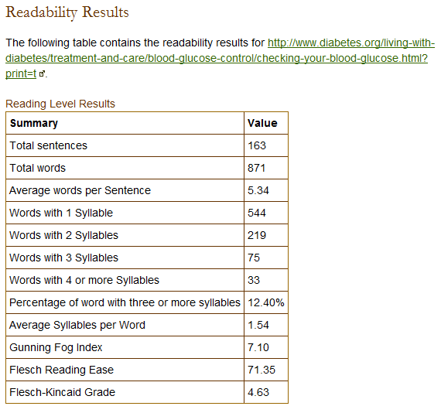
Web Site that Checks Readability
Copy URL of handout and paste into one of these:
  http://juicystudio.com/services/readability.php
  http://www.read-able.com/ Bookmark
  Problem with PDFs
Copy and paste text into http://www.readability-score.com/
Notes:
There is a web site that will tell you the readability of another web page. Here is the site at JuicyStudio.com. Let’s say you have found this page at the ADA on measuring your childs blood glucose levels. Copy the URL. Go to this page at JuicyStudio.com, paste in the URL and hit Calculate Readability. It tells us that the Fleisch Reading Grade is 4.63. The Fog level at 7.10. This is a level of schooling that it will take to understand the content of the handout.

Slide 34
How to Use Handout
Sit next to patient
Review with patient
Provide pen/marker
Point with finger to items
Communicate priorities
(most important point)
Check for understanding (health literacy and reading literacy)
ADA Recommendations for Diabetic Educators
Notes:
We suggest to students the following suggestions from the ADA. Sit down next to the patient whenever possible. It immediately focuses attention and puts you in the role of teacher and guide. "Let’s read this over for a minute or two, Ms Katz; this handout helps explain how and why yeast infections develop more often in diabetic women and how certain medications can help."
Provide pencils, pens, or a highlighter. Point to key points with your finger and ask the patient to circle, check, underline, or highlight. You will dramatically increase the speed and efficacy of the consultation, and your patients will walk out with customized notes. They won’t have to take time to read it all over to pick out the 2 or 3 points they need to remember. "From this list of foods to avoid, Mr Simic, which three do you think will be the easiest for you to cut down on? Go ahead and circle or underline them as a reminder."
Use written materials to review and make priorities. Patients often feel overloaded with technical names, difficult quantities, and confusing schedules. The best communicators have the knack of boiling down all the information into a handful of essentials. Help your patients internalize the information by putting it in order of priority. "Of all we’ve talked about, Ms Sidney, what’s the most important to remember?"
"To remember to keep my blood sugar log."
"Right! Let’s put a ‘1’ there. Now the second most important would be…?"

Slide 35
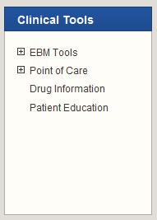
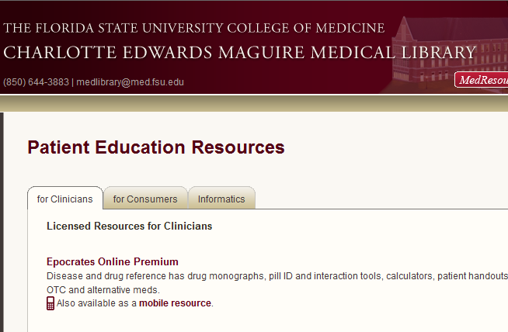
FSU Patient Education Resources
Notes:
There are a wealth of patient education resources online, both free and fee based, of varying quality, accuracy and free of bias. We subscribe to three resources where you can find high quality, reliable patient education materials. However, the free resources online are practically limitless.

Slide 36
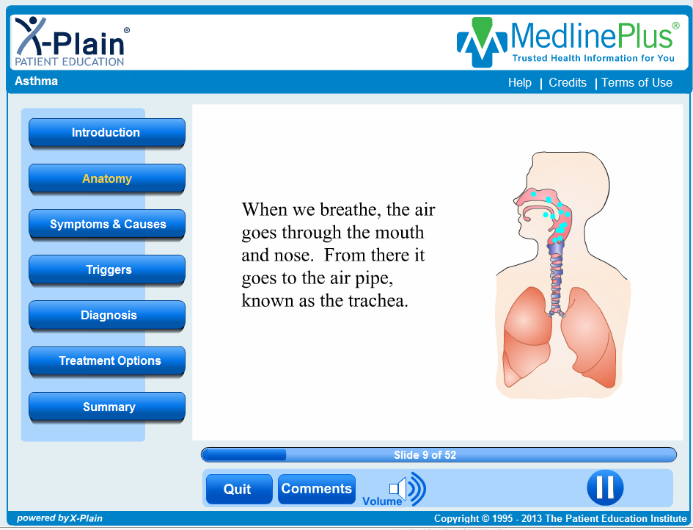
Websites for Patient Ed
Notes:
For patients who are computer literate, recommending a website is viable. MedlinePlus has purchased and made available all the instructional videos from the Patient Education Institute like this one on Asthma…linked to video.

Slide 37
Why Use Websites
Same reasons as handouts
Can be used during encounter to illustrate concepts, provide visuals
Added value:
  Animations
  Videos
  Audio
Continued self education post encounter

Slide 38
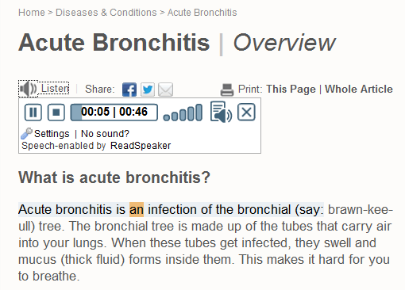
Example: Familydoctor.org
Trusted site for patient education handouts
5th-7th grade reading level
Notes:
So using the web site has advantages over the printed handouts in that you can now HEAR the computer read the handout. If they would add video with animations to these, they would be perfect. Image is linked to symptom section of bronchitis. Go there and Listen to the handout.

Slide 39
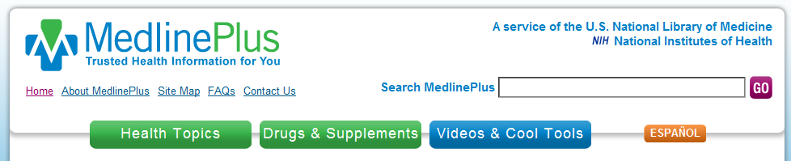
Example: MedlinePlus from NLM
Patient Education Institute interactive videos
Adam anatomy animations
Surgical videos from OR-Live.

Slide 40
Patients Do Use the Internet
According to Pew, 80% of internet users (79% adults) or 59% adults look for health information online
The quality, reliability, applicability to patient varies widely
Guide the 59% who do to best sites – else give handout
Adults with chronic disease less likely than healthy adults to have access to the internet
“Health Topics" (Pew Internet Project: February 2011). Available at: http://www.pewinternet.org/Reports/2011/HealthTopics.aspx
Notes:
http://www.pewinternet.org/Reports/2010 /Chronic-Disease.aspx
PEW Report: Health
Chronic Disease and the Internet
by Susannah Fox, Kristen Purcell
Mar 24, 2010
Report: Health, Digital Divide
Health Topics
by Susannah Fox
Feb 1, 2011
http://www.pewinternet.org/experts/~/link.aspx?_id=7195DA815EA54420B0A56D72906C0F51&_z=z

Slide 41
Considerations
Open access to internet in office (hospitals are notorious for blocking internet access)
Place set up so patient can see the computer screen easily
Hearing of patient –headphones handy?
Vision of patient – big screens
Access to internet by patient at home
Notes:
If the volume is loud, you will also need to get headphones for the patient so as not to disturb nearby activities in a clinic. If you are going to recommend a site for a patient to use at home, make sure they have the technology and knowledge to access the internet at home. Make no assumptions based on age. Socioeconomic status plays a part. Younger adults more likely than older adults, but not guaranteed to be.

Slide 42
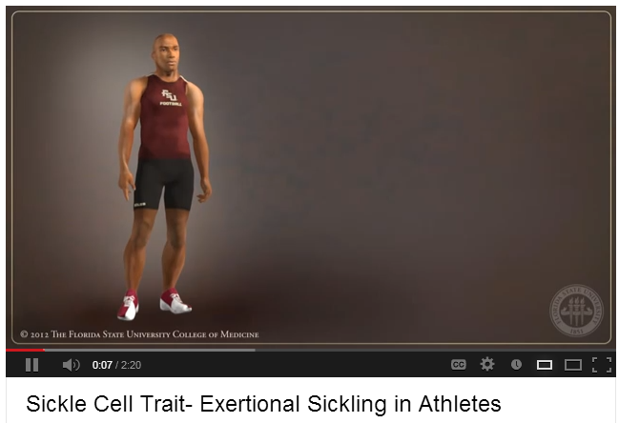
Example: Youtube.com
Patient Ed Animations. Posted by FSUCoM.
https://www.youtube.com/user/FSUMedMedia
Notes:
Animations created by our own media people for use in the CLC are examples of useful materials found online.

Slide 43
Ideas
Build lists of links for clinic patient population
Channels in YouTube (ask if patient has a computer at home, internet connection, speakers,…)
Email links to patients with questions or for further explanation

Slide 44

Finding Reliable Information
Teach patients to evaluate information found on web
  Where did the information come from?
  Who wrote it? Is it opinion or fact?
  How current is the information?
  Who is responsible for the content?
Helpful Handout at Familydoctor.org
http://familydoctor.org/familydoctor/en/healthcare-management/self-care/health-information-on-the-web-finding-reliable-information.html
Notes:
You can also tell them to look for the HON code symbol, which means the site has earned a “seal of approval.”

Slide 45
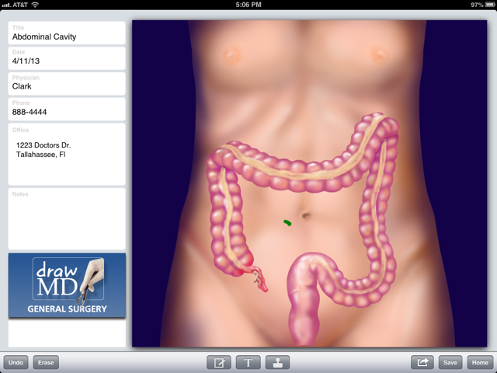
Mobile Apps for Patient Ed

Slide 46
Using Mobile Apps with Patients
Larger screen devices better than smartphones
Interactive anatomical illustrations that can be emailed to patient instead of models
Animations of conditions, like asthma, murmurs
Video demonstrations of skills at fingertips

Slide 47
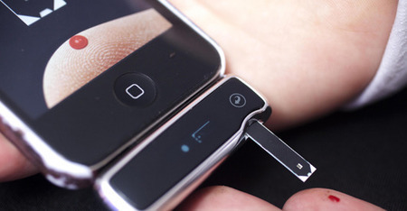
Prescribing Mobile Apps
If the patient has a smartphone or tablet, recommend apps for:
  Medical reference
  Health and fitness
  Personal health record
  Medical social media
  Monitor and manage illness
What apps are you using for your own health or fitness?
Notes:
Ryan Berger and I gave a presentation to a group of about 15 retirees at the Pepper Center. 2/3s of the attendees had iPhones, and almost half had iPads. In spite of the fact that they were in their 60s and 70s+, they were very interested in mobile apps for these uses.

Slide 48
Assessing Quality and Usefulness
iTunes does not discriminate medical apps into categories
Hundreds of apps for patients vs healthcare professionals - Search ‘diabetes’ get 600 apps
Check Dx organizations for reviewed apps
New effort to curate med apps like HON code, http://www.happtique.com/
New www.medicalappjournal.com reviews
Peck, Andrea. A solution to app overload. Medical Economics. Dec 25, 2011.

Slide 49
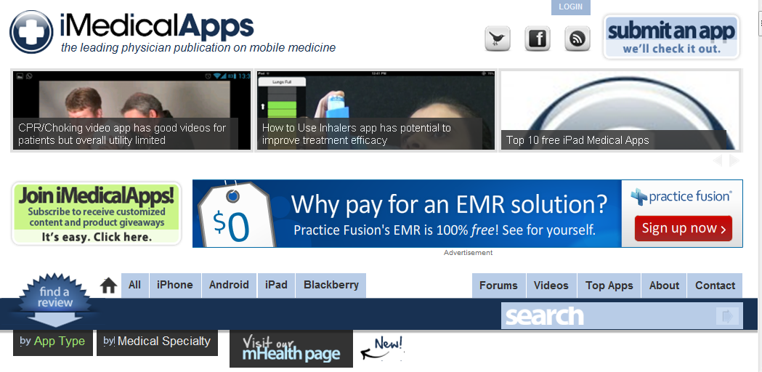
Keeping up with Medical Apps
iMedicalApps.com

Slide 50
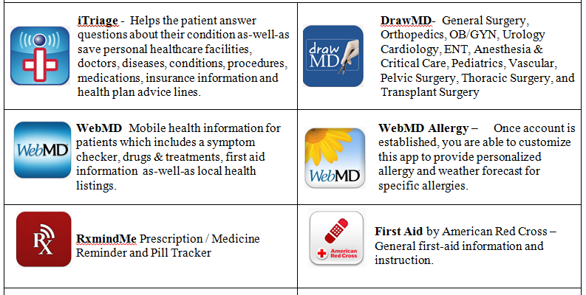
Mobile Apps for Patient Education
See Handout

Slide 51
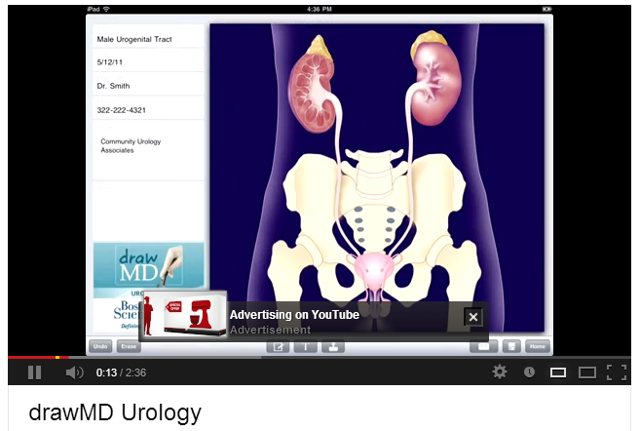
DrawMD Demo
http://www.youtube.com/watch?v=OcV2A85tln0

Slide 52
As Mobile Apps Mature
Learn from your patients
Learn from peers
Ask what apps they find helpful
Include mobile apps recommendations into CME sessions on disease topics
Watch for more efforts to curate medical apps

Slide 53
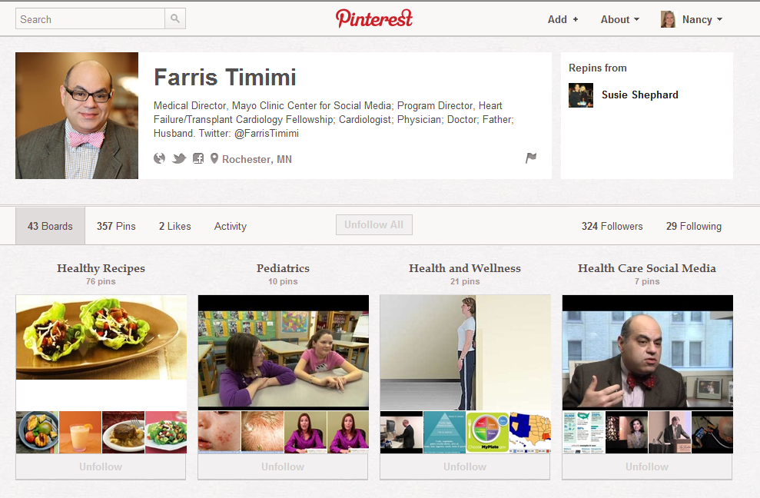
Social Media as Patient Ed

Slide 54
Patient Medical Use of SM
#HCSM is the new word-of-mouth
Find a local doctor, read and write reviews of doctors
  http://vitals.com
  http://yelp.com
Find health information - 80% of internet users gather health information online (Pew)
Find support groups for chronic disease, health issues
Notes:
By participating in free review websites such as Healthgrades, Vitals, and even Yelp, physicians can help maximize your website rankings and ultimately the number of patients visiting their sites.

Slide 55
Social Media and Informal Support Groups
Chronic Disease support groups
  Awareness, support, education
  Community of bloggers
Lifestyle and health maintenance support
  Diet plans, track exercise …
Caregiver social support groups
  Caregivers for elderly, family members with chronic disease
Notes:
For patients, the relationships that they build online are often as genuine as relationships that they build in real life.
Identifying with a community of people with like health issues builds trust and community, be it online or in real life.
The online patient community is available 24/7/365, and is utilized in all social media vehicles.
From Diabetes Social Media Advocacy…
“The virtual community is one of the first and largest to champion social media for chronic disease awareness, support, and education. The Diabetes Online Community provides places online for people affected by diabetes to communicate with others who understand the mental, physical, and emotional challenges of this chronic condition. The community also helps people find ways to embrace their condition and spread diabetes awareness. Diabetes/Patient bloggers are the foundation of the DOC. They share their personal experiences of living with diabetes, including health insurance issues, depression, motivation, mishaps, relationships, and much more. Diabetes/Patient bloggers make us laugh, cry, smile, and think, “I remember when that happened to me,” and “It’s good to know I’m not alone.” You need not be a blogger (nor a person living with diabetes) to participate in the Diabetes Online Community and DSMA. A computer with internet access or a smartphone is the only requirement.

Slide 56
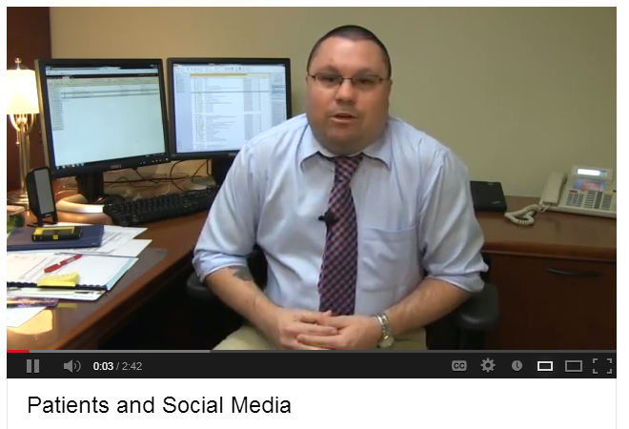
Martin Wood on Social Media
Martin Wood, Assistant Director of the Maguire Medical Library
http://www.youtube.com/watch?v=BnKqco8G7t4&feature=plcp
Notes:
http://www.youtube.com/watch?v=BnKqco8G7t4&feature=plcp

Slide 57
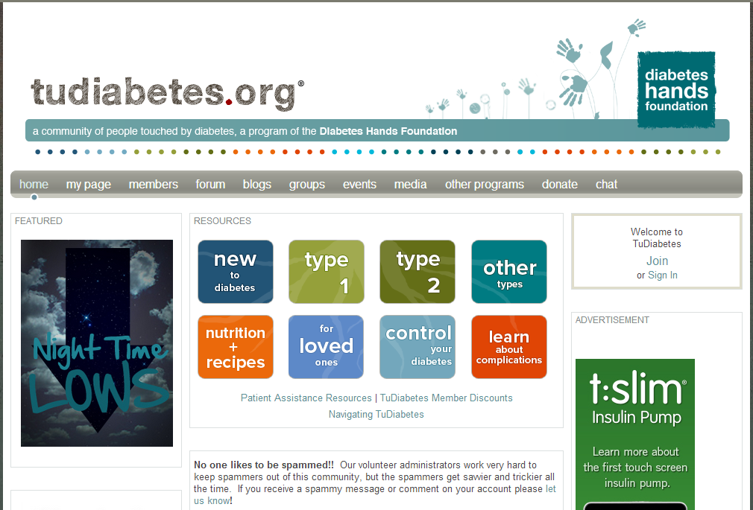
Diabetes, as an Example
Social Media for Chronic disease
Awareness
Support
Education
Diabetes Hands Foundation. http://www.tudiabetes.org

Slide 58
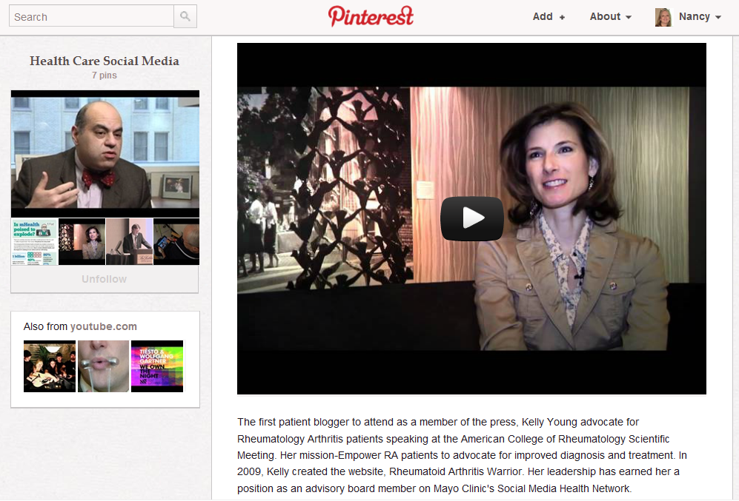
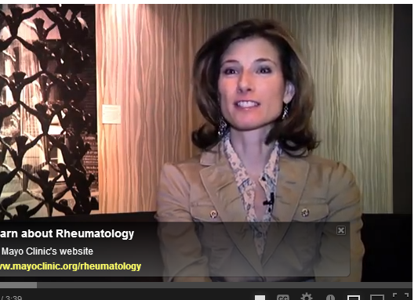
Rheumatoid Arthritis
http://bit.ly/MgNS8t
Notes:
Here is a video of a doctor who suffers from and treats patients with RA, who created a social networking web site for patients with RA. (show about 1 minute of this).

Slide 59
Peer-to-peer Healthcare
One in four internet users living with high blood pressure, diabetes, heart conditions, lung conditions, cancer, or some other chronic ailment (23%) say they have gone online to find others with similar health concerns.
By contrast, 15% of internet users who report no chronic conditions have sought such help online.
Fox, Suzannah. Peer-to-peer Healthcare. Pew Internet Survey Results. http://pewinternet.org/Reports/2011/P2PHealthcare.aspx

Slide 60
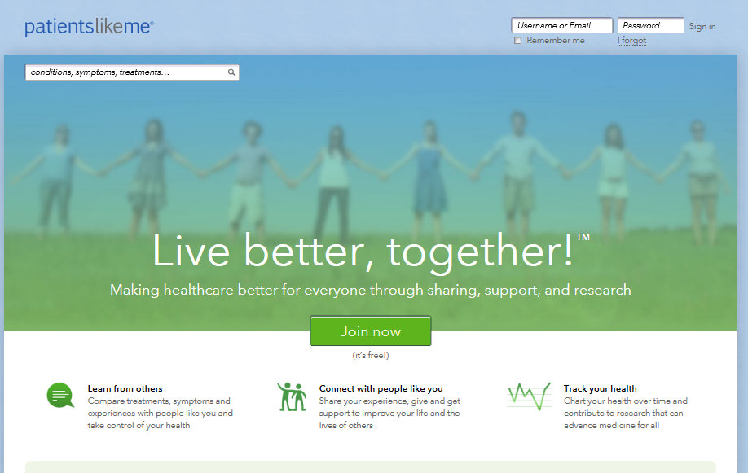
PatientsLikeMe.com
Notes:
This site is for-profit. However, it is designed to collect and share outcomes data on specific treatment experiences from patients as well as help patients with conditions share their experiences with other patients.

Slide 61
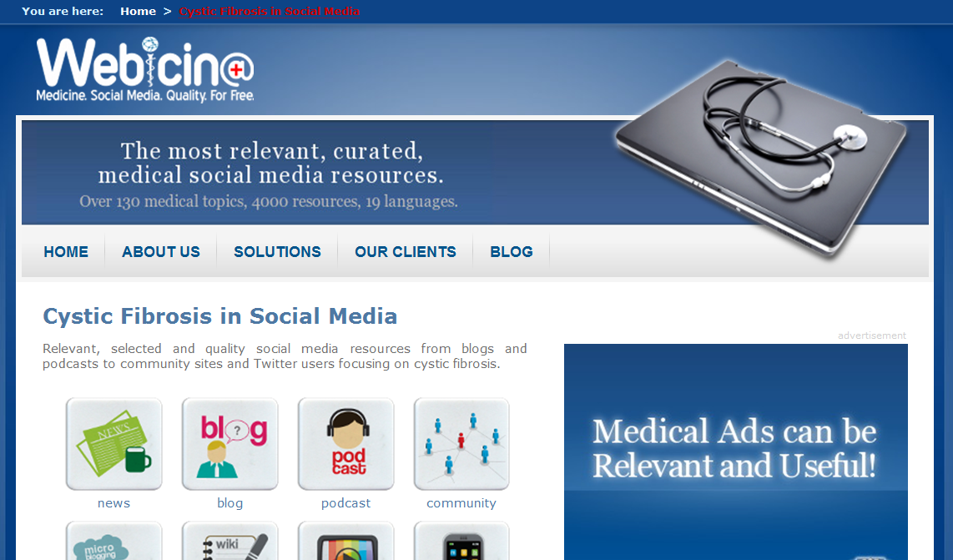
Curated Medical Social Media Sites
http://www.webicina.com/?select=patient
Notes:
Another site in its infancy that is an attempt to curate/rate/evaluate medical social media sites for providing instructional materials and bring together communities of people with the same conditions is webicina.com. This site, instead of using experts, relies on crowdsourcing for reviews of sites.

Slide 62
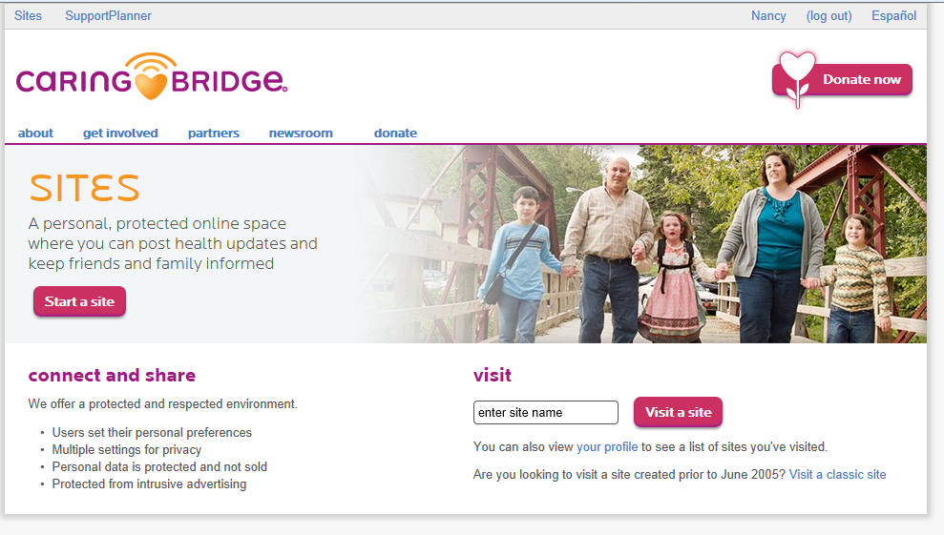
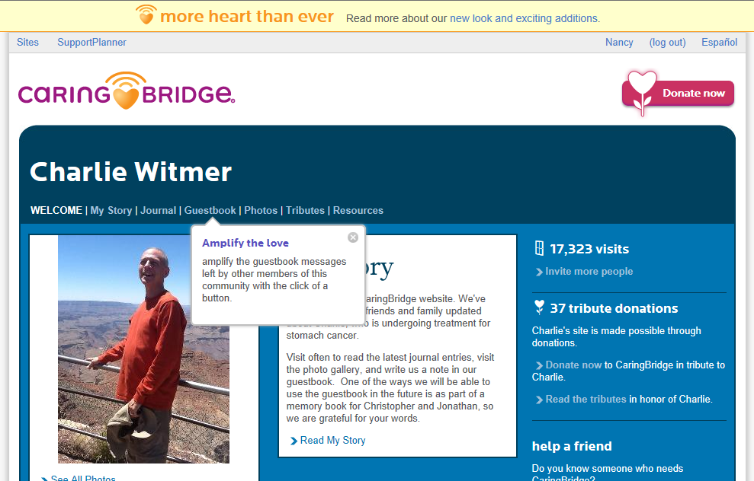
Health Crisis and Community Support

Slide 63
Documentation of Patient Ed
Assessment:
  Document assessed patient education need
Plan:
  Document patient education provided
  “Patient was given handout #24…and reviewed…”
  “…mobile app was recommended to help…”
  “…website was recommended to patient for more information on…

Slide 64
In Summary
Patient Ed vital to adherence, outcomes
Patient Ed needs to be tailored to each patient
Document patient ed in SOAPnote
New technologies create opportunities for better patient education
CME talks should mention new technologies to support patient education and self-care

