Slide 1
Patient Education Resources
Nancy Clark
Director, Medical Informatics Education

Slide 2
Objectives
Recognize when and why a patient education materials would be needed
Identify the appropriateness of various patient ed materials
Find a patient education handout online
Determine the reading level of handout
Identify web sites, social media sites and mobile apps that support patient’s educational needs

Slide 3
Handouts
Worksheet
PowerPoint
Patient Ed Handout
Evaluation
Please complete your pre-workshop evaluation

Slide 4

Why Patient Ed Resources?
Memory (Memory Test)
Anxiety
Hearing
Demand management
Communication
Complexity
https://www.youtube.com/watch?v=nvwR74XpKUM
Notes:
“Tell me what you know about hospice.”
“Show me how you use your nebulizer.”
There are tests that measure health literacy. These would intimidate a patient if they think they are being ‘tested’
Instead, it should seem more like you are just having a conversation. We will talk about using a handout to assess health literacy later.

Slide 5
Health Literacy
According to the National Assessment of Adult Literacy:
Only 12% of adults have Proficient health literacy.
9 out of 10 adults may lack the skills needed to manage their health and prevent disease.
14% of adults (30 million people) have Below Basic health literacy.
Notes:
Bottom line, never assume your patient is understanding what you are telling them.

Slide 6
Health Literacy
Excerpt from “Health literacy and patient safety: Help patients understand,“ AMA Foundation (23 minutes), (YouTube), URL: http://www.youtube.com/watch?v=cGtTZ_vxjyA
http://www.youtube.com/watch?v=BgTuD7l7LG8 4 min excerpt
Notes:
http://www.youtube.com/watch?v=BgTuD7l7LG8
4 minute excerpts from longer video.

Slide 7
Please complete the Worksheet
We will use your topics as we look at the resources

Slide 8
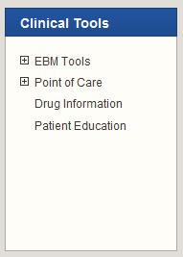
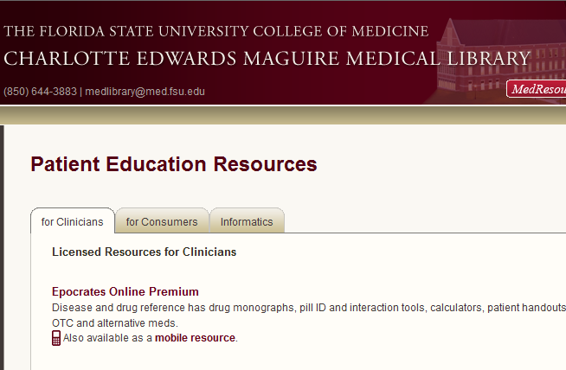
FSU Patient Education Resources
Notes:
There are a wealth of patient education resources online, both free and fee based, of varying quality, accuracy and free of bias. We subscribe to three resources where you can find high quality, reliable patient education materials. We have a great handout for students that we use in our second year Medicine and Behavior course that we are providing you as a handout. Lets look at the handouts at each of these sites.

Slide 9
Strategy
Pick one topic that is commonly seen in your office that would benefit from a handout, a video/animation, web or a social media site.
Use that topic to compare all the different resources we visit
Suggestions: Asthma, ADHD, Breast Feeding, Carotid artery surgery

Slide 10
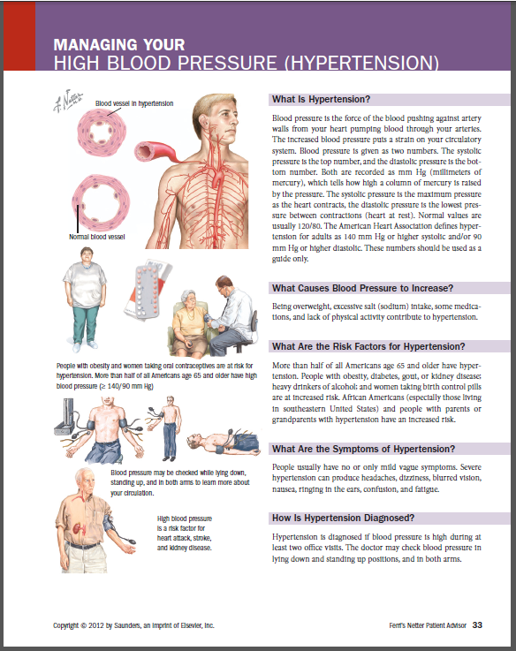
Handouts
Suggestion: Look for
Printer Friendly View
Sample Ferri’s Netter handout from MDConsult
Notes:
This is just the highlights. Read the handout for the indepth information.

Slide 11
Typical Office Handouts
Prescription refill requests
Referral requests
How to help your doctor run on time
The role of midlevel providers
Doctors' availability after hours
Procedures for school physical appointments
Notes:
These are normally developed by the office team to benefit smooth operation of the clinic.

Slide 12
Others
Medication Schedule
Wound Care Instructions
Community Resources
Immunization Schedule/Record
Disease management
More…
Notes:
What do you have in your office ready to use?

Slide 13
Why Handouts?
Memory (Memory Test)
Anxiety
Hearing
Demand management
Communication
Complexity
Notes:
Memory — If there are a number of issues to be related to a patient, it is best to write them down or provide a handout. The average person can only retain 2 or 3 items in a set of instructions if presented with these verbally. Providing written instructions and explanations as well as verbal, can greatly increase their understanding and retention of multiple facts or instructions. MEMORY TEST: in their packet is a worksheet for writing 20 things they see. Have them pull it out and get ready. Start the test. It self times.
Anxiety — The memory capacity of patients is reduced by the general anxiety experienced by any patient during a doctor’s visit. Add to this “bad news” or a new condition with which they are unfamiliar, and their capacity for understanding and retaining decreases significantly.
Hearing — Many of your patients may have hearing loss, especially if they are older. Some will nod knowingly to all you say to them, while not hearing or understanding half of what you are telling them.
Demand management — This is what physicians do when they communicate to their patients “when to call.” “If your temperature gets higher than 102º….” “If your incision does not stop draining after 2 weeks…” Many times, especially post op or with chronic disease management, these options can be numerous and should be provided in written format as well as verbally.
Communication — The reason teachers use visual stimulation (PowerPoint) while giving lectures is that we recognize the improvement in communication and retention of facts when accompanied by written words. A handout can guide an encounter, and can be used to facilitate communication and assess understanding if used properly.
Complexity — The more complex a patient’s problems are, the more likely handouts of some sort can help them understand and manage their conditions. Consider the patient with multiple chronic problems, poly-pharmacy, and pre-senile dementia. A grid-like schedule of when to take their medications can be vital for achieving their compliance with your treatment plan. If they need to do a series of steps daily to say care for a surgical site, those are best provided in a step by step handout.

Slide 14
Handout Considerations
Reading level
  5th to 7th Grade
Language/Ethnicity/Cultural
Design
  Large font (over 40)
  1-2 pages best
Illustrations
  helpful
Notes:
We teach the medical students to consider these things when selecting an appropriate handout.
Reading level. Newspapers and other commonly read materials are written on the sixth-grade to eighth-grade level. Even patients who read at a much higher level generally appreciate information that is simple and to the point -- as long as the tone isn't.
Design. The type should be big enough to be easily read. Fancy typefaces and long stretches of text in italic type or all in capital letters should be avoided. White space (generous margins, blank lines between sections, etc.) and subheadings enhance readability. A ragged right margin is generally more readable than an even one.
Illustrations. Illustrations aid comprehension for those with poor reading skills and are generally easier to remember than text. But a bad illustration can wreck an otherwise excellent patient education handout. The illustration must match the words and be understandable without text accompanying it. Illustrations should be simple; a detailed anatomical diagram may not be as effective as a simple line drawing. Illustrations of patients should be representative of your target audience.

Slide 15
Considerations
Content
  Accurate, objective, up-to-date, less is more.
Demand-management value
  When to call physician or go to ER
  When NOT to call
Source
  unbiased
Generation
  15 yr olds versus 75 yr olds
Notes:
Content. Above all, the information needs to be accurate, up-to-date and consistent with what you would teach the patient. Also ask yourself these questions: Is the benefit of the information clear to the reader? Is too much detail provided, or too little? Ask yourself whether the content respects diverse cultural and religious views and avoids bias. Does it present information about treatment objectively, address both sides of controversial issues and explain positive and negative aspects of procedures?
Demand-management value. Look for handouts that include specific advice to help patients understand when they should (and should not) seek your attention. For example, a patient education handout about the flu and colds would include a list of symptoms that should prompt the patient to call you.
Source. Finally, consider how the content of the material might have been affected by its source. Determine who funded the piece, who endorsed it and whether these organizations have a commercial interest in its content. If the information isn't copyrighted, you can adapt the content to suit your purposes.
Generation. Are we talking about a 15 year old, 35 yr old, 55, or 75 yr old. A 15 year old might pull up a web site you recommend on his/her iPhone in the exam room and look at a video!

Slide 16
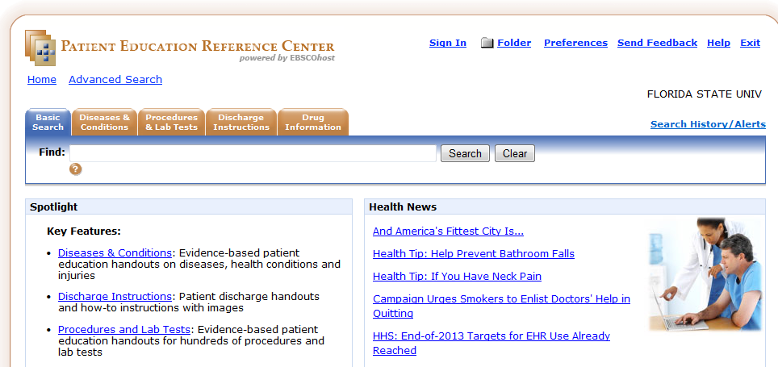
Patient Education Reference Center
New Resource from EBSCO

Slide 17
Patient Education Reference Center
6000+ handouts
  Diseases & Conditions
  Discharge Instructions – good demand mgmt
  Procedures and Lab Tests
  Drugs – include overdose instructions
Reading Level 3rd-7th grade
Customizable – Add patient’s name and clinic information
Notes:
There is no way to put in the clinic info once like MDConsult. You have to type it in each time you print.

Slide 18
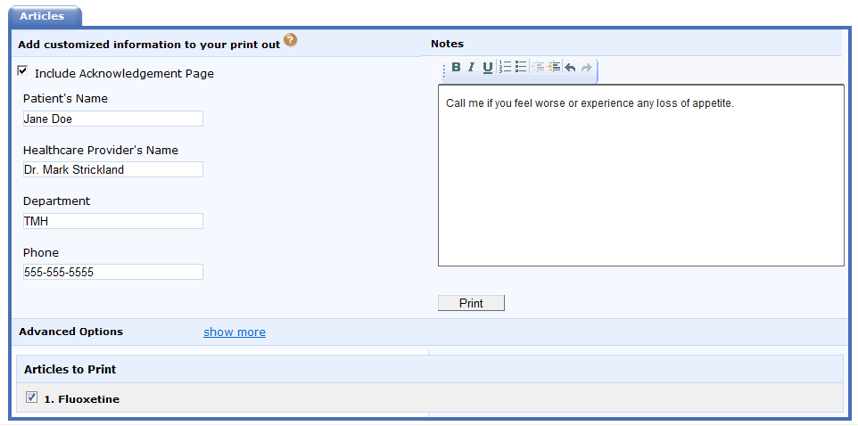
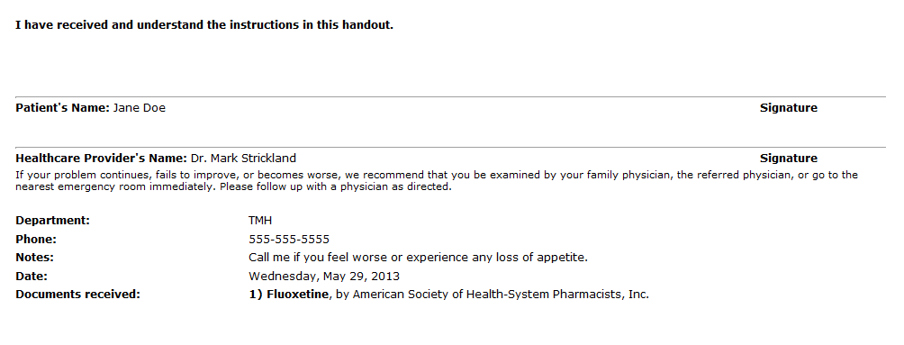
Printing from PERC
Notes:
When it prints, there is a tear off at the top for patient to sign verifying they received and understand instructions

Slide 19
PDF Handouts
Any PDF can be saved to the computer
File inserted into most EMRs
Suggest: Ferri’s Netter handouts in MDConsult
  2 pages, add clinic info, low reading level
Or Print good handout to PDF
Notes:
Thanks to Larry Deeb, MD, who brought his computer to the last TLH session and saved the handouts he needed to his computer then inserted a link to the file in his EMR.

Slide 20
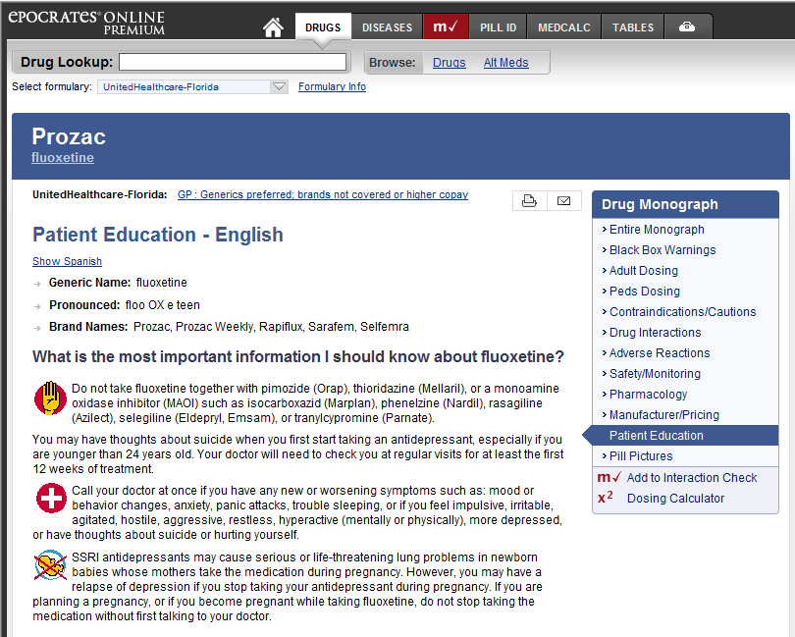
Epocrates Online ($)
Handouts are under each drug
Provided by Cerner Multum, Inc.
Reading level 11th grade
Notes:
While most pharmacies provide handouts with prescriptions, you can get a handout for prescription drugs to discuss with your patient in the clinic in Epocrates Online
Sadly, Epocrates does not provide handouts for alternative and OTC medicines.
Look up an Epocrates Handout.

Slide 21
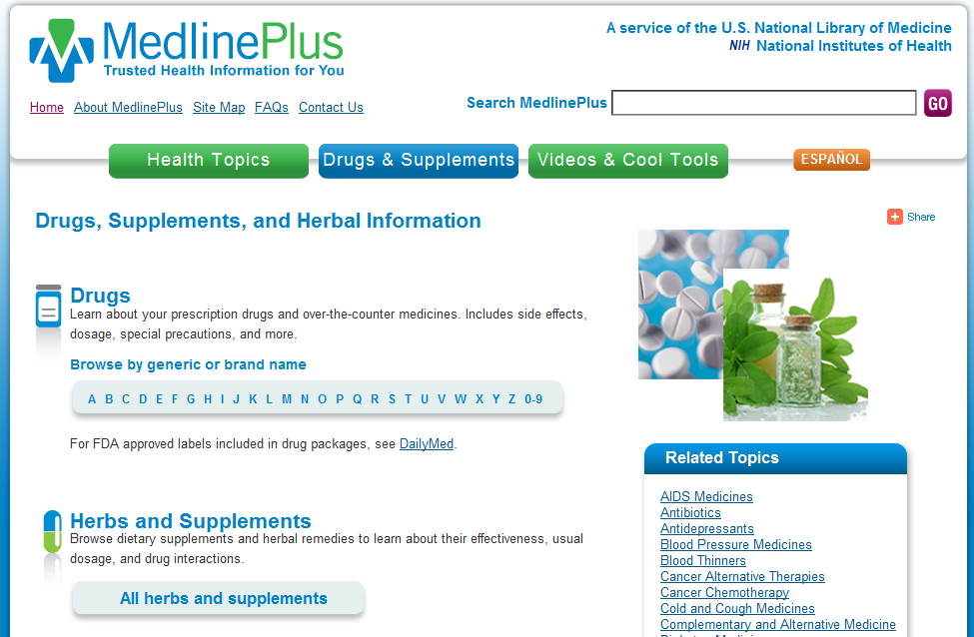
MedlinePlus Drug Handouts
Notes:
These are a good alternative to Epocrates Drug handouts. They are written at a much lower reading level.

Slide 22
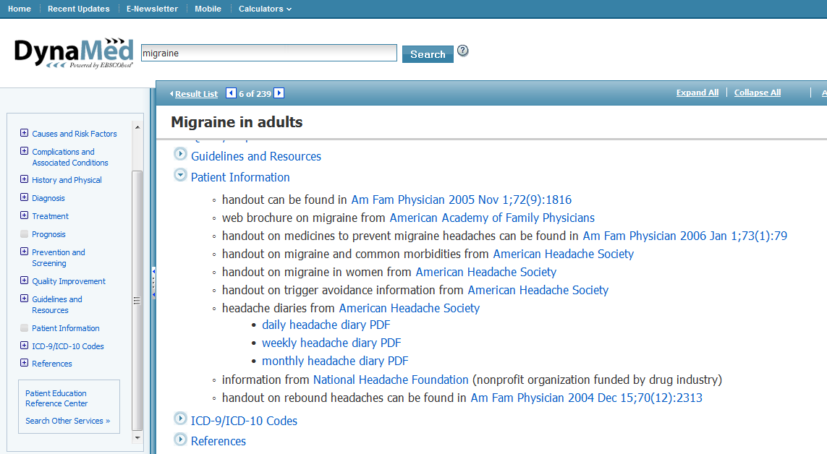
Notes:
Dynamed does a nice job of linking to patient education handouts in their disease monographs. The new Patient Education Resource Center is also linked from Dynamed since they are both EBSCO products.

Slide 23
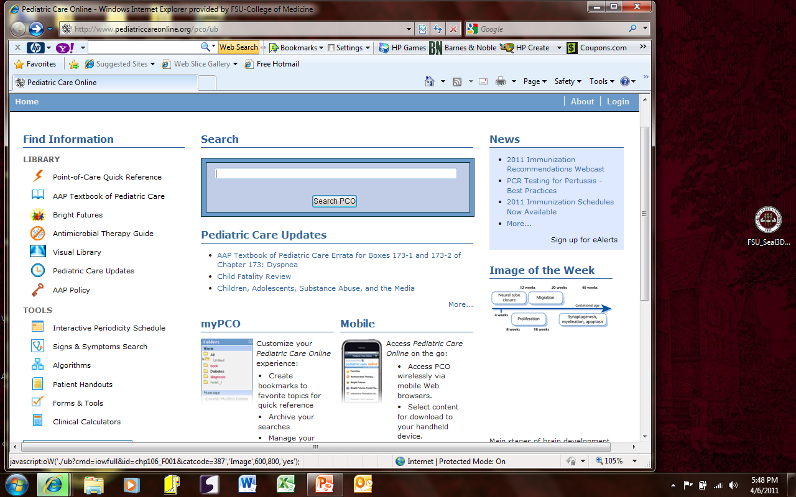
Pediatric Care Online
Notes:
Pediatric Care also has handouts. Work through this to show faculty example. Choose “ANAPHYLAXIS”

Slide 24
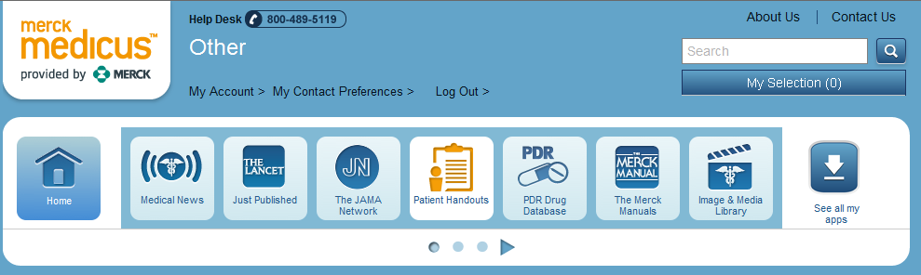
MerckMedicus.com Handouts
New, iPad friendly format website
Formerly in MDConsult, McKesson/Relay Health
Adult and Peds, English and Spanish
Free, but need to register
6th-8th grade reading level.

Slide 25
How to Use Handout
Train Staff/Students
Sit next to patient
Review with patient
Provide pen/marker
Point with finger to items
Communicate priorities
(most important point)
Check for understanding (health literacy and reading literacy)
ADA Recommendations for Diabetic Educators
Notes:
We suggest to students the following suggestions from the ADA. Sit down next to the patient whenever possible. It immediately focuses attention and puts you in the role of teacher and guide. "Let’s read this over for a minute or two, Ms Katz; this handout helps explain how and why yeast infections develop more often in diabetic women and how certain medications can help."
Provide pencils, pens, or a highlighter. Point to key points with your finger and ask the patient to circle, check, underline, or highlight. You will dramatically increase the speed and efficacy of the consultation, and your patients will walk out with customized notes. They won’t have to take time to read it all over to pick out the 2 or 3 points they need to remember. "From this list of foods to avoid, Mr Simic, which three do you think will be the easiest for you to cut down on? Go ahead and circle or underline them as a reminder."
Use written materials to review and make priorities. Patients often feel overloaded with technical names, difficult quantities, and confusing schedules. The best communicators have the knack of boiling down all the information into a handful of essentials. Help your patients internalize the information by putting it in order of priority. "Of all we’ve talked about, Ms Sidney, what’s the most important to remember?"
"To remember to keep my blood sugar log."
"Right! Let’s put a ‘1’ there. Now the second most important would be…?"

Slide 26
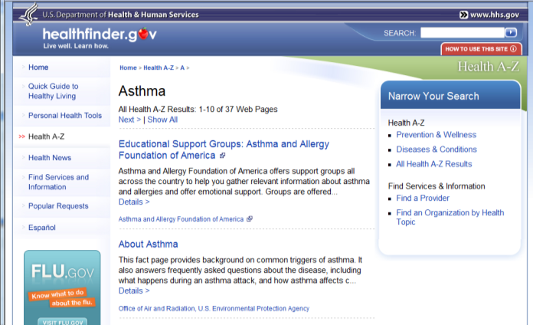
Websites for Patient Ed
Notes:
For patients who are computer literate, recommending a website is viable.

Slide 27
Why Use Websites
Same reasons as handouts
Can be used during encounter to illustrate concepts, provide visuals
Added value:
  Animations
  Videos
  Audio
Continued self education post encounter

Slide 28
Considerations
Open access to internet in office (hospitals are notorious for blocking internet access)
Place set up so patient can see the computer screen easily
Hearing of patient –headphones handy?
Vision of patient – big screens
Access to internet by patient at home
Notes:
If the volume is loud, you will also need to get headphones for the patient so as not to disturb nearby activities in a clinic. If you are going to recommend a site for a patient to use at home, make sure they have the technology and knowledge to access the internet at home. Make no assumptions based on age. Socioeconomic status plays a part. Younger adults more likely than older adults, but not guaranteed to be.

Slide 29
Patients Do Use the Internet
According to Pew, 80% of internet users (79% adults) or 59% adults look for health information online
The quality, reliability, applicability to patient varies widely
Guide the 59% who do to best sites – else give handout
Adults with chronic disease less likely than healthy adults to have access to the internet
“Health Topics" (Pew Internet Project: February 2011). Available at: http://www.pewinternet.org/Reports/2011/HealthTopics.aspx
Notes:
http://www.pewinternet.org/Reports/2010 /Chronic-Disease.aspx
PEW Report: Health
Chronic Disease and the Internet
by Susannah Fox, Kristen Purcell
Mar 24, 2010
Report: Health, Digital Divide
Health Topics
by Susannah Fox
Feb 1, 2011

Slide 30
What are they looking up?
66%: Disease or medical problem
56%: Medical treatment or procedure
44%: Doctors or other health professionals (Social Media)
36%: Hospitals or other medical facilities
33%: Health insurance, including private insurance, Medicare or Medicaid
29%: Food safety or recalls
24%: Drug safety or recalls
Pew
Notes:
According to this same study…
Speaking of Social Media, we will christen a new workshop on Medicine in the Social Media Age on June 12.
The percentage of Internet users who look online for information about:
A specific disease or medical problem: 66%. The top five conditions searched for on WebMD, for example, are shingles, gallbladder, gout, hemorrhoids, and lupus.
A certain medical treatment or procedure: 56%. For example, pain relievers, antidepressants, high blood pressure medication, corticosteroids, and hysterectomy.
Doctors or other health professionals: 44%.
Hospitals or other medical facilities: 36%.
Health insurance, including private insurance, Medicare or Medicaid: 33%.
Food safety or recalls: 29%.
Drug safety or recalls: 24%.
Environmental health hazards: 22%.
Pregnancy and childbirth: 19%.
Memory loss, dementia, or Alzheimer's: 17%.
Medical test results: 16%.
How to manage chronic pain: 14%.
Long term care for an elderly or disabled person: 12%.
End-of-life decisions: 7%.
Read more: http://www.chcf.org/publications/2011/02/health-topics-internet-users-information#ixzz1rYORmRwp

Slide 31
Finding Reliable Information
Let students teach patients to evaluate information found on web
Where did the information come from?
Who wrote it? Is it opinion or fact?
How current is the information?
Who is responsible for the content?
Helpful Handout at Familydoctor.org
http://familydoctor.org/familydoctor/en/healthcare-management/self-care/health-information-on-the-web-finding-reliable-information.html

Slide 32
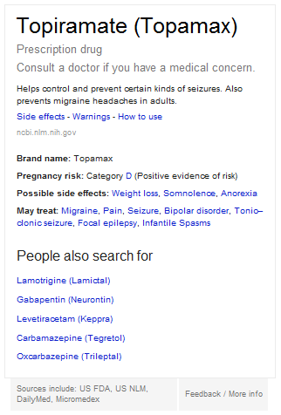
Google Knowledge Graphs
Google search results
Appears in box at top
Mostly people, history…
Added drugs from NLM
database
Patient level of info

Slide 33
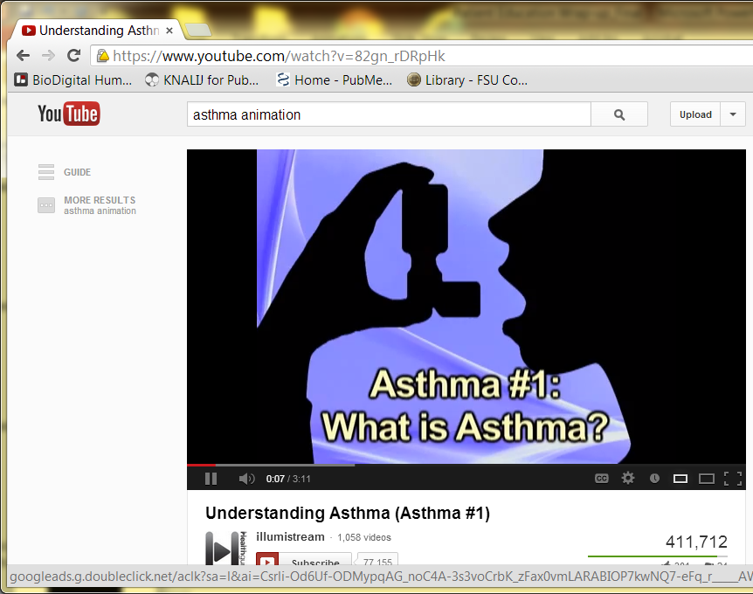
YouTube.com Videos
Healthcare organizations, medical schools, individual physicians posting patient ed videos.
Ads occasionally.
Some animations for sale.
Samples on YouTube
Reviewed by users.

Slide 34
Example
Patient Ed Animations. Posted by FSUCoM.
https://www.youtube.com/user/FSUMedMedia
Notes:
Animations created by our own media people for use in the CLC are examples of useful materials found online.

Slide 35
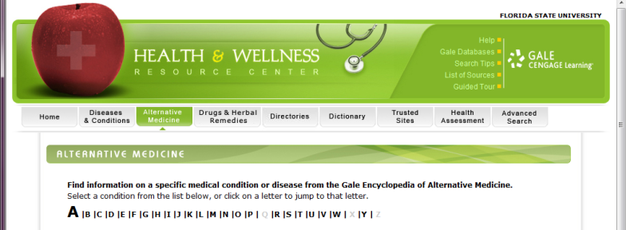
Health and Wellness Resource Center
From GALE group
Collection of resources on diseases, conditions, CAM, prevention, videos, Spanish, etc.
Click List of Resources to see reading levels
Available Free to all FL residents at www.FLeLibrary.org > Health
Notes:
The advanced Search is recommended to find resources because of the huge number and type of resources found here. If you look under List of Resources it shows you the reading level of the print handouts.

Slide 36
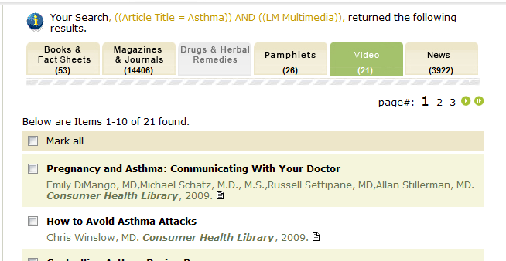
Searching Health and Wellness Resource Center
Advanced Search Results
Note Tabs
Notes:
After you do an advanced search on a couple of terms, note the tabs which divide your results into the type of media found. Videos are good to show patients if you have a space set up for that.

Slide 37
Healthfinder.gov (free)
DHHS curated web sites on health topics
Organized links to free online resources
Notes:
This site is just a collection of selected online resources reviewed for their content and ease of use by DHHS and provided to the public free. Look up

Slide 38
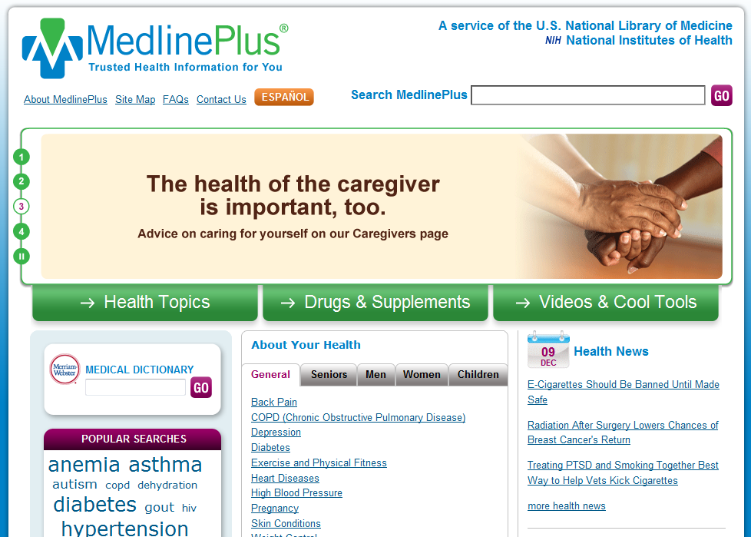
Medline Plus from NLM (free)
NLM curated web sites on health topics
Notes:
This site combines links to curated sites plus a selection of licensed resources. Patients can use this at home to gain information on their conditions. It is also a set of selected links to respected resources organized by topic under Health Topics. The encyclopedia and dictionary supplement patient knowledge on medical terminology.
The Drug Handouts are much better than Epocrates for patients….lower reading level, less scientific language, more patient centered.

Slide 39
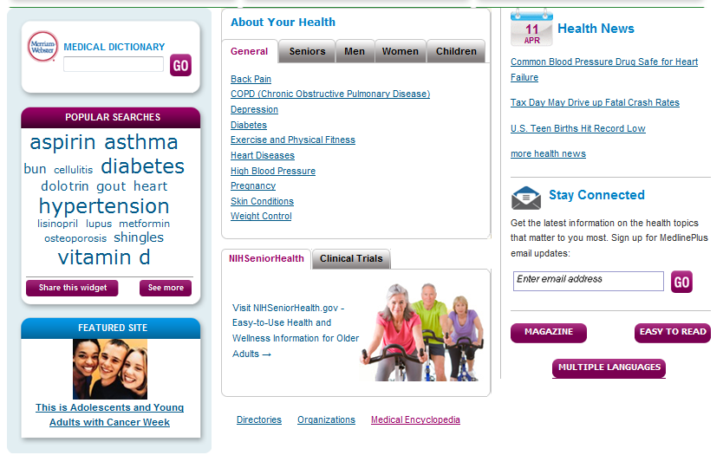
Medline Plus Resources
Notes:
The Easy to Read resources are videos and handouts for people who may not read well. Also the Medical Encyclopedia contains the A.D.A.M. handouts that used to be in MDConsult, that have very nice illustrations.

Slide 40
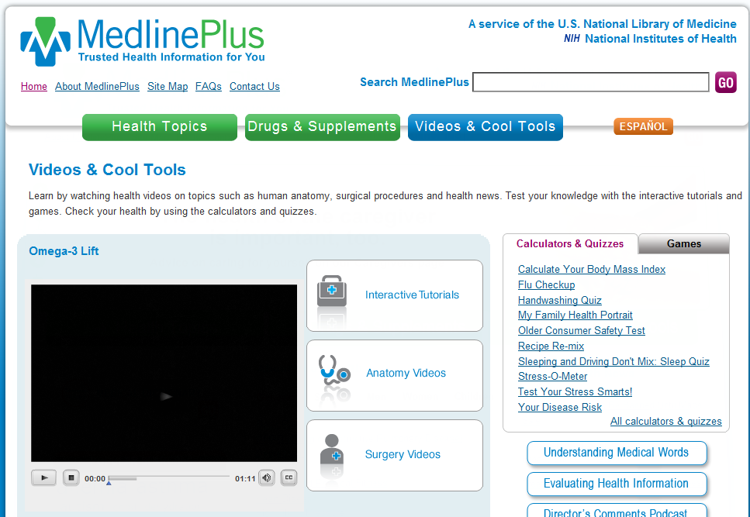
Medline Plus Surgery Videos
Notes:
They have purchased and provide interactive tutorials with animations from the patient education institute. They require advancing and answering questions. There are videos on anatomy and…
There are a number of scary surgery videos. If your goal is talking a patient out of one, here is your resource.

Slide 41
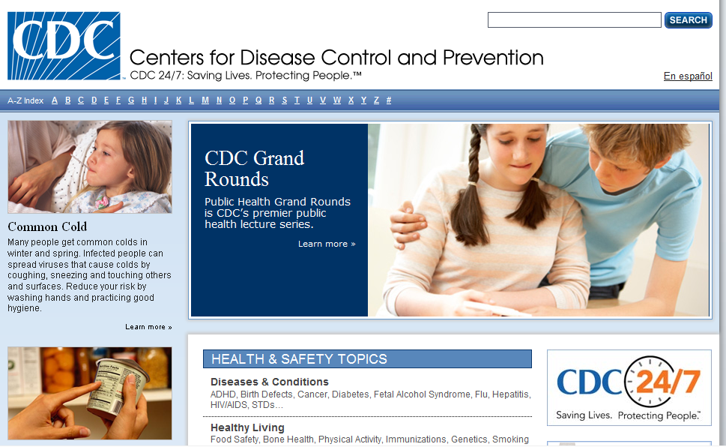
www.CDC.gov

Slide 42
Prevention, Public Health and Population Resources
Travelers' Health CDC
Healthy People 2010 (DHHS)
Immunizationed.org
National Center for Farm Workers Health
Patient asks if they need shots to go on a ‘Nile Cruise’ in Egypt.
Notes:
There are many useful sites on the web that contain patient education materials. When you search HealthFinder or MedlinePlus, you get links to these types of sites. Based on your practice, you might keep these in mind and bookmark them.

Slide 43
Specialty Organization Sites
AAP sponsored website for patient education : www.healthychildren.org
  Topics reading level ~9th & soon there will also be a version completely in Spanish.
ACOG.org Patient Education Pamphlets under Publications, reading level 6-7th
AACAP.org adolescent psych, nice resources.
Notes:
We have already mentioned the AAFP handouts which can be found at familydoctor.org in addition to in MDConsult and are linked from both Healthfinder and MedlinePlus. Other orgs that offer handouts are…

Slide 44
Chronic Disease Specific Sites
American Diabetic Association
American Lung Association
Arthritis Foundation Handouts
American Academy Allergy, Asthma, and Immunology
What they have:
  Handouts
  Support groups
  Local chapter locations
  Discussion lists
Notes:
Each of the major disease organization has resources for patients with these chronic problems. They not only have handouts but usually access to support groups, the location and contact information of local chapters, and discussion lists for patients to get help from their peers as well as practitioners. Depending on the literacy level and computer access of your patient with chronic disease, these sites are always good to refer patients to.

Slide 45
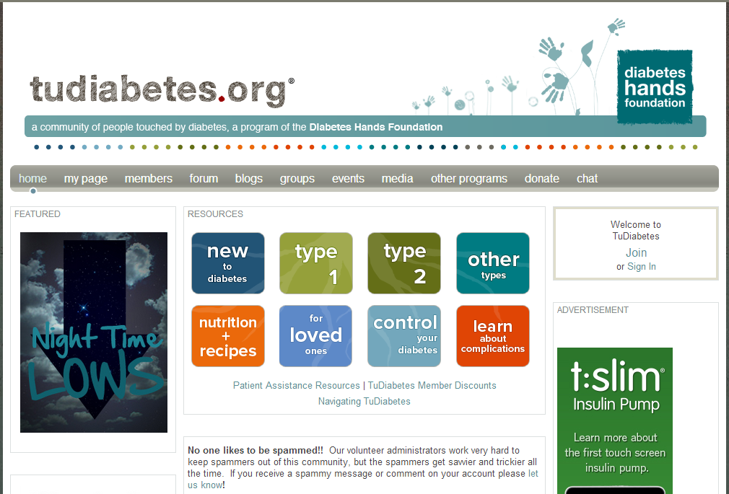
Social Media Sites for Pt Ed
Social Media for Chronic disease
Awareness
Support
Education
Diabetes Hands Foundation. http://www.tudiabetes.org

Slide 46
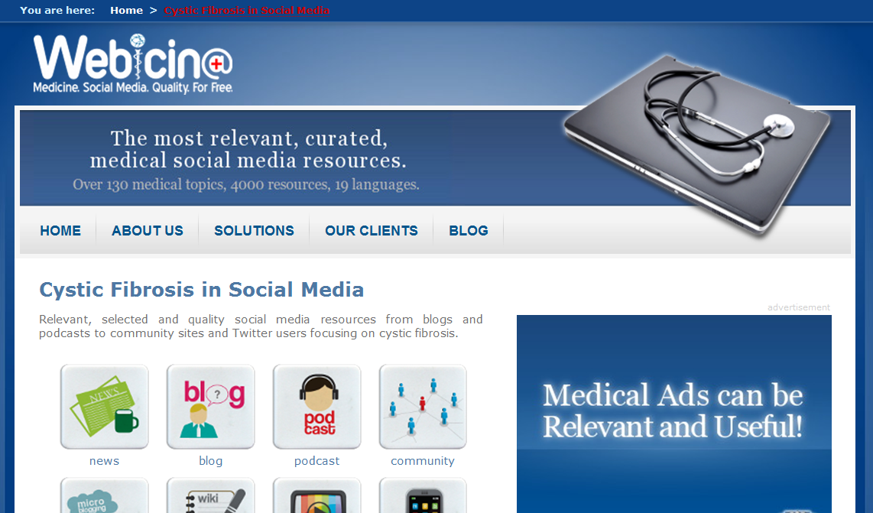
Curated Medical Social Media Sites
http://www.webicina.com/?select=patient
Notes:
Another site in its infancy that is an attempt to curate/rate/evaluate medical social media sites for providing instructional materials and bring together communities of people with the same conditions is webicina.com. This site, instead of using experts, relies on crowdsourcing for reviews of sites.

Slide 47
Selecting Web Sites
Reviewing a site
  ease of use
  quality of handouts/videos/images
  number of available topics
  type of patients/handouts
  whether you might use this site
  Bookmark the site
  Make a handout with recommended web sites to give to patients
Notes:
Depending on your chosen specialty, it will be helpful to review a number of sites that might be applicable to your patients and bookmark them for future use. A number of physicians create their own clinic web sites and link to applicable patient education web-sites creating an online resource for their patients.

Slide 48
Ideas
Build lists of links for clinic patient population
Channels in YouTube (ask if patient has a computer at home, internet connection, speakers,…)
Email links to patients with questions or for further explanation

Slide 49
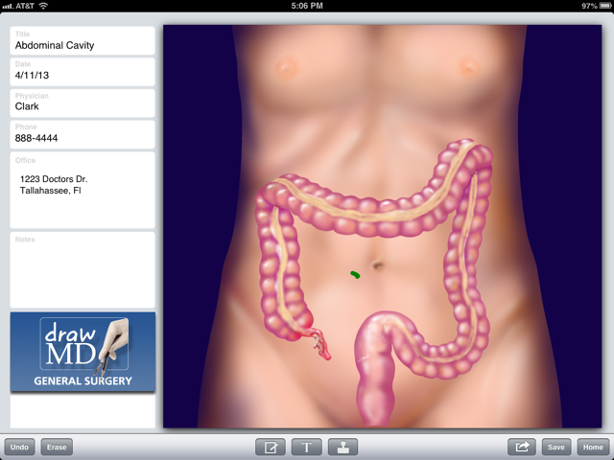
Mobile Apps for Patient Ed

Slide 50
Using Mobile Apps with Patients
Larger screen devices better than smartphones
Interactive anatomical illustrations that can be emailed to patient instead of models
Animations of conditions, like asthma, murmurs
Video demonstrations of skills at fingertips

Slide 51
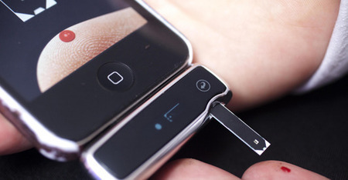
Prescribing Mobile Apps
If the patient has a smartphone or tablet, recommend apps for:
  Medical reference
  Health and fitness
  Personal health record
  Medical social media
  Monitor and manage illness
What apps are you using for your own health or fitness?
Notes:
Ryan Berger and I gave a presentation to a group of about 15 retirees at the Pepper Center. 2/3s of the attendees had iPhones, and almost half had iPads. In spite of the fact that they were in their 60s and 70s+, they were very interested in mobile apps for these uses.

Slide 52
Assessing Quality and Usefulness
iTunes does not discriminate medical apps into categories
Hundreds of apps for patients vs healthcare professionals - Search ‘diabetes’ get 600 apps
Check Dx organizations for reviewed apps
New effort to curate med apps like HON code, http://www.happtique.com/
New www.medicalappjournal.com reviews
Peck, Andrea. A solution to app overload. Medical Economics. Dec 25, 2011.

Slide 53
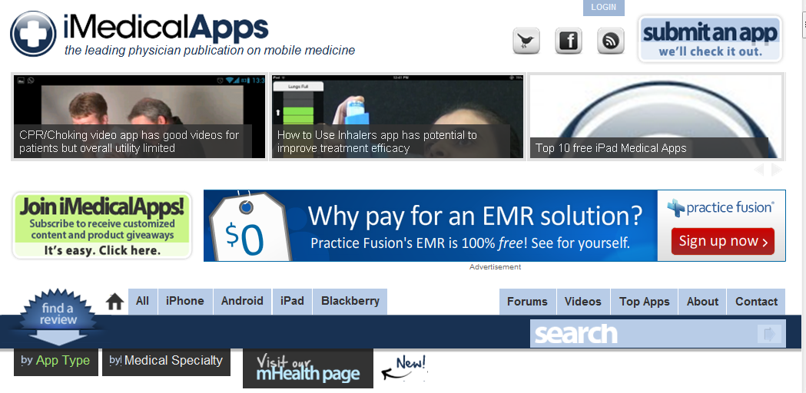
Keeping up with Medical Apps
iMedicalApps.com
Notes:
The image is linked to a nice review of a patient education app for cardiac catheterization.

Slide 54
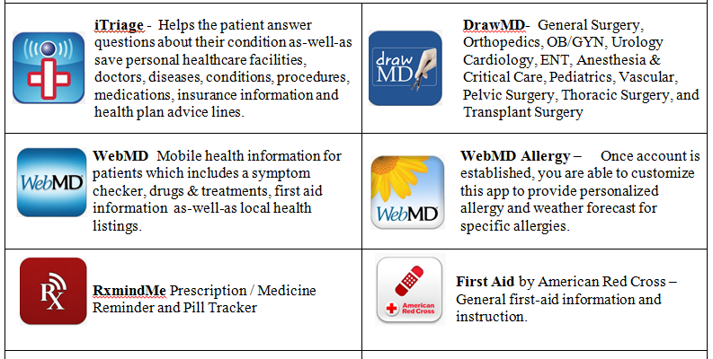
Mobile Apps for Patient Education
See Handout
Notes:
If you have these loaded on your iPad, you can demo some, like Draw MD or I have a demo linked on the next slide

Slide 55
DrawMD Demo
http://www.youtube.com/watch?v=OcV2A85tln0

Slide 56
As Mobile Apps Mature
Learn from your patients
Learn from students and peers
Ask what apps they find helpful
Include mobile apps recommendations into CME sessions on disease topics
Watch for more efforts to curate medical apps

Slide 57
More on Considerations

Slide 58
Scary Reading Statistics
35 million adults in the United states as functionally illiterate.
one in five adults cannot read
20 million adults in the United States have an 8th grade reading level
20 million more have a reading level of 4th grade or below.
Assume that the reading ability of your patient is below the level of education that they have completed.
Health Literacy ?
Notes:
Newspapers and other commonly read materials are written on the sixth-grade to eighth-grade level. Even patients who read at a much higher level generally appreciate information that is simple and to the point -- as long as the tone isn't condescending. Recent estimates number 35 million adults in the United states as functionally illiterate. Simply put, about one in five adults cannot read. Of those who can read, about 20 million adults in the United States have an 8th grade reading level, while 20 million more have a reading level of 4th grade or below.

Slide 59
Reading Level
To conduct your own quick assessment of a handout, keep these general guidelines in mind as you read:
  one or two syllables per word
  one idea per sentence
  one concept per paragraph
  no more than five key points per handout
  medical terminology should be avoided whenever possible.
Notes:
Medical terminology should be avoided whenever possible. If it can't be avoided, the terms should be carefully defined. For example, bed wetting should be used rather than enuresis. Because there is no lay term for rosacea, a handout on that topic should explain how to pronounce the word and what the condition involves. Consistency in terminology is also important. Analogies, simple punctuation, contractions and even slang are good if they enhance understanding.

Slide 60
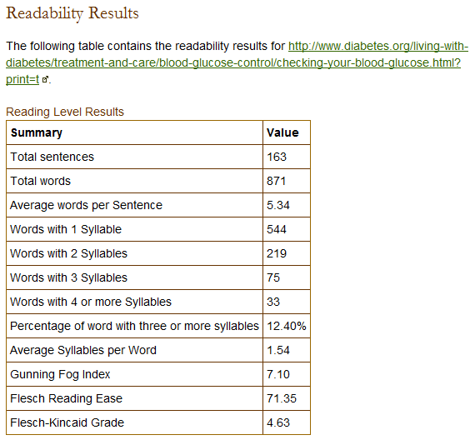
Web Site that Checks Readability
Copy URL of handout and paste into one of these:
  http://juicystudio.com/services/readability.php
  http://www.read-able.com/
  Problem with PDFs
Copy and paste text into http://www.readability-score.com/
Notes:
There areweb sites that will tell you the readability of another web page. Let’s say you have found this page at the ADA on measuring your childs blood glucose levels. Copy the URL. Go to this page at JuicyStudio.com, paste in the URL and hit Calculate Readability. It tells us that the Fleisch Reading Grade is 4.63. The Fog level at 7.10. This is a level of schooling that it will take to understand the content of the handout. Read-able lets you drag and drop a button to the top of your browser that lets you navigate to a handout, then click the button. It will give you the readability stats in a popup for that handout or site.
These sites do NOT do a good job of determining the reading level of Adobe Acrobat PDF files. So some brochures and such available online in PDF format will give you a reading level of 0 or 3, which means they can’t see the words inside the PDF.

Slide 61
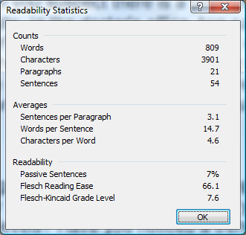
Using Word Check Reading Level
Tools menu, Options,
Spelling & Grammar tab.
Check grammar with
spelling, yes
Show readability
statistics, yes
OK.
Check Spelling
When Microsoft Word finishes checking spelling and grammar, it displays information about the reading level of the document.
Notes:
Word will tell you the reading level of the content of a handout more reliably than the web site we just showed you, but you have to copy the text and paste into a new Word document first. Then run the Spell Checker. You must go thru there steps once to make Word tell you the statistics. Here is the results of the same Glucometer handout. As you can see, it is 7.6 grade level.

Slide 62
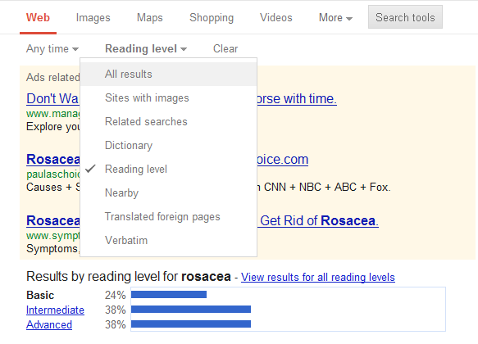
Google Searching
Google now lets you search by reading level
Top “All Results
Pick Basic

Slide 63
When Language is a Problem
Using Google to Translate
Find handout and copy it or if online copy the URL
Go to translate.google.com (type it in)
Select language to translate
Paste URL or text into the box
Notes:
Demonstrate this on a site.

Slide 64
Translating your Website
http://translate.google.com/manager/website/?hl=en
Supposedly your website can instantly be translated in 60+ languages automatically through the Google Chrome Website Translator

Slide 65
Using Word to Translate
Highlight text to translate
Under the Review (2007-10)
Select Translate…
Translate Document
From English to …Pick language
Hit arrow
Notes:
Word (2000, 2003 and 2007) will also translate for you using a 3rd party web site Microsoft built into the product.

Slide 66
Using Word to Translate
Bajo menú de las herramientas
adjetivo selecto
Debajo De los Libros De Consulta, seleccione la traducción
De inglés... a la lengua de la selección

Slide 67
Using a Mac computer to Translate
In Word Mac 2011 open your document
In Tab Menu, under View, click on “Reference Tools”
In pop-up menu scroll down to “Translation”; select languages to translate from & to
Click on Translate this document
The document will be sent unencrypted across the internet for translation & will appear in a new URL translated for you

Slide 68
Caution
The simpler the handout, the better the translator works
Suggestion: www.familydoctor.org is source for AAFP handouts

Slide 69
Teach Students: Document Pt Ed
Assessment:
  Document assessed patient education need
Plan:
  Document patient education provided
  “Patient was given handout #24…and reviewed…”
  “…mobile app was recommended to help…”
  “…website was recommended to patient for more information on…
Notes:
If you have students write progress notes, please encourage them to document their patient education activity in the Plan. This is likely to be a part of the PQRS incentive measures instituted by CMS.

Slide 70
Let’s Find Stuff

Slide 71
Patient 1
Mr. Jones is a 52 yr old construction worker, high school dropout, who is newly diagnosed with hypertension. You prescribe hydrochlorothiazide. What kinds of handouts might be appropriate in this case? Video?
Each of you take a different source and let’s compare what we find
Notes:
Considerations, reading level of 8th grade at most. Not too wordy. Bulleted lists better than long paragraphs.

Slide 72
Patient 2
A young lady presents with pityriasis rosea. This is a diffuse, often cosmetically bothersome rash. Having them read the symptoms, treatment, and the prognosis on the web seems to calm them down & the insistence on an immediate consultation with a university dermatologist is history. (She needed reassurance)

Slide 73
Patient 3
A teenager who wanted to know what effect some drugs he took could have. He only remembers doing some ‘Glass” ( He wanted information)

Slide 74
Patient 4
Do you have a patient/case we can use?

Slide 75
Summary
Students learn about this 2nd year
Patient Ed vital to compliance, outcomes
Patient Ed needs to be tailored to each patient
New technologies create opportunities for better patient education
CME talks should mention new technologies to support patient education and self-care
Notes:
Students start to learn about this in the 2nd year, but don’t get to practice it in a real patient situation supervised by an attending . But it is the 3rd and 4th year clerkships where they can be put to good use finding appropriate patient education materials for you.

Slide 76
We hope you enjoyed this workshop.
Please complete the evaluation.

