Slide 1
Point of Care Decision Support Resources [online and mobile]
, MD, Regional Campus Informatics Director
Nancy Clark, M.Ed., Director of Medical Informatics Education
Notes:
Note to presenter: You need to canter thru this workshop to cover the content. Keep your eye on the time. May not be time for all exercises for practice. Let audience do them as homework or do them with the audience quickly. Exercises for Practice should be used as examples for Demo. Start demoing when you get to these slides. You can say something like “let’s work this exercise together…” and On your computer, you would go to ….. If you let them look this up first then show them how, you won’t make it thru all the content.

Slide 2
Objectives
Identify useful Library resources to answer clinical questions quickly – select favorites
Locate disease quick references
Find laboratory information
Use Calculators for decision support
Medical equation
Clinical rules, decision support
Use the differential diagnosis tools
Use resources with students and patients
2

Slide 3
Handouts
PowerPoint
Decision Support Handout
Evaluation
Using Resources with Students
3

Slide 4
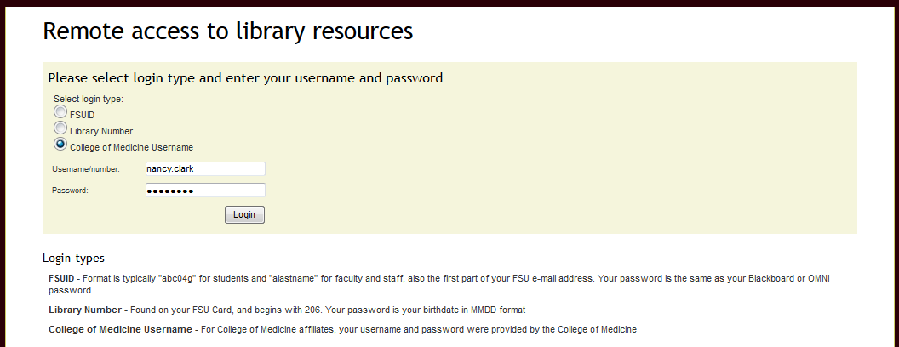
Off Campus Access Reminder
Off campus: Log into the library with CoM username and password
Use library page links to access online resources
firstname.lastname
Check College of Medicine
$fsumed$xxxx

Slide 5
Alert Regarding Off Campus Access
Starting in the Summer of 2016
Must use FSU-ID to log in
Used for Blackboard and OMNI
If you do not know your FSU-ID and password, contact your regional campus IT support person.

Slide 6
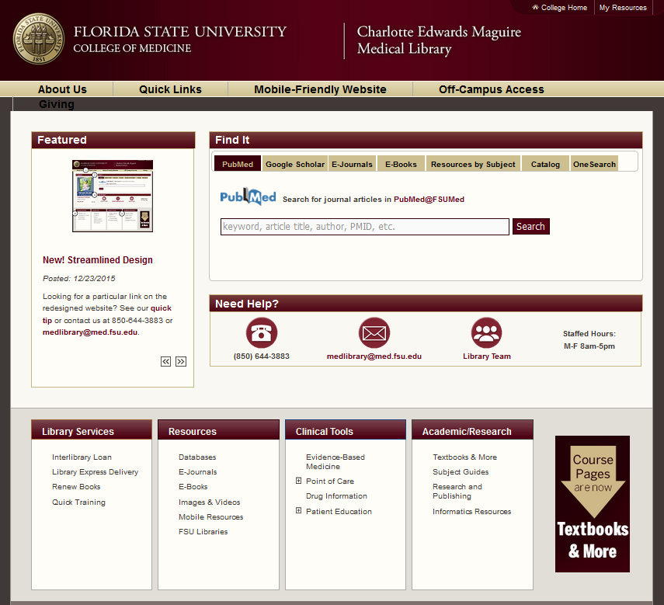
New Library Webpage
Notes:
Different ways to find the resources.

Slide 7
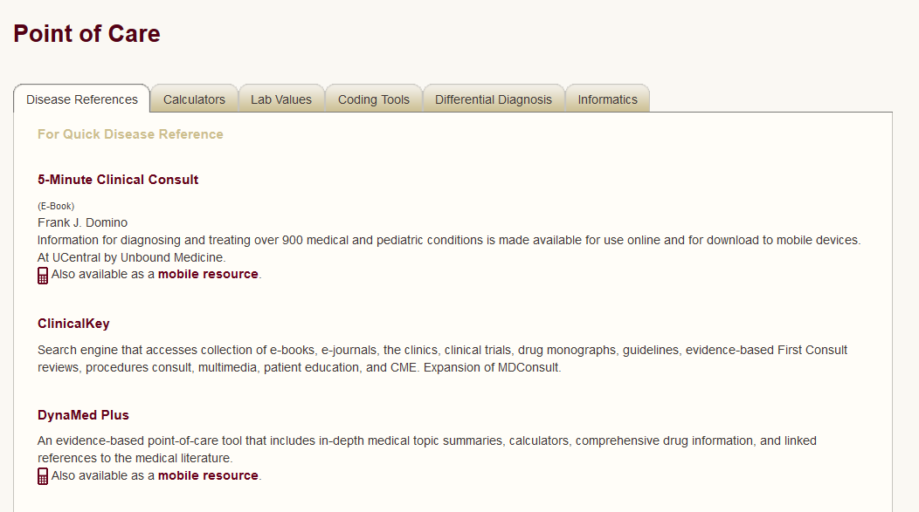
POC Decision Support Tools

Slide 8
What Apps Currently Available
DynaMed Plus
Access Medicine
BrowZine
Epocrates Essentials
First Consult
Natural Medicines Database
Pediatric Care Online/Redbook
PEPID
Prescriber’s Letter
The Medical Letter
uCentral
All have Apple and Android smartphone and tablet versions.
You must create an account with each to get the content.
Free to you…$2000+ worth
Notes:
PEPID, uCentral, Epocrates, and Dynamed Plus. have specifically friendly iPad versions as well. Any iPhone app works on an iPad, but the iPad friendly apps are easier to use and better utilize the nice real estate of the iPad screen

Slide 9
Dynamed plus
P | Disease Reference
 | Lab Reference
P | Calculators
 | Differential Diagnosis
P | Drug Information
P | Images
New 2016

Slide 10
DynaMed Plus
Overview and recommendations followed by in-depth monographs
Constantly updated review of literature and guidelines organized by topic: diseases, drugs, procedures, symptoms
Calculators from MedCalc3000
Micromedex drug monographs
Images
Links out to articles subscribed at CoM and reviews if more details needed
Mobile and Online
Notes:
Note that app is now no longer in Skyscape but stand alone

Slide 11
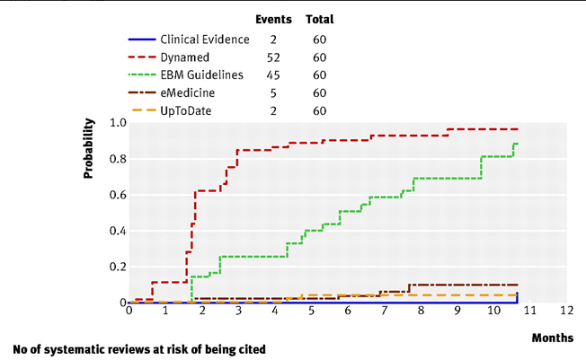
Dynamed Most Current Dx Resource
Banzi R, Cinquini M, Liberati A, et al. Speed of umobileting online evidence based point of care summaries: prospective cohort analysis. BMJ. 2011;343:d5856.
Notes:
Recent (2011) article in BMJ comparing Dynamed with UpToDate and other disease resources finds DynaMed to be the most current point-of-care resource and the best overall “Disease Reference” resource. They were looking at Cochranes and other systematic reviews of the literature, which are the highest level evidence for diagnosis and treatment and the frequency with which they are added upon release to the resources.

Slide 12
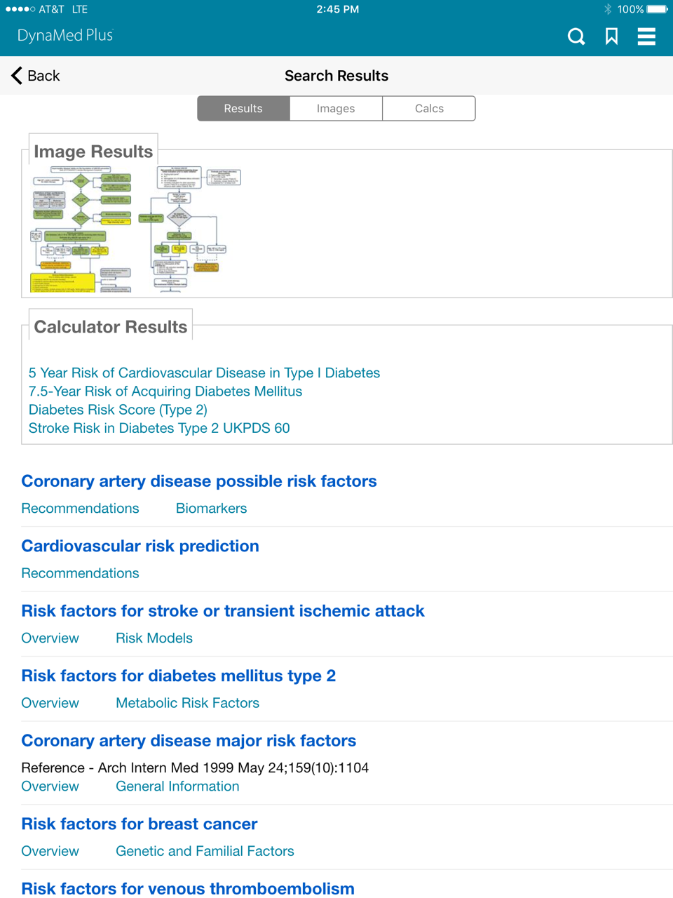
Using Dynamed Plus
Search for terms like: diabetes risk
Results include images, calculators and topics: disease, drugs, procedures
Notes:
Go there and demo. Let audience follow along.

Slide 13
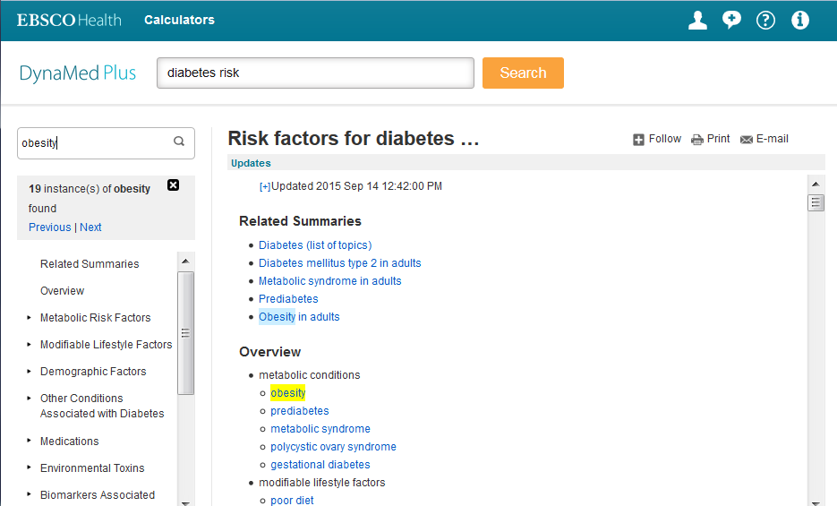
Search Within Topic Text
Notes:
Some topic monographs can be very long. If you have one term you want to find within that topic, you can search within text which will highlight all instances of that term and let you advance thru the matches. This works the same on the mobile interfaces.

Slide 14
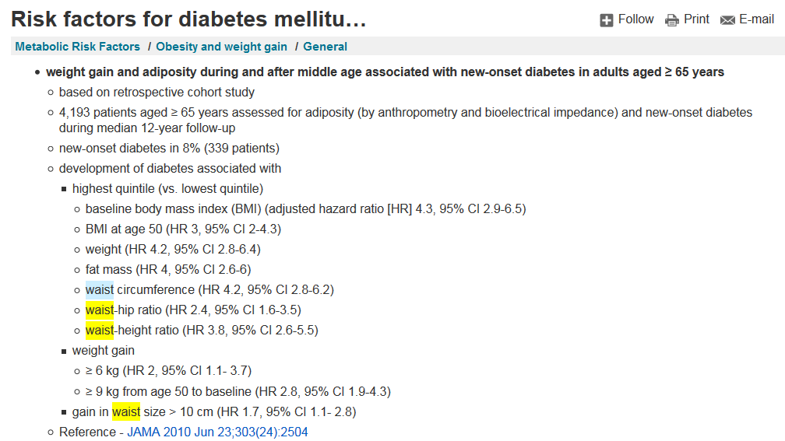
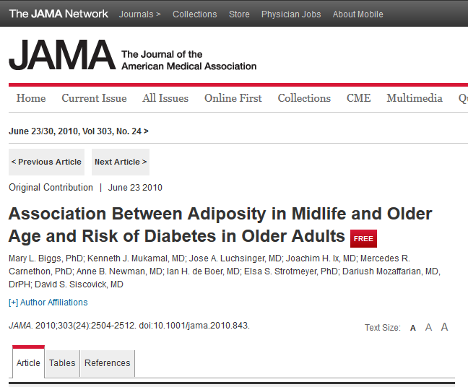
Links to Full Text Articles
Notes:
Within Dynamed Plus, there are links to the citations in Pubmed for all articles cited. Open Pubmed from the library first, then If you have signed in to off campus access or are on campus, the Find@FSU button linking Pubmed to the full text articles should be there. See next slide.

Slide 15
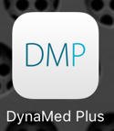
DynaMed Plus Mobile
Complete content of web site
Free to faculty and students
iPad easier to use. Lots of scrolling on small screen
Updates in the background
Linking out only works if wireless
Apple and Android versions
15
Notes:
The iPad version is much easier to use.

Slide 16
Calculators in Dynamed
Medcalc 3000 (same as Epocrates Online)
Listed in Search Results
Linked in content of monographs

Slide 17
Exercises for Practice
In patients with Atrial Fibrillation, is antiplatelet therapy associated with reduction in thromboembolism risk?
Your patient is an active 64 year old male who has been recently diagnosed with atrial fibrillation and put on aspirin. You are wondering about additional anticoagulation. He has a history of HTN controlled with furosemide. He has no other chronic conditions and no history of CHF, vascular dx, emboli or TIAs. What is his stroke risk? Arterial thromboembolism risk?
Notes:
Look up Atrial fibrillation. Find in the search results Thromboembolic prophylaxis in atrial fibrillation. Look at antiplatelet therapy. Links to calculators are in the monograph as well as listed in the search results.

Slide 18
PEPID
P | Disease Reference
P | Lab Reference
P | Calculators
P | Differential Diagnosis
P | Drug Information

Slide 19
PEPID Online/Mobile
Contents:
Clinical rotations (Peds, Surg, IM, etc.)
Calculators
DDx Generator
Disease reference
Drug information and interaction tool
Lab Manual
Stedman’s Dictionary
Illustrations (anatomy, EKG strips, etc.)
Procedures

Slide 20
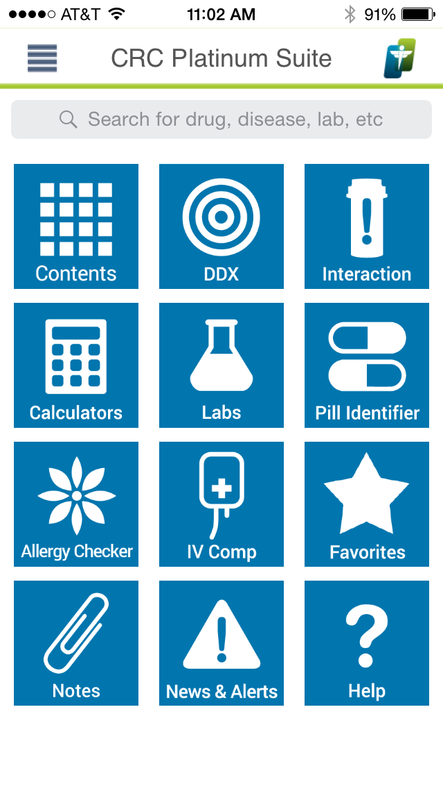
PEPID Mobile
100% of content on web
Links between diseases, drugs, images and calculators.
Notes:
We dropped First Consult to purchase a subscription to PEPID. One reason was that the content in FC on the mobile was less than 15% of the web content. PEPID is complete in both formats.
The iPad version is much easier to use.
Demo this to them using either your own topic or the one in the Decision Support handout.

Slide 21
PEPID CRC Disease
Web and mobile (Apple and Android)
2,700 Disease and Trauma topics with diagnosis, pathophysiology, treatment and disposition
Notes:
CRC stands for Clinical Rotation Companion. Designed for students on clerkships. Has sections on each clerkship that include all the history and physical exams for each specialty, order writing, etc.
We replaced First Consult with PEPID because of the Pediatric content among other reasons. This resource competes with Epocrates Essentials for the variety and usefulness of the resource. We will explore more sections of the resource at the next workshop. For now, lets look at just the disease content.
FILTER: Medical Content The index will limit itself to medical conditions. Type in Otitis, and pick Otitis Peds from the list. You will see in the center column various organ systems and the diseases under them Where you see Otitis Media click on Diagnosis. Then click on Treatment. Explore the content organization. Note that anything that is underlined is a link to additional content, ie drugs.

Slide 22
PEPID Disease Ref
Search for a disease – Alzheimer’s
Sometimes split up between Background, Diagnosis and Treatment.
Background: What is the median survival time in yrs for someone with Alzheimer’s?
Diagnosis: What score on the Mini mental-state exam indicates mild dementia?
Treatment: How soon after initiation of therapy should you see (follow-up) the Alzheimer’s patient?
Notes:
1. 3.3 yrs 2. 20-23 3. 8 wks

Slide 23
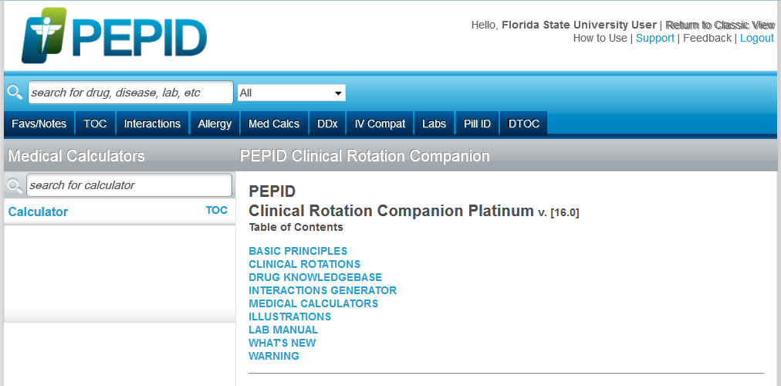
PEPID Calculators
Both medical equations and “Scores”
Online and mobile same instruments
Notes:
I prefer the alphabetical list to the medical calculator TOC. You can also search for the calculator you want. Put BMI into the Find box and you will see both adult and pediatric BMI calculators. PEPID is the only resource we have with a pediatric BMI calculator.

Slide 24
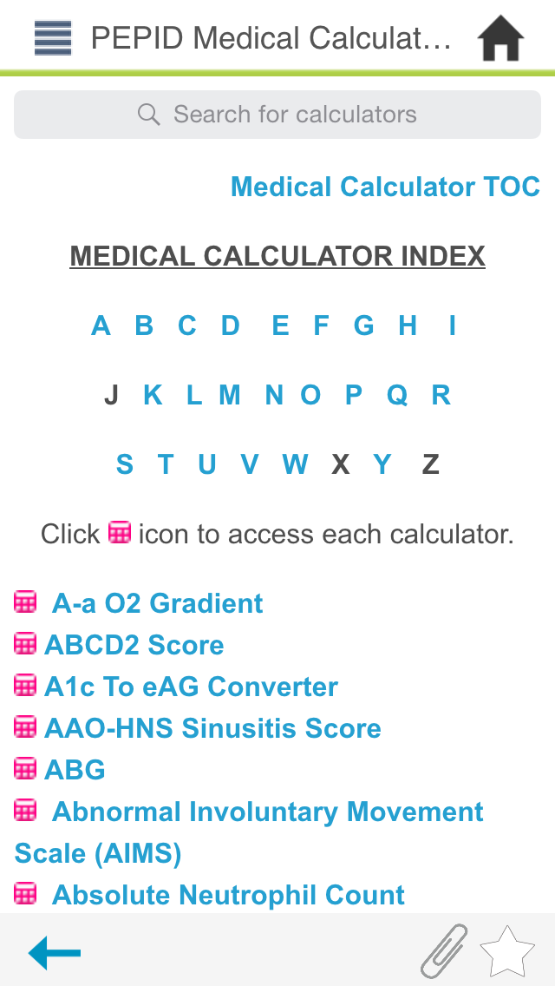
PEPID Calculators mobile
Under Table of Contents
Or Search for desired calculator (BMI, IADL, etc.)
Alphabetical List or by category
Icon in text

Slide 25
Exercises for Practice
An 8 year old girl who is 60 pounds (27.2 kg) has moderate dehydration. What should her maintenance fluids in mL per 24 hours be?
Others: Framingham, MMSE, ADLs, NIH Stroke,

Slide 26
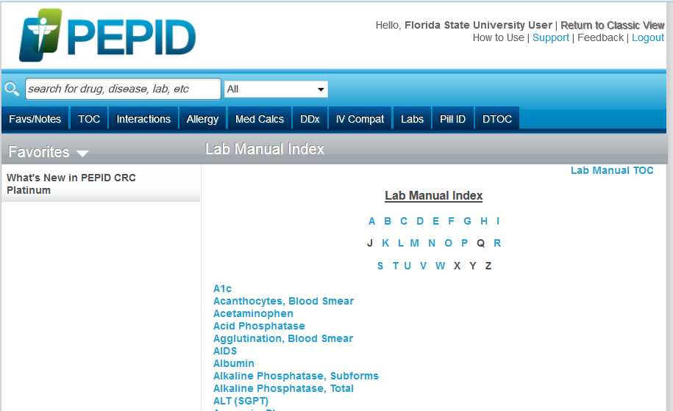
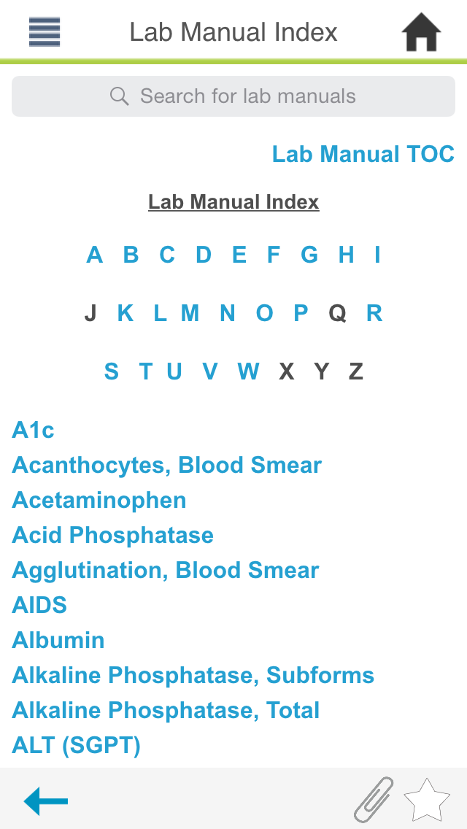
PEPID Lab Manual
Notes:
The icon is broken(2/22/2012) will call and let them know tomorrow, so use the table of contents button and then click on Lab Manual from the TOC list. Or just search for the lab test in the Find field ie HbA1c (Lab) and the test will come up.

Slide 27
Exercises for Practice
A basic metabolic panel reveals that a 30 year old man suffering from bipolar disorder has a serum calcium level of 12.9 mg/dL. He is taking lithium and valproate. Could his medications be a factor?

Slide 28
PEPID DDX
Enter symptoms, exam, labs
DDx nicely numbered as to likelihood
Linked to disease info for more information

Slide 29
Exercises for Practice
A 32 year old female presents to you complaining of off and on blurry vision in right eye (vision, loss, one eye) and intermittent eye pain, tingling on right side of face (paresthesia), Leg cramping (usually calf muscle at night), fatigue and constipation (chronic). Examination and questioning reveals that she has had some double vision, and her eyes are moving involuntarily back and forth (nystagmus).
Notes:
Should be MS

Slide 30
Exercises for Practice
You have a male 42 yr old present in the ER with a severe headache, nausea, myalgia, malaise, prostration. This just started suddenly a day or so ago. Physical exam reveals generalized macules that are red, fever, skin erythema, generalized papules that are small red, rash on his palms and soles of his feet. He thinks he has had insect bites while camping recently.
What could this be?
Notes:
This slide is hidden in case you need another example for DIAGNOSTIC TOOLS
This is Rocky Mountain Spotted Fever. It is a Rare disease. Therefore, it won’t be under the common problems. It will show up as highly likely with ++
PEPID only takes: Headache, severe; palmar erythema; skin rashes, erythematous, maculopapular; muscle pain (instead of myalgia) malaise and tick bite. Adding others confuses it.
Exercises for Practice should be used as examples for Demo. Start demoing when you get to these slides. You can say something like “let’s work this exercise together…” and On your computer, you would go to ….. If you let them look this up first then show them how, you won’t make it thru all the content.

Slide 31
Epocrates
P | Disease Reference
P | Lab Reference*
P | Calculators
 | Differential Diagnosis
P | Drug Information
*mobile Only

Slide 32
Epocrates Diseases
Content from BMJ
Linked drugs to drug monographs
Linked from Lab to diseases
Excellent Interface
Images
More detail online than on mobile version
32
Notes:
Use Acne Rosacea to demo and show them the images.

Slide 33
Exercises for Practice
What is the incidence and prevalence of Rocky Mountain Spotted Fever in the US?
What is the treatment of choice and dosage for RMSF?
What medication should be used to treat RMSF during 1st trimester of pregnancy?

Slide 34
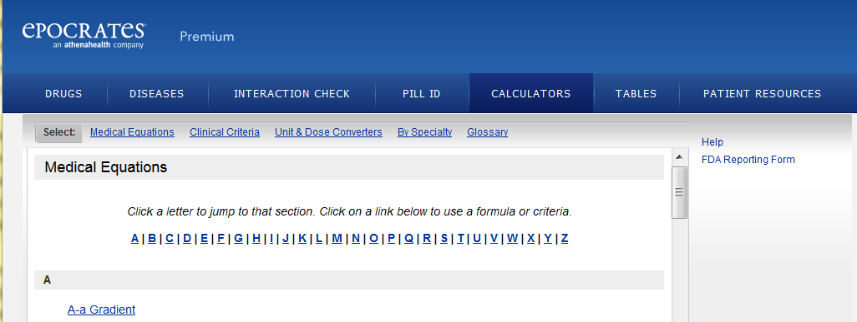
MedCalc on Epocrates Online
Online version is better than mobile version
MedCalc3000 (medcalc3000.com)
Extensive medical calculators and clinical rules, decision trees
Organized by specialty or alphabetical
Notes:
The calculators that are in the Epocrates Online version are quite extensive, while the calculators on the Mobile version are very limited. Online, the calculators are from a product called Medcalc 3000.

Slide 35
Types of Calculators
Medical equation calculations
i.e. body mass index, dosage calculator, unit converter – emphasis Patient Safety
Largely free online and for mobile
MedMath and MedCalc
Clinical rules, decision trees or criteria calculators
i.e. Ottowa ankle rule, NIH Stroke Score, diagnostic likelihood calculator, mortality calculator

Slide 36
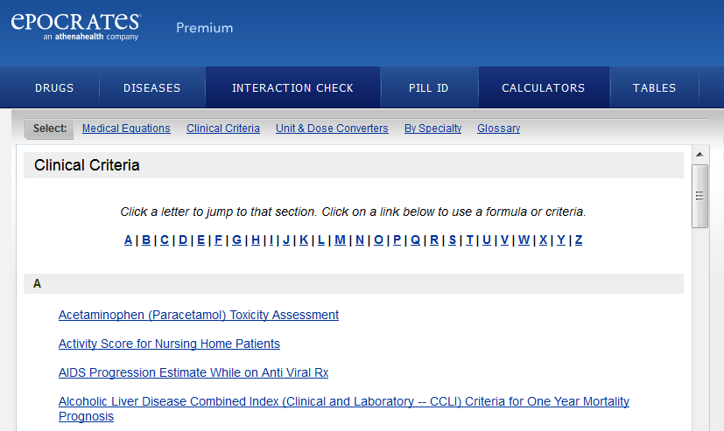
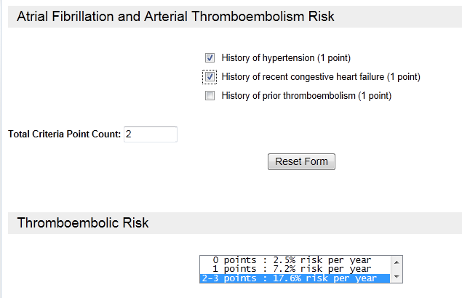
Epocrates Online Clinical Criteria

Slide 37
MedCalc3000 Calculators
Also available online in
Dynamed
Facts and Comparisons
Medscape
MerckMedicus
Medscape only app with all MedCalc3000 calculators
Notes:
The same Medcalc300 calculators that are in Epocrates Online can be found in Dynamed and in Facts and Comparisons. Medscape, Merck Medicus, Up-to-Date,

Slide 38
Exercises for Practice
What is the predicted peak flow for a 60 year old woman with asthma? She is 5’2”.
A 40 year old woman has just had a mastectomy. She had a grade 1 tumor, no lymph nodes and no lymphatic or vascular invasion. What is her Breast Cancer Recurrence risk?
Notes:
436 L/min Search for predicted, Peak Flow (predicted) pops up.

Slide 39
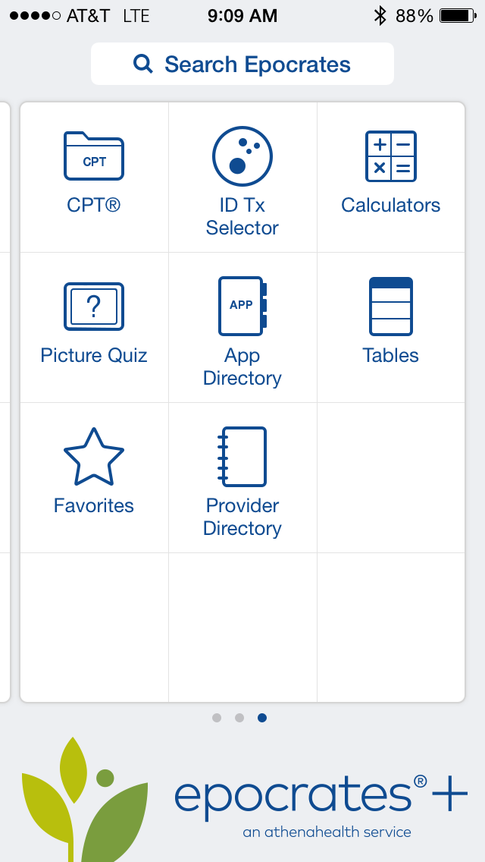
MedMath in Epocrates mobile
Does not have same calculators as Epocrates Online.
Few basic calculators
Pick Calculator or type in Search box.
Notes:
On the Mobile Device Epocrates version are calculators from MedMath, which are a limited selection of the most basic ones. Look at the list on the handout or pull those up and scroll thru them.

Slide 40
Exercises for Practice
81 year old female with long standing diabetes, and hypertension. Her BP is usually 140-150/85-90. Her ideal body weight is 112 lb. Laboratory tests: serum creatinine 1.2mg/dl, Hgb A1C 7.8, liver function tests normal. What is her creatinine clearance?
Your DKA patient in the ICU has Na+ 133, glucose 785. You remember that hyperglycemia throws off the Na+. What is the real, corrected Na+?
Notes:
Use Cockcroft Gault 29.5

Slide 41
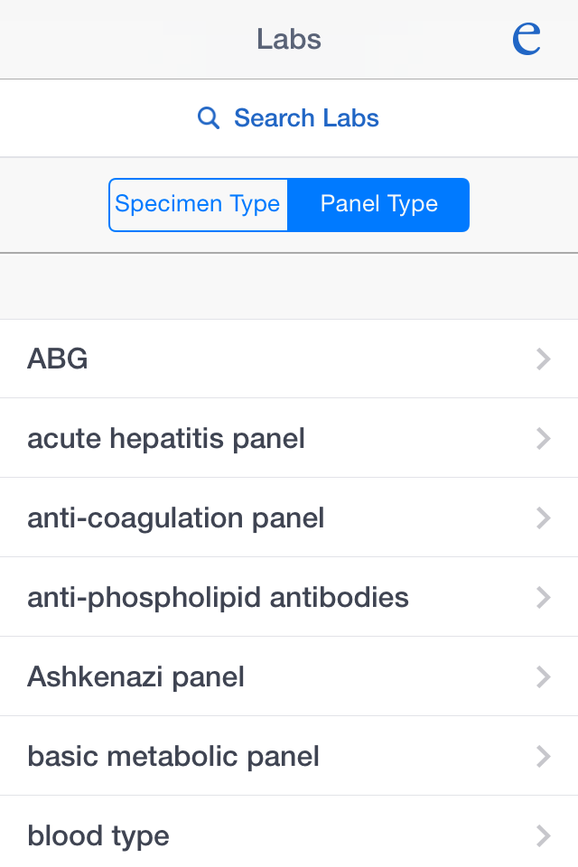
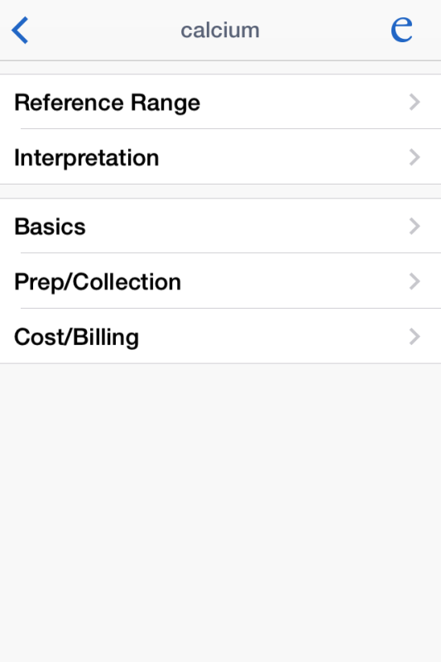
Epocrates Essentials Lab on mobile
Labs only
Interpretation linked to Rx and Dx sections
Search or
Browse Panels or Specimen type
Notes:
Emphasize the interpretation section and links to the Dx and Rx sections—how to use with students.

Slide 42
Exercises for Practice
A basic metabolic panel reveals that a 30 year old woman recovering from trauma has a serum chloride level of 108.9 mEq/L. She is taking ASA. Could her medications be a factor?
What ICD-9 codes might get you authorized and/or paid to order an RF?

Slide 43
Access Medicine
P | Disease Reference
P | Lab Reference
P | Calculators
P | Differential Diagnosis
P | Drug Information

Slide 44
Access Medicine
Online: Major resource with journals, books, drugs, quick reference, guidelines, calculators, patient education and Diagnosaurus
Mobile version contains:
Quick Medical Diagnosis & Treatment
Fitzpatrick’s Clinical Dermatology Atlas
Diagnosaurus
Pocket Guide to Diagnostic Tests
Notes:
This is the McGraw-Hill content which contains Harrison’s, Currents,
However, mobile version requires you to log into your online account every 90 days.

Slide 45
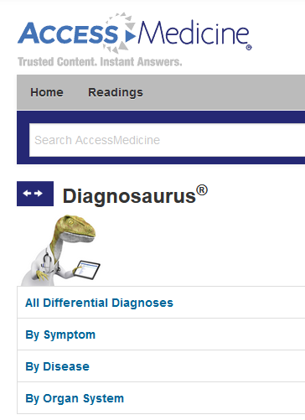
Diagnosaurus
DDX tool
Look up a symptom or presenting problem
Get a list of possible diagnoses
What are the top 3 causes of Chronic Cough (Cough, chronic)?
Notes:
LIDE 3 – Let’s look at Diagnosaurus. It is a very simple differential diagnosis tool. You pick a symptom or condition, and it will give you a list of possible diagnoses, which may or may not be in order of likelihood. The power in this is it’s link to the other content in UCentral, specifically 5MCC.

Slide 46
Use of DDx Tools with Students
During presentation of Patient with acute problem
Ask student for DDx
Tell student to use Diagnosaurus or PEPID and name other possibilities
46

Slide 47
Clinical Key
P | Disease Reference
 | Lab Reference*
 | Calculators
 | Differential Diagnosis
P | Drug Information
Notes:
Clinical Key replaced MD Consult last year. It contains all of the Elsevier books and journals plus the Gold Standard Multimedia drug database, a number of patient education handouts, guidelines and a procedure guide.

Slide 48
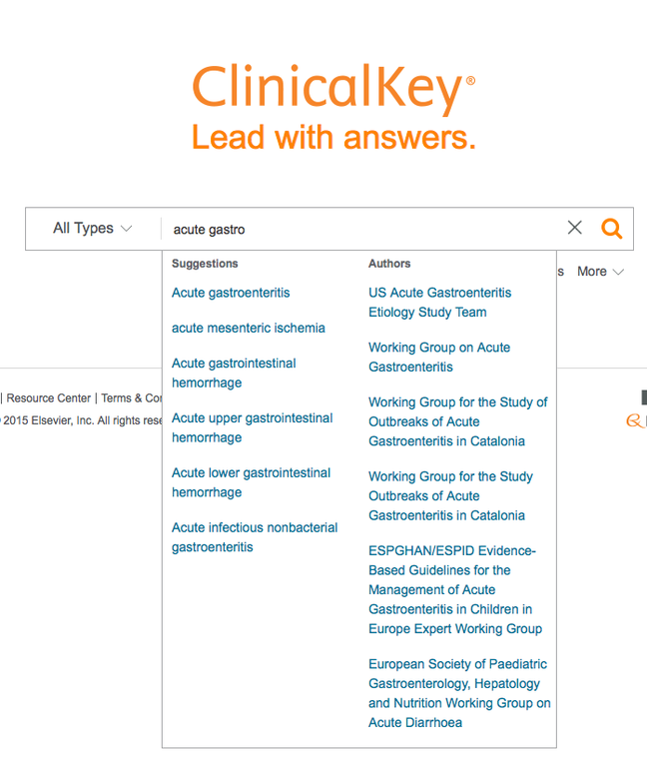
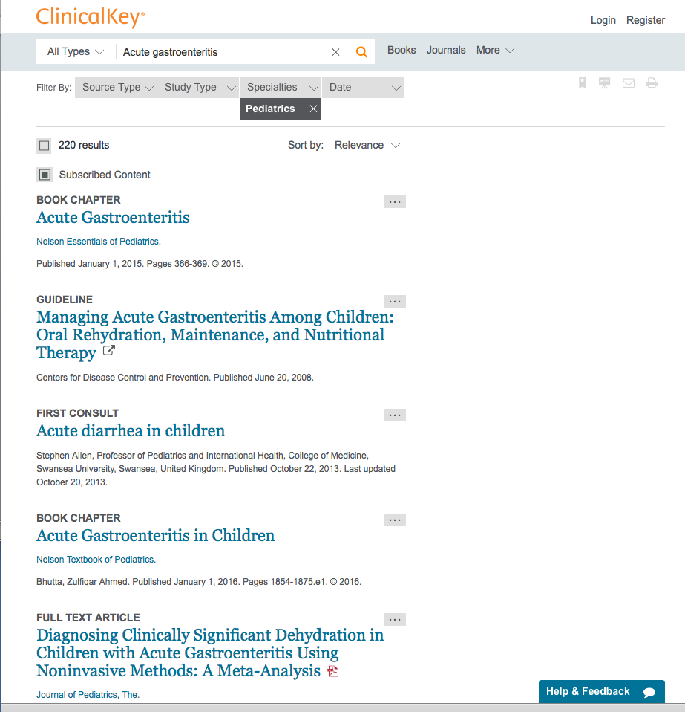
Notes:
This is demonstrating Clinical Key and how one can quickly search drugs/diseases & come up with an array of resources. There is an app that contains no content, but requires a connection to the web. So it is not fast.

Slide 49
P | Disease Reference
 | Lab Reference
P | Calculators
 | Differential Diagnosis
P | Drug Information
uCentral:
5 Minute Clinical Consult, etc.

Slide 50
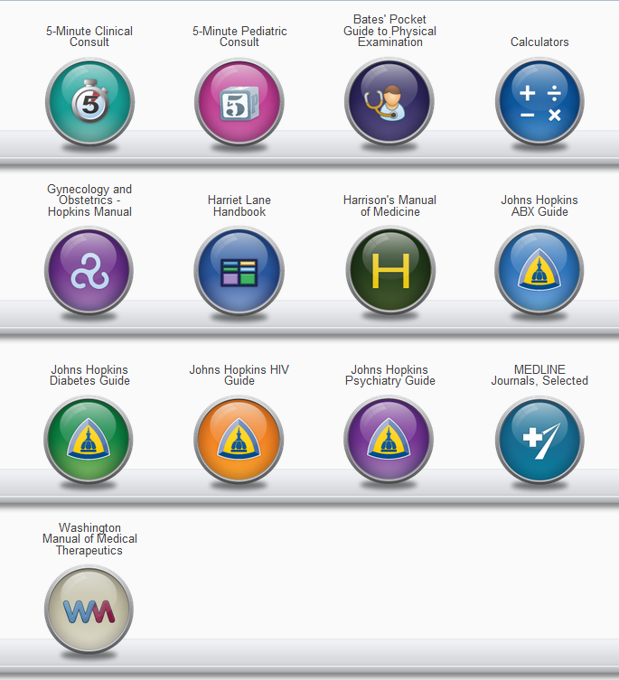
U Central Resources
Bates Guide to Physical Exam
Calculators
Harrison’s Manual
Washington Manual
5 Minute Clinical Consult (5MCC)
Johns Hopkins ABX, DM, and HIV Guides
MEDLINE search
Notes:
Slide 2 –5MCC along with several other highly respected resources, are provided to us by Unbound Medicine. These same resources are available from other vendors. However, we chose to subscribe to these resources with U Central because of their nice mobile app. By subscribing online, we get their mobile version.

Slide 51
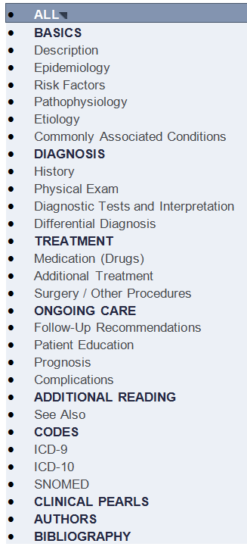
5 Minute Clinical Consult
Ideal disease quick reference
Bulleted lists
Updated annually
Navigation on left
Notes:
Slide 4 – This well organized disease quick reference seems to me to have just the right depth of content for a quick review on any disease or condition or even some chief complaints. The organization is standardized and consistent throughout.

Slide 52
Essential Evidence Plus
P | Disease Reference*
 | Lab Reference
P | Calculators
P | Differential Diagnosis
 | Drug Information
*evidence summaries by disease

Slide 53
Essential Evidence Plus
Evidence based resource for:
Cochrane Abstracts
InfoPOEMS
Summaries of latest evidence on conditions/diseases
Clinical decision/prediction tools
Guidelines
Calculators
Dermatologic DDx (Derm Expert)

Slide 54
EE+ iPhone/iPod
Access EE+ online in mobile formatted webpage. Use Safari. www.eeplus.mobi/m
Requires either a wireless or cell connection to use.
Notes:
NEED TO BE ON CAMPUS to sign up for EE+ to your iphone/ipad/ipod or will not work

Slide 55
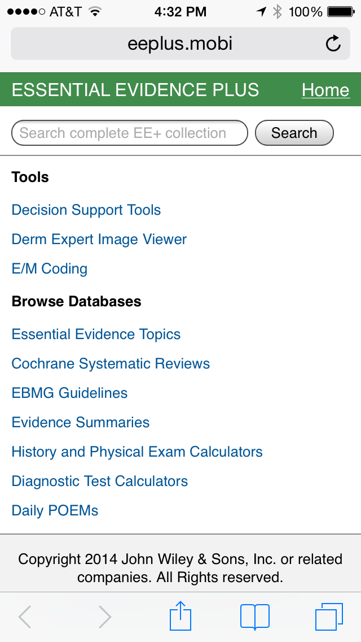
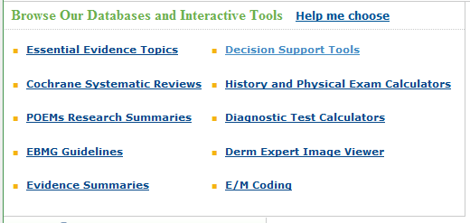
Essentials Evidence +
Web page
See Handout for list of calculators

Slide 56
Derm Expert
Dermatological DDx
Web and mobile
Pick your lump or bump
Drill down to the disease with images
Notes:
REMEMBER Differential Diagnosis at beginning? This is the Derm version Works better on iPad than on line.
On line = select one pix at a time, it doesn’t always download properly & skips pix.
DEMO= blisters , non-umblicated, etc.

Slide 57
Essential Evidence Plus (EE+) Calculators
Few medical equation calculators, many decision rules
Evidence based, translating guidelines into decision tools
Appear in content of keyword search
Separate index of just Decision Support clinical rules and calculators

Slide 58
EE+ Online and mobile
Three Types of calculators
Decision Support Calculators (index)
Diagnostic Test Calculators
History and Physical Test Calculators
Tutorials on how to use under Support online
Notes:
https://www.brainshark.com/wiley/EEPDermCalcs/zDGz6muOnz0z0

Slide 59
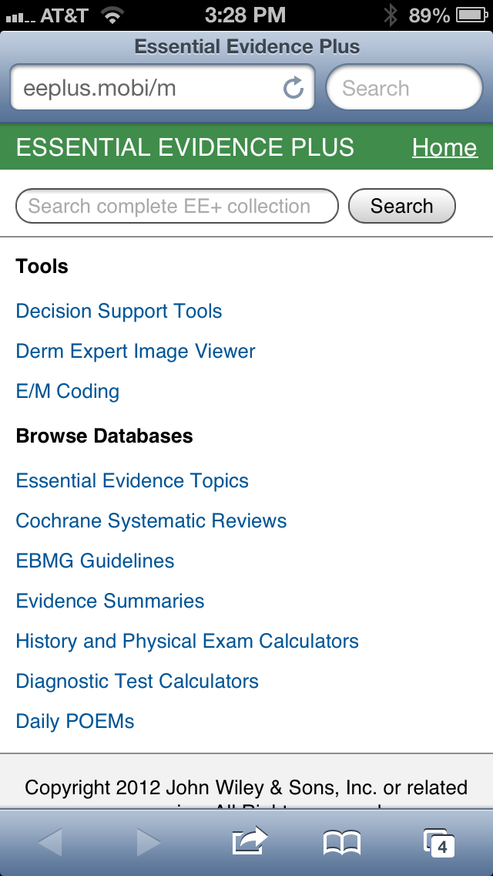
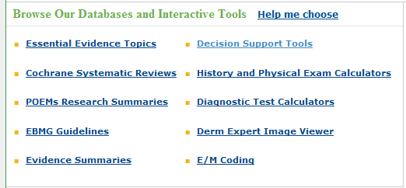
Clinical Rules and Calculators
Link bottom right of Web site
On mobile, First thing under Tools
See Handout for list of calculators

Slide 60
Using EE+ Rules & Calculators
Several ways to locate calculators
Look up a disease and expand section needed (Dx, Tx, etc.) and refine by type of resource
Browse by Resource and select Clinical Rules and Calculators, then drill down to disease
Notes:
Demo Hyperbilirubinemia neonatal

Slide 61
EE+ Decision Support Tools
Some medical equations
Estimate the likelihood of a diagnosis
Calculate risk for disease
Estimate a prognosis
Determine actions

Slide 62
Exercises for Practice
In the ER a 19 y.o. MVA patient is semiconscious. He opens eyes to pain only, mutters nonsensical sounds intermittently, and localizes extremity movements to painful stimuli. What is his Glasgow Coma Scale score?

Slide 63
Exercises for Practice
According to the EE+ Screening: cardiac risk profile (Framingham data) tool, what is the Framingham 10 year risk of Miocardial Infarction (MI) for a 64 yr old man with the following cardiac risk factors:
BP 126/86, Total Chol 188, LDL 111, HDL 42, Smoking? Yes, Diabetic? Yes

Slide 64
Pediatric Care Online
P | Disease Reference
 | Lab Reference
P | Calculators*
 | Differential Diagnosis
P | Drug Information
*Online Only

Slide 65
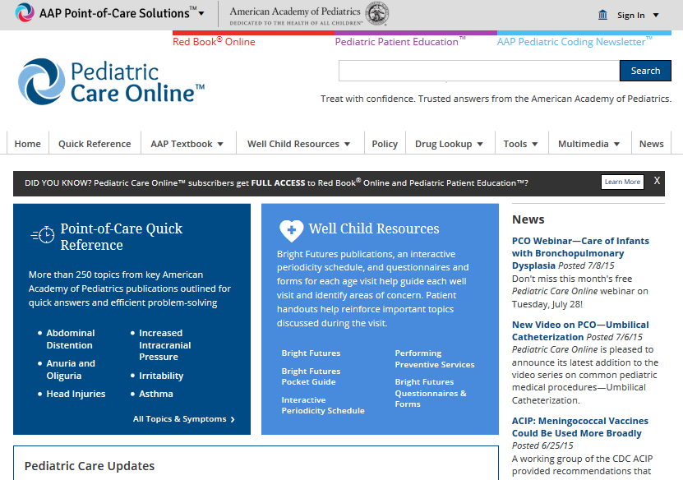
Pediatric Care On-line
Notes:
ON your handheld device you can select what you want downloaded. Would not recommend antibiotimicrobial therapy guide – not great x handheld – mostly drug classes. D0 Bilirubin calculator
Bright Futures Pocket Guide
Bright Futures
Point of Care Quick Reference
Pediatric Care Umobilete
Interactive Periodicity Schedule

Slide 66
Using Mobile Resources with Patients
Patients think you are texting or taking photos
Reassure patient you are not
Tell the patient what you are doing (looking up patient’s medications, interactions…)
Share information found
Maintain eye contact with patient as much as possible
Message given to students on using technology with patients.

Slide 67
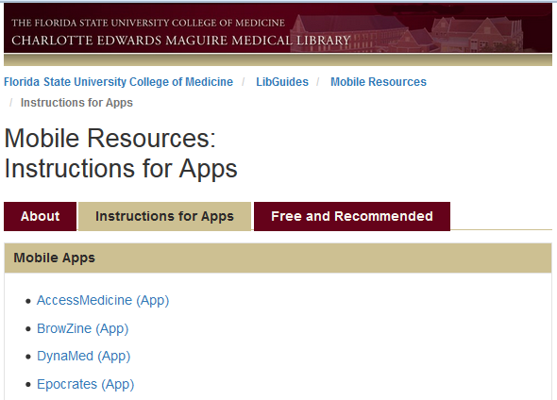
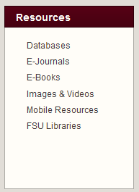
Getting the CoM Apps
On the Library page > Mobile Resources

Slide 68
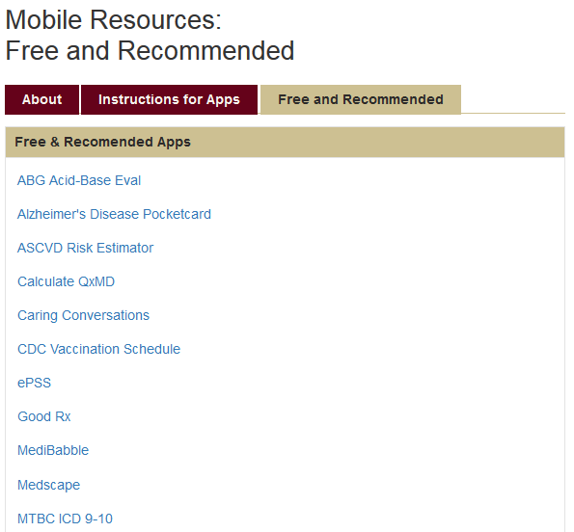
Some Free Decision Support Apps
On Mobile Resources Site
List of Free Apps recommended by our faculty

Slide 69
In Summary
Great resources for decision support are available to you
Help teach students to use them by modelling their use
Involve student in decision making process
Always adding new resources
Notes:
We have covered the Drug Resources in the last workshop. We have now provided you with a wide variety of decision support tools to complement those resources. As all seem to have disease information, you should pick based on your comfort with the resource as well as the depth of information you are seeking.

