Slide 1
Introduction to the Maguire Medical Library Online and Mobile Resources
, MD
Regional Campus Informatics Director
Nancy Clark, M.Ed.
Director of Medical Informatics Education

Slide 2
Handouts
PowerPoint slides
Syllabus
Evaluations

Slide 3
Objectives for Session
Learners will
Access and navigate the library web site
Find an eBook or eJournal
Use a drug and decision support resource
Find a patient education handout
Find mobile resources
Get help: online or a person

Slide 4
Goals of Virtual Library
Excellent service
Collection relevant to curriculum & research
99.9% electronic
Instant, seamless access, 24/7
Notes:
We can’t say we are unique in the library field in having “excellent service” as a goal but we put it first and foremost in our list because everything else depends on a strong service philosophy.
We work very closely with education directors, clerkship directors and faculty, both in curriculum and other college committees, and during one-on-one research consultations. We work with students who search side by side with us to locate information for papers and research projects – they with their laptops and we at our desks. Because of these opportunities to work closely and directly with the people we serve (you! And your students!), our collection is relevant to the COM curriculum and research interests.
We are 90% electronic – probably closer to 95%. With students and faculty located throughout Florida and with no interest in investing in the past, we collect only core medical reference and reserve books in print, especially for the regional campus reading rooms at each RMC. Everything else is electronic.
Since 1995 when the internet arrived on the scene, instant, seamless access has been our dream goal. Imagine searching Google and locating all books and journals in full text and everything is interlinked. That is where we are headed and we are getting closer all the time. Until then, it is important to think of library resources by publisher or vendor. To get Harrison’s Principles of Internal Medicine, Current Medical Diagnosis and Therapy, Goodman and Gilman’s Pharmacology and other books published by the McGraw-Hill company, the Medical Library licenses these resources directly from the publisher. In other cases, several publishers allow their books to become available to libraries by going to the OVID company. Think department store and how some department stores don’t call all brands or how some brands are less expensive from specific stores or outlets. DSM-V example. LWW e-book example. An understanding of this basic principle will go a long way to your understanding of how to navigate the post-Web medical library!

Slide 5
Finding the Library Web Site
Open a web browser
Type in URL www.med.fsu.edu
Top of page, click on Library
Bookmark site: IE Favorites Menu, Add to Favorites
Notes:
Please use the computer to open the library website. The easiest way to access the library is to go to the college of medicine home page, www.med.fsu.edu. These computers are set to go to Google. Type in on the address med.fsu.edu. Wait until everyone gets there. Now at the bottom of the page click on Medical library
On these machines the browser that is available is Internet Explorer. The icon is a blue lower-case letter ‘e’ with sort of an orbit path crossing it diagonally.
The address bar near the top is where you type http://med.fsu.edu.
Find the navigation bar at the bottom of the page and click on Medical Library.
You will want to find it more directly next time, so save the link in your Favorites.
Click on the word ‘Favorites’ in the top menu bar. Then click on ‘Add to Favorites...’ Then click ok in the box that comes up.

Slide 6
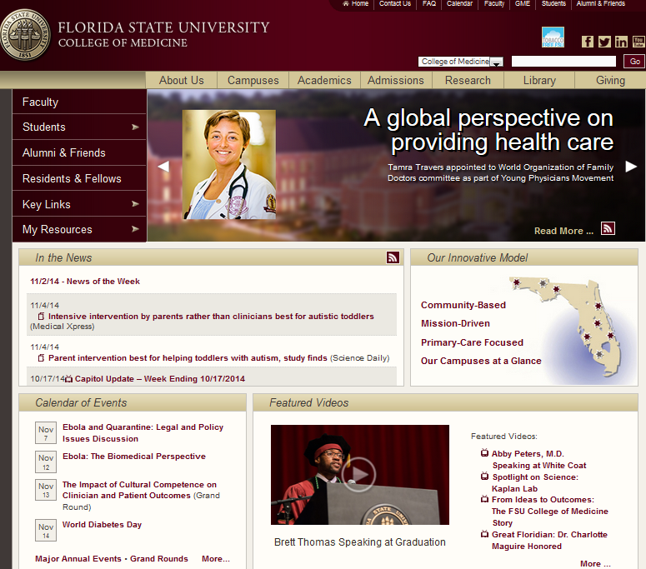
www.med.fsu.edu
Notes:
You have been hearing a lot about the library – how do you get to it?
On the FSU College of Medicine home page, there is a link in the navigation bar at the bottom of the page.
It’s the third from the left.
Let’s try it.

Slide 7
24/7 Access to Resources
>2400 medical eJournals (millions of articles)
Hundreds of clinical eBooks
Evidence-based medicine resources and Guidelines
Disease, drug, images and patient education resources
Mobile versions of web resources
Web-based course materials
Notes:
Right now, speaking of seamless access, you can sit at your desk and access 3 million medical articles. It’s like having a filing cabinet filled with articles or a bookshelf with 1000+clinical handbooks, textbooks and manuals, all indexed for immediate access from your computer.
In addition to e-journals and ebooks, there are many resources that are collections of clinical and evidence-based guidelines, image files and patient education resources. There are search engines that are specific to medicine. One such search engine that we use and teach our medical students to use is called Medical Matrix. The people at Medical Matrix review and rate quality medical resources both free and those to which we subscribe (as well as others that charge subscription rates but not subscribed by the Maguire Medical Library).
Over 200 databases including those in psychology, law, social sciences, education and general literature round out our collection…

Slide 8
Who May Access Resources?
All CoM faculty with appointments
Full and part time
All CoM students and residents
All CoM staff
Who can’t? (legally)
Faculty clinic staff
Affiliated hospitals
Alumni
Notes:
All College of Medicine faculty, students and staff including faculty preceptors have access to all that the Medical Library and FSU general university library resources, and visa versa!
The only people who cannot access our resources are those who do not have an official position (employee, student, faculty member) with FSU. This is not an arbitrary decision but one that has everything to do with the legal responsibility we have to comply with licenses signed by us and by the university at large. Those who are not currently students (our alums for instance) fall within this category, as do hospitals since hospital employees with whom we are affiliated are not FSU employees, and office staff who are paid by you or your broader organization/company.

Slide 9
Off Campus Access
IP authentication
FSU CoM ID and password
firstname.lastname
$fsumed$xxxx [xxxx = last 4 SSN]
Use links on library page
Notes:
But first, let us make sure you know how to access the library web resources from off campus. Just because you can see the web site, does not mean you can actually pull up anything. Our web subscriptions verify that the users of our library resources are from FSU by means of what is called IP authentication. This is the internet address of the computer you are using to access the internet. Our campuses have a range of numbers that are assigned to computers that are logged on, and this range of numbers is provided to the vendors to use for authentication. Anyone using the library from off campus must fool the vendors (this is not illegal) by using their college of medicine user ID and password to sign into a proxy server first, then using the resource through this server. To do that, from the top of the library web page, click on Off Campus Access (EZProxy).

Slide 10
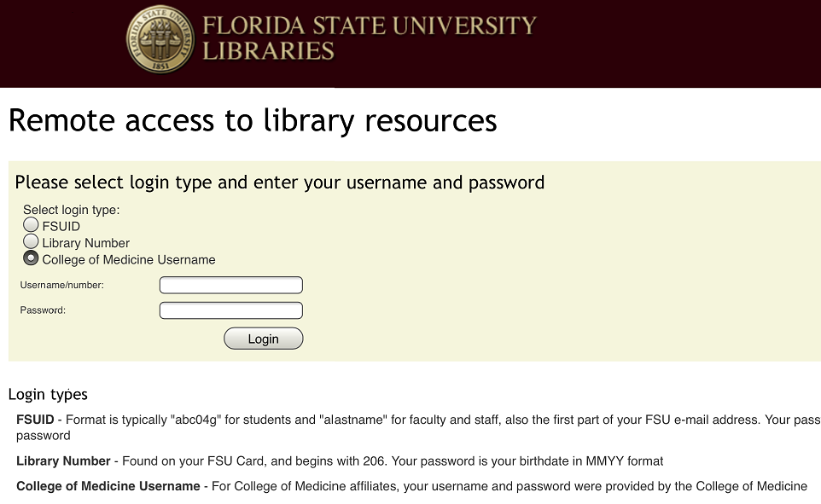
Off Campus Access
Check College of Medicine Username and log in
Notes:
But if you forget to click on the Off Campus Access button before you start browsing, when you click on any subscription resource, you will be brought to this page and asked to log into the remote access proxy. Once you have logged into the proxy server, you should not have to do so again during this session. If you close your browser or reboot your computer, you will have to log in again. Just be sure you have clicked the College of Medicine button before putting in your CoM credentials.

Slide 11
Username and Password Issue?
If your user name and password doesn’t work…
Regional Campus Faculty: Call your regional campus IT coordinator
All others: Call the Central Campus IT Office (850)644-3664 7:30 AM to 6:00 PM Monday – Friday
Notes:
Because we are on campus, the library will not bother to ask you to log in to access our resources. If you want to verify your username and password work, you can use your smartphone with the wifi off and try to access a library resources on the browser. If you have any problems logging in, don’t remember your username and password, call the regional campus IT support person. He can reset your password or make sure you are in the system.

Slide 12
Alert Regarding Off Campus Access
Starting in the Summer of 2016
Must use FSU-ID to log in
Used for Blackboard and OMNI
If you do not know your FSU-ID and password, contact your regional campus IT support person.

Slide 13
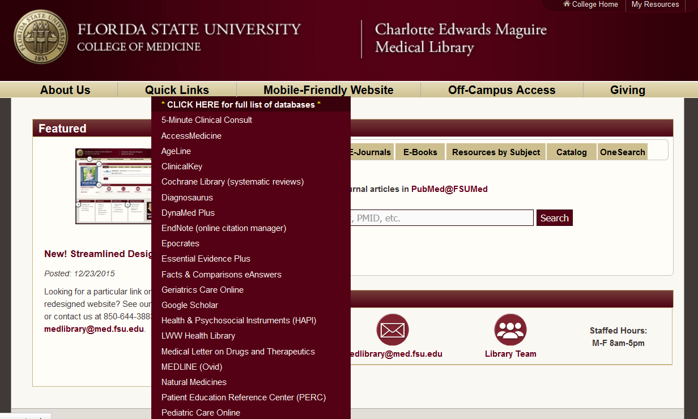
Quick Links to Major Resources
Intro to Medical Library Resources
13
Notes:
13
The Quicklinks drop down highlights the resources most often used, but by no means represents our entire collection of databases. If you wish to see the entire list, click the link on the Quick Links box to the entire list of databases.

Slide 14
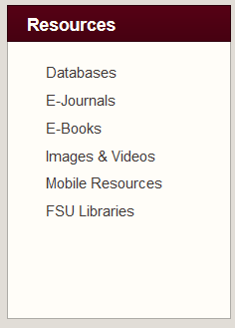
Complete List of Resources
Found under Resources > Databases
Linked in Quick Links
“Click Here for Full List of Databases”
Notes:
14
This list is daunting. We include this list, largely for those users who have been with us from the beginning, who have identified the resource they want, use it frequently, and want to go directly to that resource from the library web site after signing into EZProxy. It is likely that these are one of what we refer to as our major sites: those that have a variety of resources (like journals, books, images…) Hopefully, as a result of this course you will pick your favorites, and use this list the same way our established users do.

Slide 15
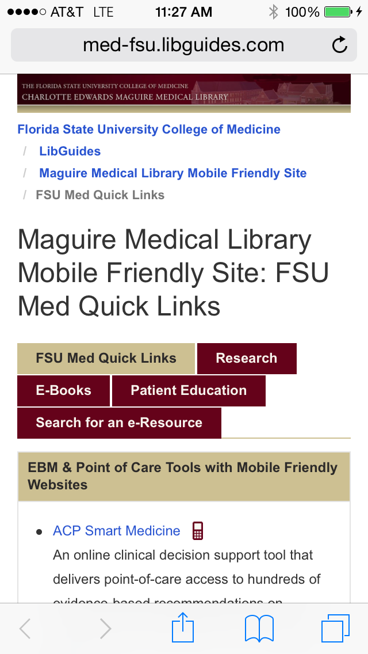
Mobile Friendly Website
Ever-increasing number of resources in mobile friendly format
Use on smartphone to access many mobile friendly resources
Notes:
MedResources map is gone
If you want to access the library on a smartphone, we recommend using the mobile friendly version of our library site. This links to only those resource websites that are also formatted to be used on a smartphone. The link at the top of the library will take you there. Note that is does not look “right” on a computer or iPad screen.

Slide 16
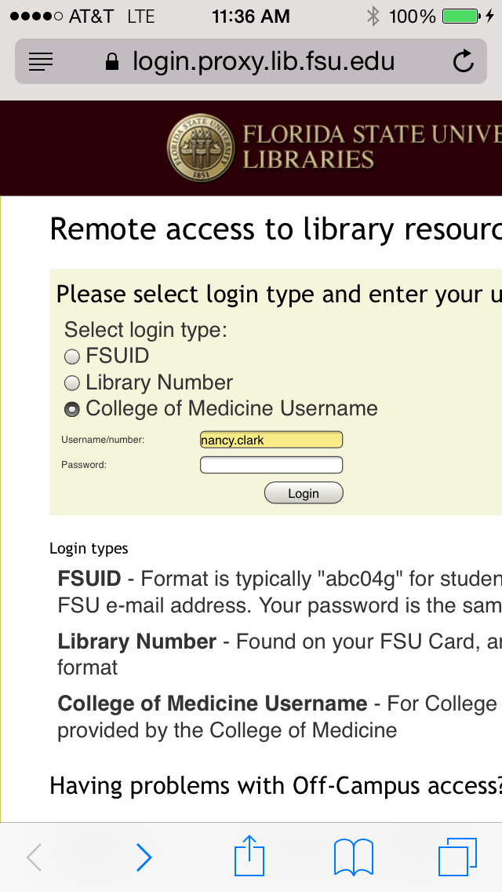
Off Campus Access
Uses Remote Access just like regular library website.
Will ask when you try to open a resource
Log in with CoM username and password
When asked, tell it to remember your password
Notes:
Keep in mind that the same rules apply if you are off campus using the mobile friendly resources. These aren’t apps. Their content isn’t loaded on your phone. You have to have a cellular or wifi connection to the internet to use these, and if off campus, must log into the off-campus access with your COM username and password.

Slide 17
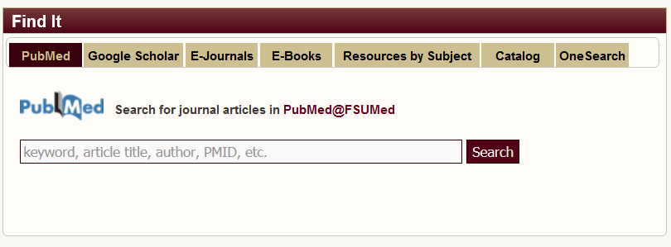
Search Tools
Notes:
Use PubMed for journal articles
Use Google Scholar for journal articles
E-Journals for Journal Titles
E-Books for Book Titles
Catalog for all FSU Libraries
Use OneSearch to search all of the FSU University Libraries’ collections
[there is a Section in Syllabus on this is a good resource for explanation]. Use this search section to start a Pubmed search, Google Scholar search, or look for a specific journal or ebook. We will talk more about those.
New OneSearch is a discovery tool that searches across most of FSU’s books, journals, articles, and more, including some materials outside the FSU collections. OneSearch also searches College of Medicine e-books and e-journals. It gives you almost too much information.

Slide 18
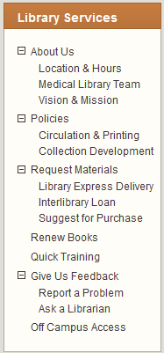
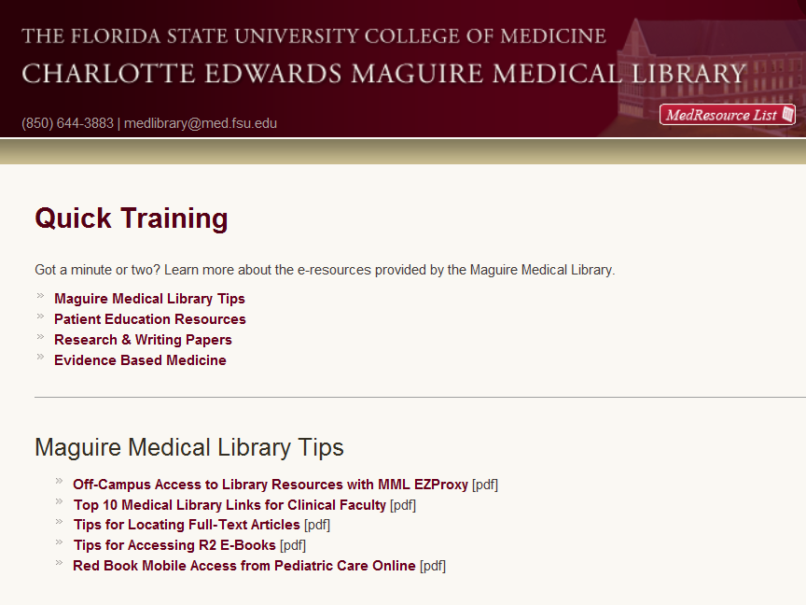
Get Quick Training
Notes:
Tutorials: Now labeled as Quick Training. These are the same wonderful 1-3 minute how-to modules we have always enjoyed. Will mention that the name had to be changed because of ‘Generational Differences’. No self-respecting under 40 year old would ever click on anything that said ‘Tutorial”. The word ‘Quick’ is bait for the younger clinicians and students, they know it and are okay with it.

Slide 19
Getting Help From a Librarian
Contact us
E-mail medlibrary@med.fsu.edu
Call
Voice: 850-644-3883
Fax: 644-9942
Interlibrary loan under Request Materials
Notes:
There are several ways to contact the librarians. You can send an e-mail, make a phone call, come in person or e-mail the medlibrary#med.fsu.edu e-mail. Probably the quickest way to get assistance is to e-mail the medlibrary as there always folks watching the account.

Slide 20
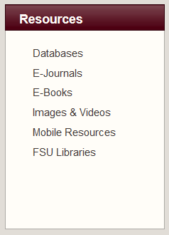
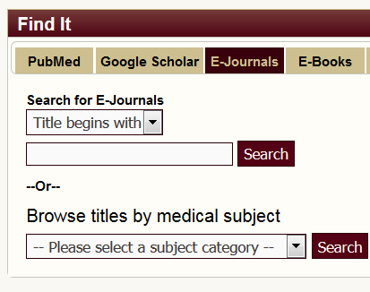
Finding eJournals
Notes:
20
The number of journals has increased to the point that the Maguire Library can’t maintain a separate list of just medical journals. So now, the e-journals link under Resources pulls up a search page. We will dedicate one workshop to doing a MEDLINE search and finding full text journal articles to answer clinical questions. This is extremely time consuming, not to be attempted during patient care. However, our resources of 3 million full text journal articles gives you access to the research, in case you want to spend the time after hours to dive into the latest research on some disease or condition of interest to you because of a special patient, a talk you might agree to do, or even an article you decide to write.
Find a journal of interest to you.
If you know which journal you would like to check to see if we subscribe, under Search all FSU e-journals by title. Under “title contains” put in a couple of words.
You can browse the ejournals by specialty to see what we have in your field.

Slide 21
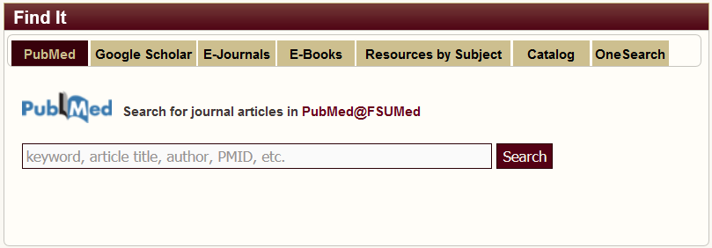
Topic Searching all eJournals
Pubmed searches linked to full text
See tutorial on Pubmed searching
Find@FSU button in abstract view linked to full text article or interlibrary loan
Notes:
Search Engines:
Pubmed searches NLM MEDLINE database and is linked to our subscription journals so that you can follow the trail with one click to the full text article. Our librarians are committed to get you a copy of any full text article you might need. However, you can pretty much find an article yourself using this interface. The Red FSU bar on the article page in Pubmed links you to the full text articles.
Change the Display Settings to “Abstract” to see the bar.

Slide 22
Find@FSU Button
When full text is not available, the link will direct the user to interlibrary loan options.

Slide 23
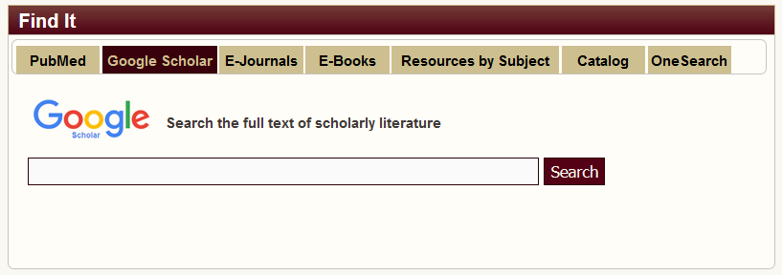
When Article Not There…
Pubmed Linked to full text? No…
Search Google Scholar for Title first
Then request an Interlibrary loan for title not owned by FSU
Contact MedLibrary@med.fsu.edu
Notes:
Just because there is no red button, don’t give up on finding an article. In case there is no red button, you can try a couple of things before you submit an interlibrary loan request to our librarians. If you will highlight, copy and past the title of the article into a Google Scholar search, if the article is available to FSU, it will probably come up. If not, you can search the eJournals search box for the Journal Title. See if and what dates we have electronically. Sometimes if the article is too old, it isn’t available electronically. When all else fails, ask the librarians to send you the article.
The Interlibrary loan request form is under Library Services at the bottom left of the library page.

Slide 24
New CoM Published Journal - PLAID
PLAID is an open access, peer-reviewed, interdisciplinary research journal focused on people living with and inspired by diabetes. http://theplaidjournal.com/
Notes:
PLAID is an open access, peer-reviewed, interdisciplinary research journal focused on
people living with and inspired by diabetes. PLAID includes research and perspectives
that encourage dialogue between healthcare professionals and people living with
diabetes. PLAID aims to gain from the insights of individuals, families, friends,
colleagues, advocates, healthcare professionals, and researchers who work to raise
awareness of and create solutions to the complexities of living with diabetes.

Slide 25
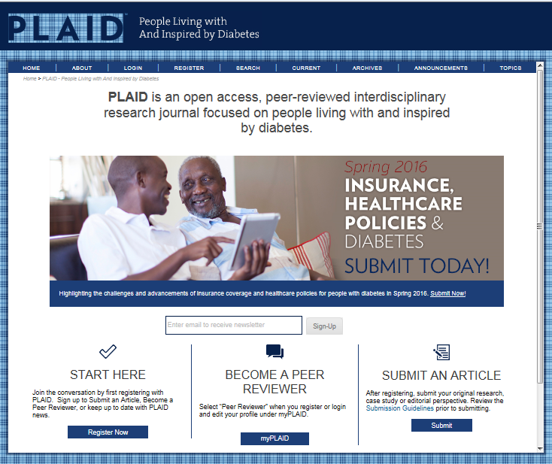
Notes:
We are soliciting COM faculty to be peer reviewers for the PLAID journal and to contribute articles to this unique journal.

Slide 26
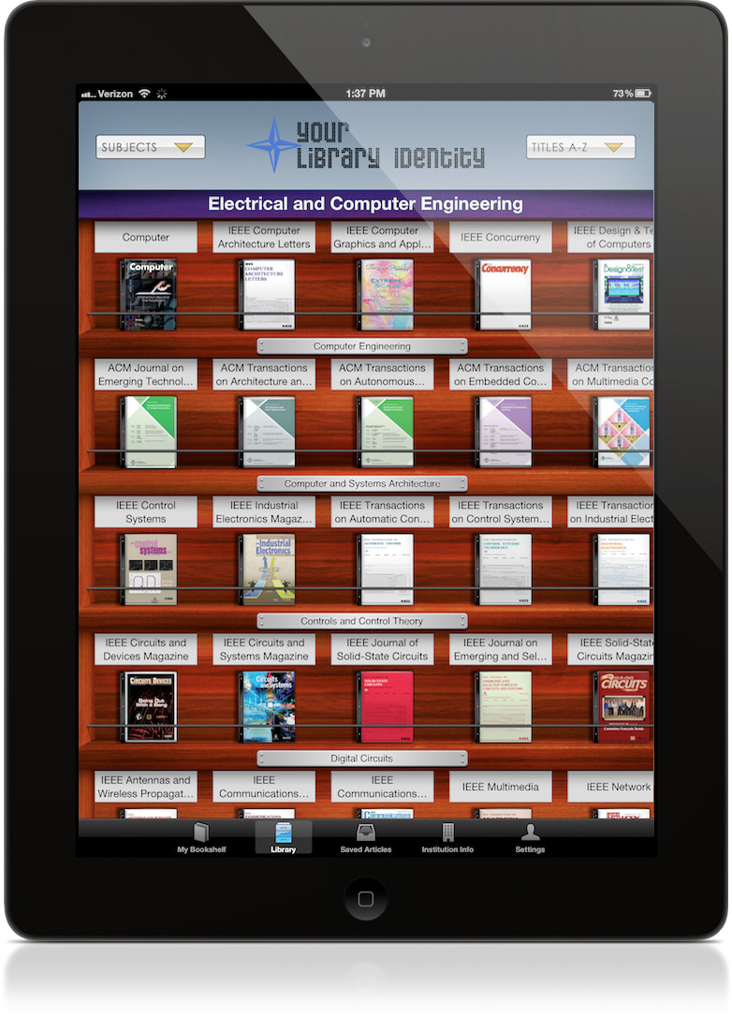
BrowZine
Journal e-reader
Select most FSU COM Journals to read
Use online, tablet and phone; sync your bookshelves
Allows saving articles to read offline
Notes:
Is available online and for iPad, Android Tablets, iPhone and Android phone. It allows you to view journals as they are published, and read them electronically. You pick out the journals you want to follow/read, and put them on your bookshelf. Then sync online/tablet/phone. Must create an account first. Instructions are in a handout.

Slide 27
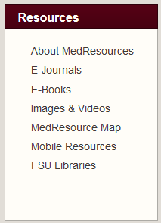
Finding eBooks
Using FSU Main Library system
Search for a title
Currently browsing by specialty is not possible
Watch for a new process
In Transition
Notes:
27
Once again, because of a huge increase in the number of books we have available, the library no longer maintains a separate list of medical books, but now rely on the main FSU library to catalog these books. We use their search engines to find books you may want. We are hoping for a more friendly interface to these that will allow us to browse the books by specialty, but at this time do not have one.

Slide 28
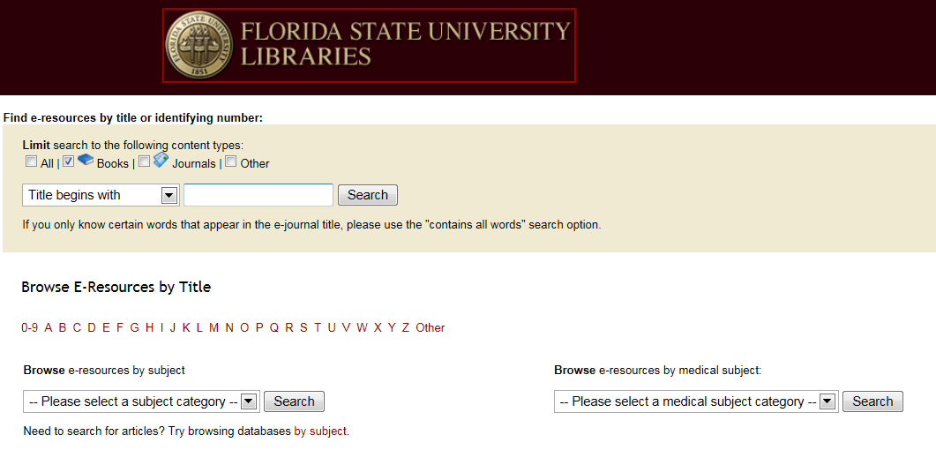
eBook Search Page
Change to “Title Contains”
Notes:
If you know the book you want, search for it using a few words in the title.
Again, suggest they use Title Contains instead of Title begins with.
Browsing doesn’t work. Tried the medical subject category and get nothing for things like endocrinology or gastroenterology.
The best strategy for browsing books to find books on topics of interest is to use the browsing functionality of the major book resources: Clinical Key, Access Medicine, OVID and uCentral.

Slide 29
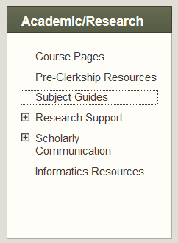
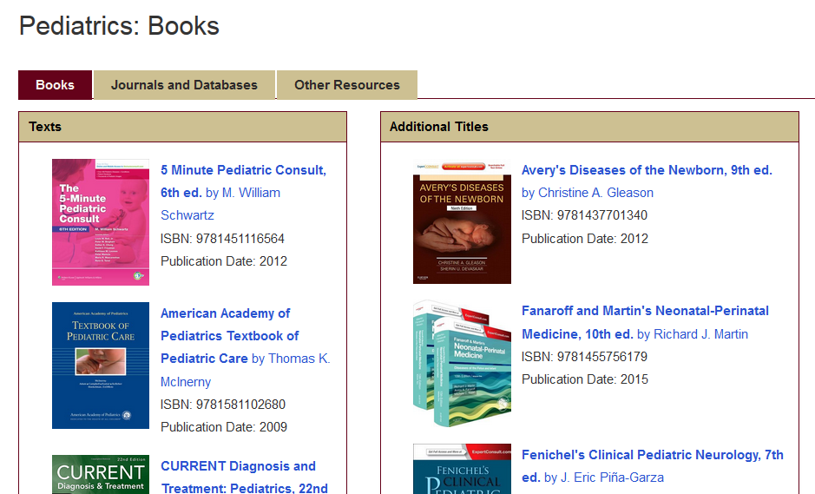
Subject Guides
Links to pertinent textbooks, journals and medical web sites for each specialty.
Replacing Course Pages – with curriculum revision
Notes:
We are in the process of developing subject guides that will provide links to the most important books and journals for the specialty. So far they have them for each clerkship and a few elective topics.

Slide 30
Using Major Resources
Contain multiple types of resources
Books
Journals
Drug
Patient Ed
Videos
More…
Clinical Key
Access Medicine
uCentral
Specialty:
Pediatric Care Online
Geriatric Care Online
Psychiatry Online

Slide 31
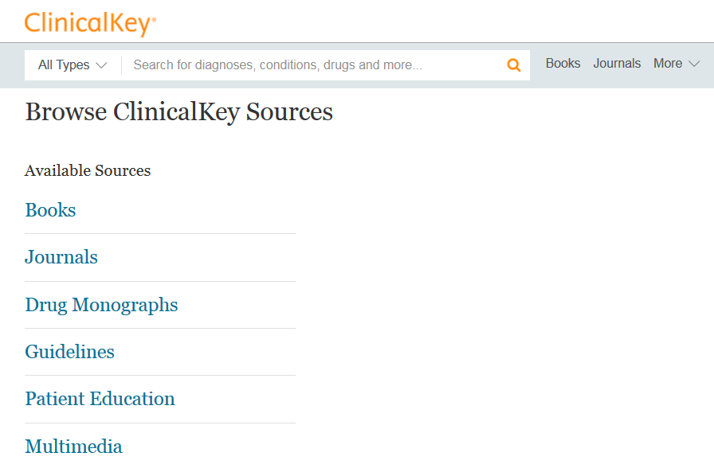
Site is Mobile Friendly
Notes:
Let’s play with Clinical Key

Slide 32
Clinical Key
Replaced MDConsult (Elsevier)
Books: 1,100 medical and surgical reference books
Journals: 600 medical and surgical journals
Procedures Consult: procedural videos in various specialties
First Consult: more than 850 Point-of-Care clinical monographs
Drug Monographs: some 2,900 clinical pharmacology drug monographs from Gold Standard
Patient Education: 15,000 customizable handouts
Clinical Trials: all trials from the ClinicalTrials.gov database
Practice Guidelines: 4,500 practice guidelines

Slide 33
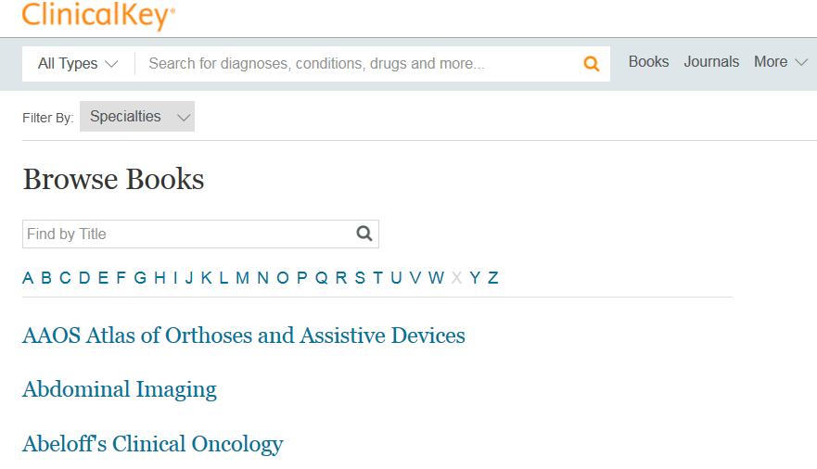
Browse Books
By Specialty

Slide 34
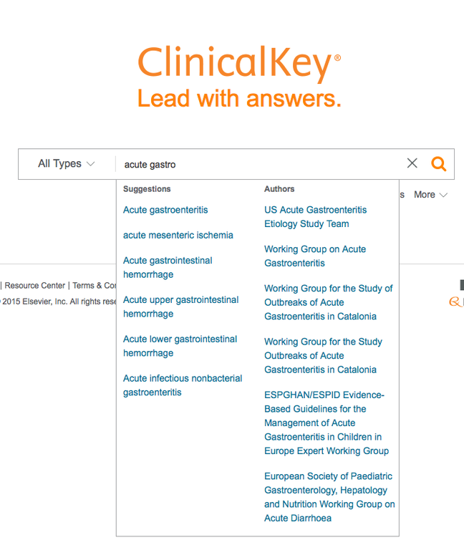
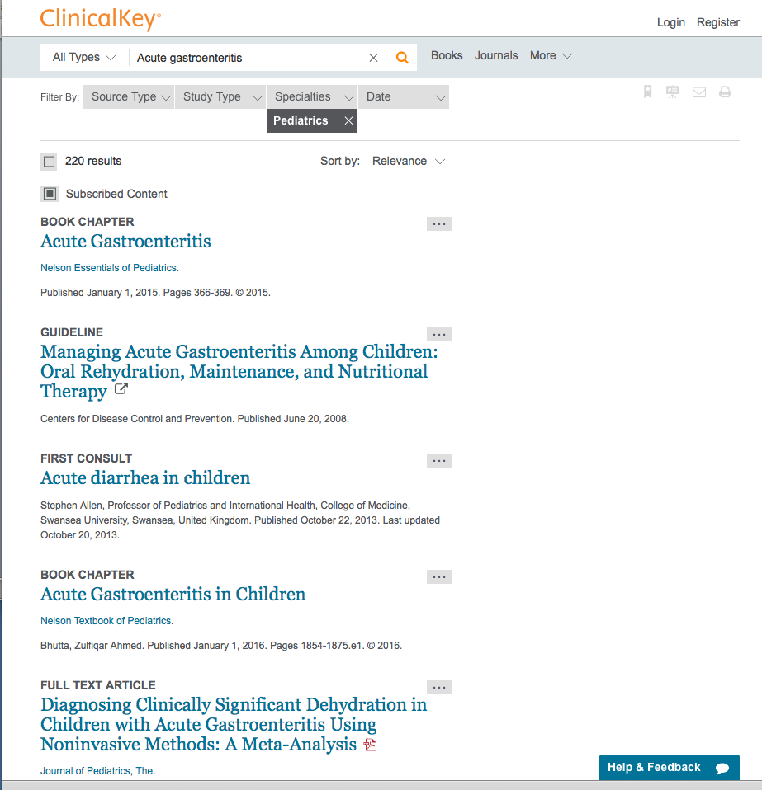
Search Topic and Limit to Specialty
Notes:
This is demonstrating Clinical Key and how one can quickly search drugs/diseases & come up with an array of resources.

Slide 35
Clinical Key eBook Interface
TOC only; No index
Search site, books, or this book
Notes:
As of Nov 2014, we have just acquired Clinical Key as Elsevier’s replacement for MDConsult. It contains 500 of Elsevier's journals, 1000 books, and 9,000 medical and procedural videos, which is several times the number of books that were in MDCONsult, and the interface is quite a change. At this time, the librarians are adding the books to the ebook list on the library page, but that is going slowly as there are several hundred books in this collection.

Slide 36
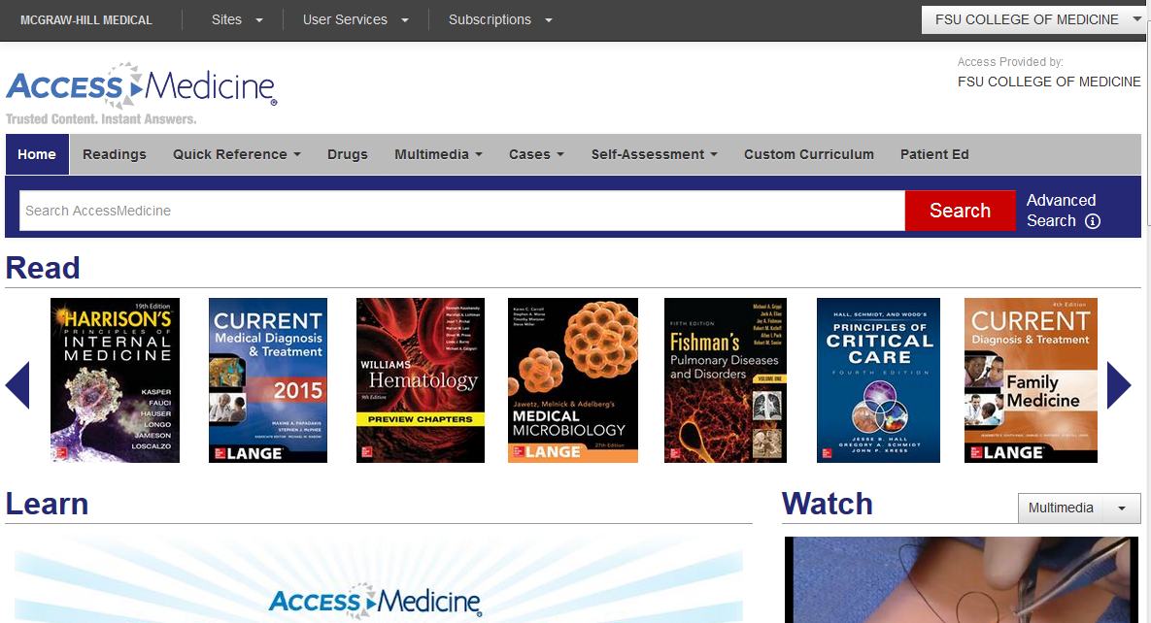
Access Medicine
Site is Mobile Friendly
Notes:
Access Medicine contains all McGraw Hill resources, You can browse books by specialty,

Slide 37
Access Medicine – McGraw Hill
Textbooks (Readings) 85, Harrison’s…
Multimedia and Images – extensive
Diagnosaurus
Multiple Quick Reference Tools
Self Assessments and Cases
Patient Ed Handouts (7000)
Drug database

Slide 38
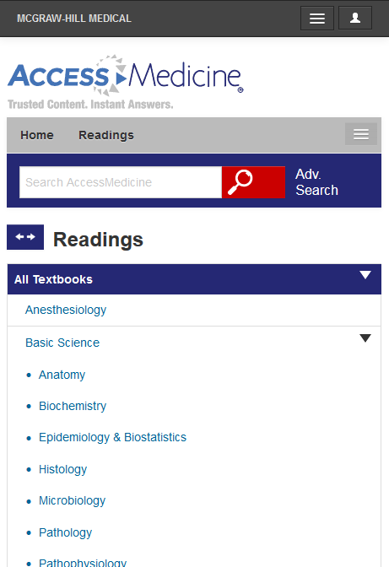
Access Medicine Books
Use Advanced Search to search one book, some or all books
Browse Readings by specialty
Notes:
The interface in Access Medicine is mobile formatted to make it easier to use on an iPad. Here, you will find Harrison’s Online, Current Diagnosis and Therapy, both of which are constantly updated instead of presented in the latest static edition. Indices are sometimes at the end of the Table Of Contents. You will find Goodman and Gillman here as well as Hurst’s the Heart, William’s. Obstetrics.

Slide 39
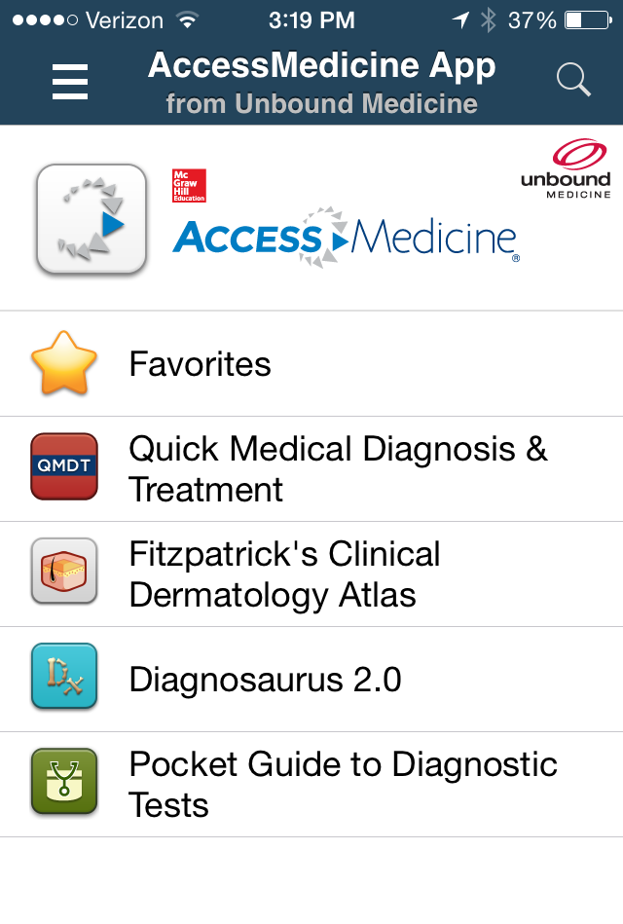
Access Medicine App
Quick Medical Diagnosis & Treatment
Fitzpatrick’s Clinical Dermatology Atlas
Diagnosaurus
Pocket Guide to Diagnostic Tests
Requires 90 day authentication
Has a separate tablet version
Notes:
The Mobile friendly web site may be a better choice because of the huge added content. like all the Current Diagnosis & Treatment books and Harrisons, Fitzpatrick, Williams, Goodman & Gilmans, etc. The link to their mobile friendly web site is in the Mobile Library site. However, this app is developed by Unbound and is very user friendly. The images in Fitzpatrick are excellent.

Slide 40
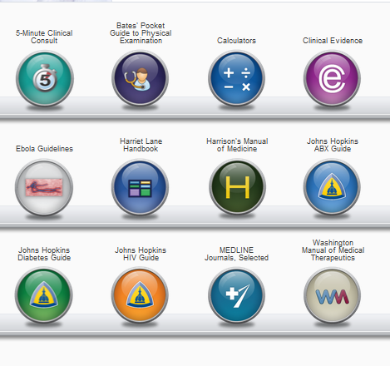
U Central Online and App
Collection of books and manuals
Calculators
New additions include:
5-minute Pediatric Consult
Johns Hopkins Manual of Gynecology and Obstetrics
Johns Hopkins Psychiatry Guide
Notes:
Slide 2 –5MCC along with several other highly respected resources, are provided to us by Unbound Medicine. These same resources are available from other vendors. However, we chose to subscribe to these resources with U Central because of their nice mobile app. By subscribing online, we get their mobile version.

Slide 41
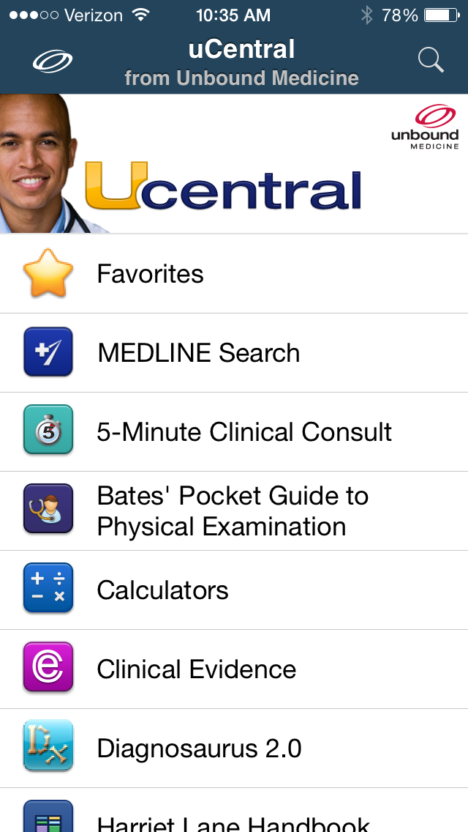
uCentral Resources Online and App
5-Minute Clinical Consult
5-Minute Pediatric Consult
Bates’ Physical and Hx Taking
Calculators
Harriet Lane
Harrison’s Manual of Medicine
Johns Hopkins ABX Guide, Diabetes G, OB/Gyn, Psych, and HIV Guides
Washington Manual
Medline search
Notes:
The library is adding resources to this bucket all the time. This interface is very easy to use. (There is NO Mobile friendly uCentral site. YET.)

Slide 42
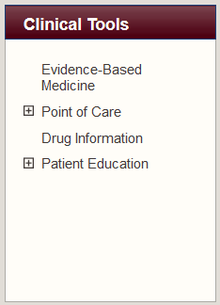
Clinical Information Needs
Organized by Topic
EBM
Point of Care Decision Support
Drugs
Patient Education
Notes:
Let’s look at the clinical Tools.
We consolidated all of the clinical tools into one area divided up into four Sections: Evidence Based Medicine, Point of Care Decision Support, Drug information and Patient Education.
Let’s look at some of these and play with a resource under each.

Slide 43
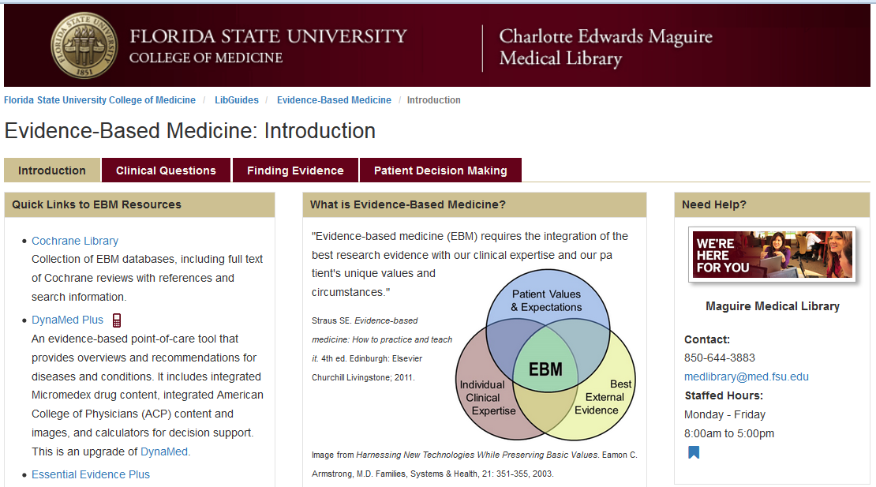
EBM Resources
Notes:
Let’s try out some of the different resources you have available to you. First, expand EBM Tools at the bottom of the page and click on Summaries. These are all resources that have summarized the latest evidence on diseases and conditions into friendly resources. There are also resources with Guidelines, Reviews of the literature and instructional resources on evidence based medicine.
We will be doing a workshop on using EBM resources that will cover each of these areas.

Slide 44
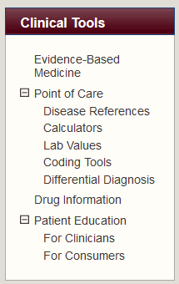
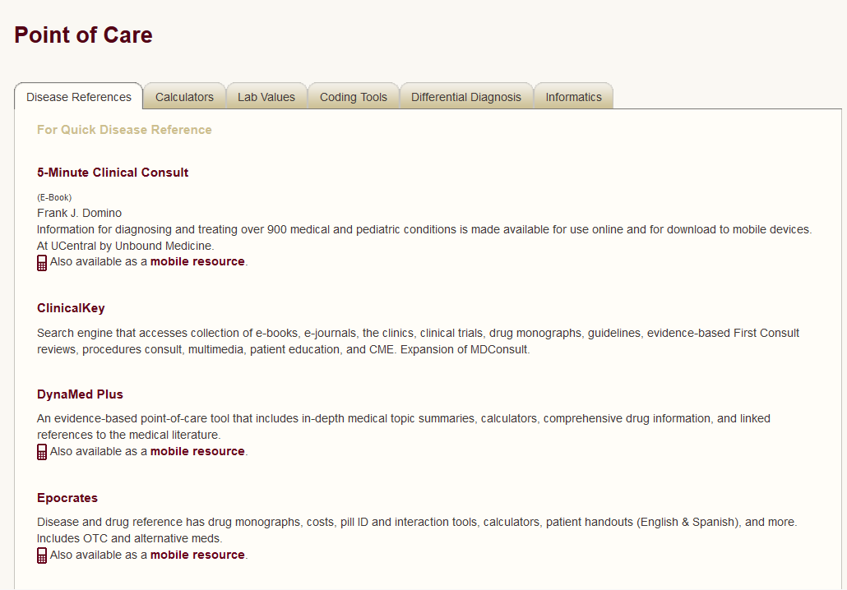
Point of Care Resources
Notes:
Now at the bottom, expand the Point of Care and click on Disease References. Here you will find separated out resources with disease information, calculators, lab manuals, coding tools, and ddx tools. We will be doing a workshop on decision support tools that will cover all of these resources. Let’s look at the first disease reference listed, which is Dynamed.

Slide 45
Dynamed Plus
Constantly updated review of literature and guidelines organized by topic: diseases, drugs
Calculators from MedCalc 3000
Micromedex drug monographs
Images
Links out to articles subscribed at CoM and reviews if more details needed
Available online and mobile app
Notes:
Describe Dynamed as the most comprehensive and current disease resource we have. The web site is mobile formatted if accessed on a smartphone browser!! Apps available for all iOS and Android platforms. No longer in Skyscape, so if they still have it there, need to download the new app.

Slide 46
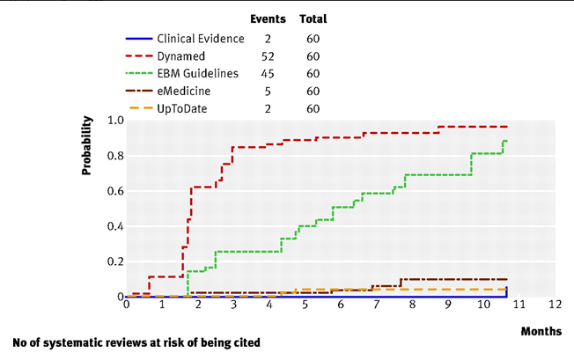
Dynamed Most Current Dx Resource
Banzi R, Cinquini M, Liberati A, et al. Speed of updating online evidence based point of care summaries: prospective cohort analysis. BMJ. 2011;343:d5856.
Notes:
Recent (2011) article in BMJ comparing Dynamed with UpToDate and other disease resources finds DynaMed to be the most current point-of-care resource and the best overall “Disease Reference” resource. They were looking at Cochranes and other systematic reviews of the literature, which are the highest level evidence for diagnosis and treatment and the frequency with which they are added upon release to the resources.

Slide 47
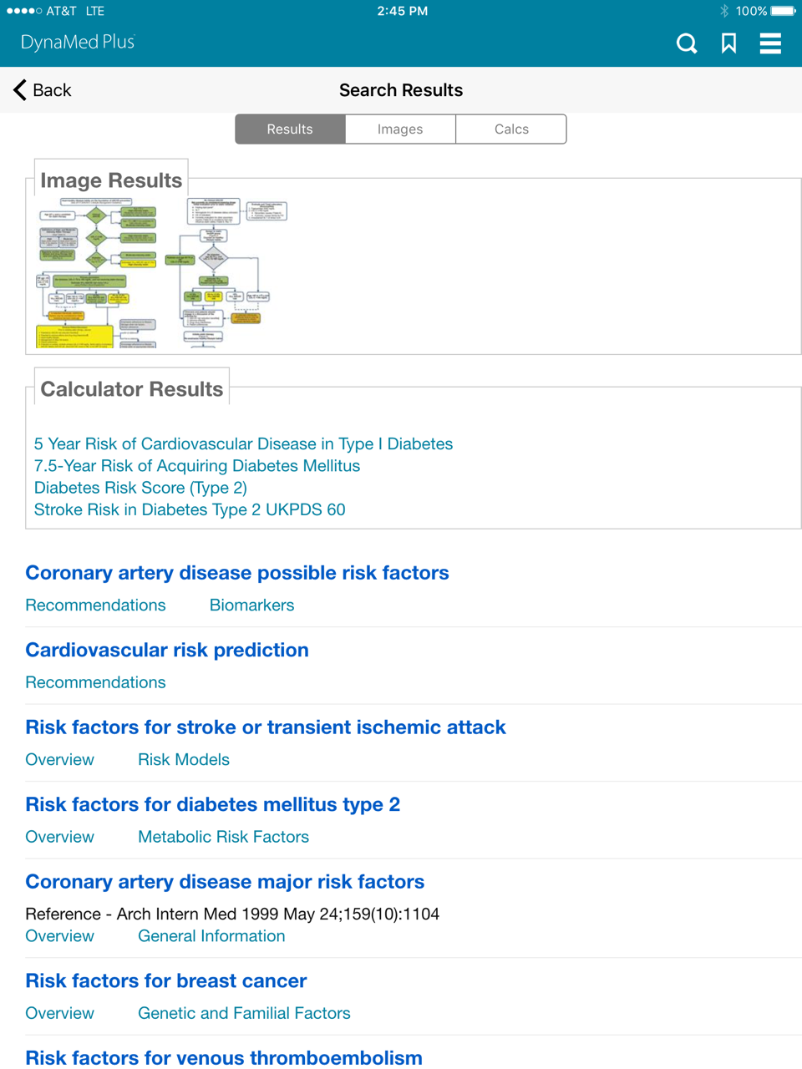
Using Dynamed Plus
Search for terms like: diabetes risk
Results include images, calculators and topics
Notes:
Go there and demo. Let audience follow along.

Slide 48
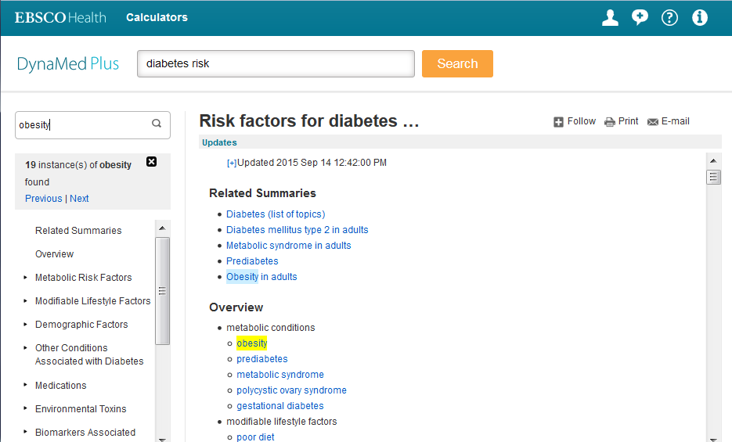
Search Within Topic Text
Notes:
Some topic monographs can be very long. If you have one term you want to find within that topic, you can search within text which will highlight all instances of that term and let you advance thru the matches. This works the same on the mobile interfaces.

Slide 49
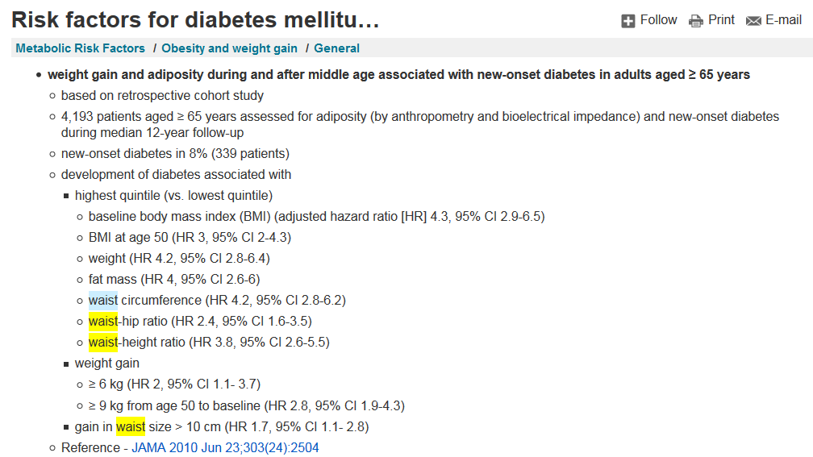
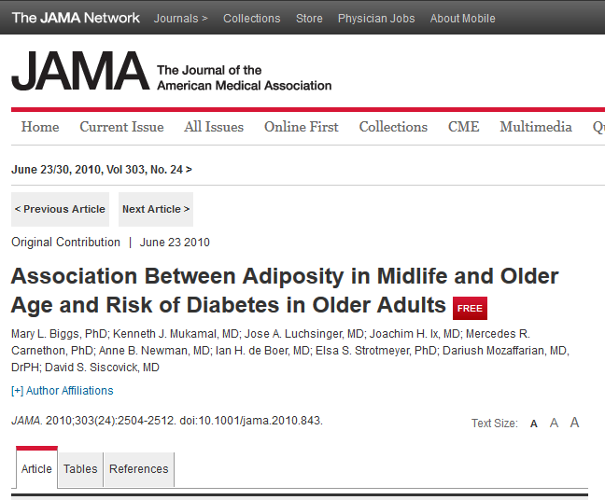
Links to Full Text Articles
Notes:
Within Dynamed Plus, there are links to the citations in Pubmed for all articles cited. Open Pubmed from the library first, then If you have signed in to off campus access or are on campus, the Find@FSU button linking Pubmed to the full text articles should be there. See next slide.

Slide 50
Trick to Get Full Text
Open Pubmed from the CoM Library site and leave open
In same browser, open Dynamed Plus and find topic
Links to cited articles will pull up Find@FSU button in Pubmed

Slide 51
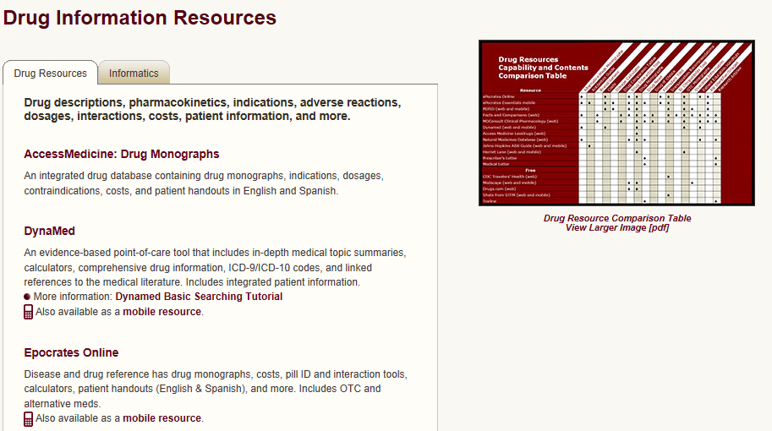
Drug Information
Notes:
Let’s look at a good drug resource. Now navigate back to the library page and under Clinical tools pull up the Drug resources. We will have a workshop on just Drug references. The best, most thorough drug resource we have is Facts and Comparisons. However, the most popular with physicians is Epocrates. For now, let’s look at Epocrates Online.

Slide 52
Epocrates Online
Drug Monographs: Rx, OTC and CAM
Disease Reference from BMJ
Formularies
Drug Interactions (enter multiple drugs)
Pill Identifier
Calculators, tables
Mobile version includes antibiotics guide, lab manual, ICD-9, CPT, and guidelines

Slide 53
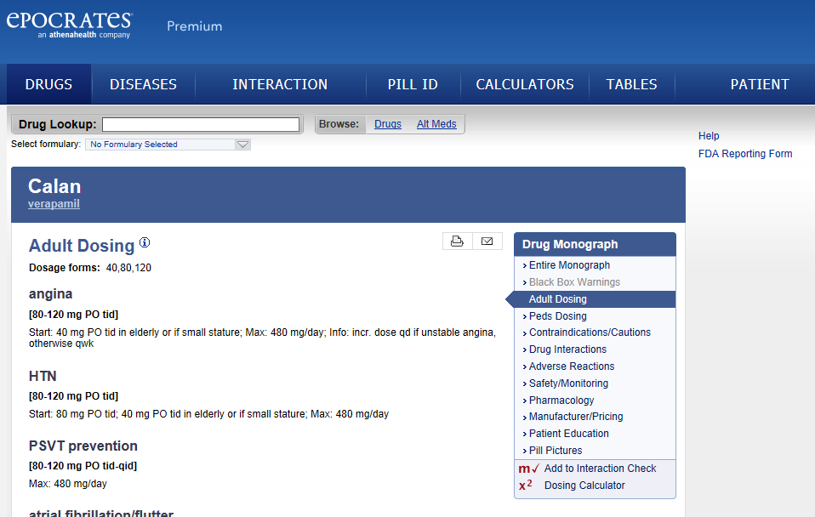
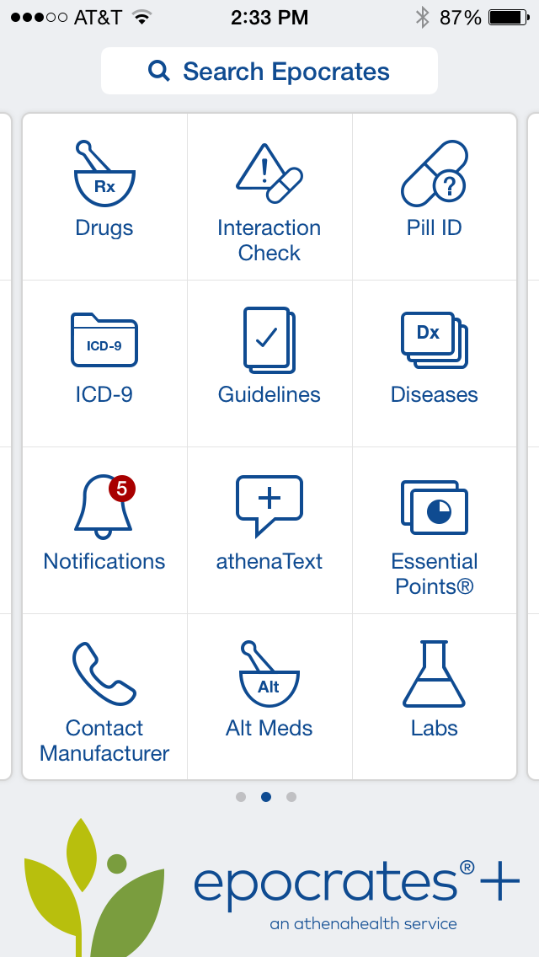
Epocrates Online and App
Site is Mobile Friendly
Notes:
Walk them thru finding a drug, how they are organized and how to do a drug interaction check. Formularies.

Slide 54
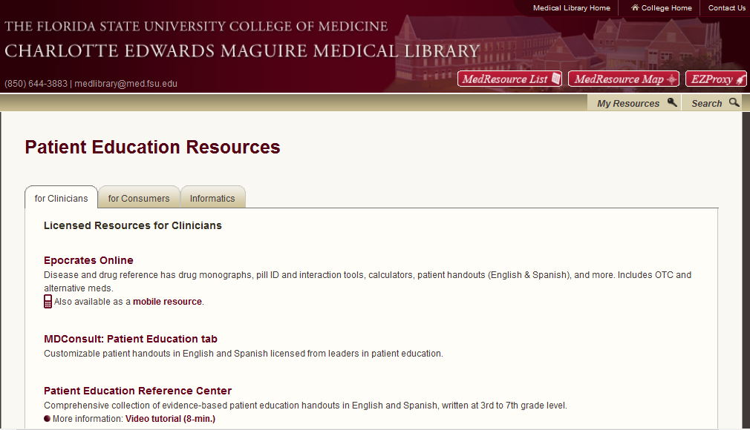
Finding Patient Education Handouts
Notes:
We will have a future sessions on patient education materials, but will do a quick search for patient education materials. There are a wealth of these online, of varying quality, accuracy and free of bias. We subscribe to four resources where you can find high quality, reliable patient education materials.

Slide 55
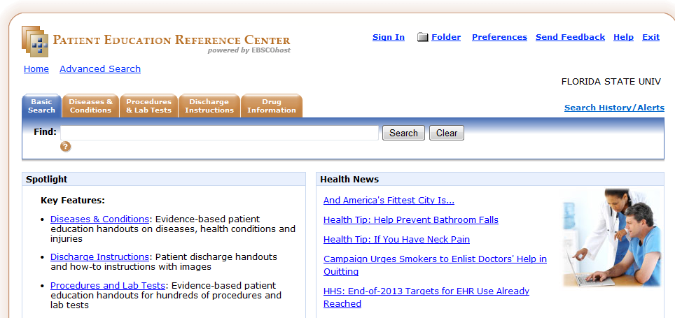
Patient Education Reference Center
New Resource from EBSCO
Notes:
Demonstrate this.

Slide 56
Patient Education Reference Center
6000+ handouts
Diseases &Conditions
Discharge Instructions – good demand mgmt
Procedures and Lab Tests
Drugs – include overdose instructions
Reading Level 3rd-7th grade, English & Spanish
Customizable – Add patient’s name and clinic information
Email handout to patient is an option
Notes:
There is no way to put in the clinic info once like MDConsult. You have to type it in each time you print.

Slide 57
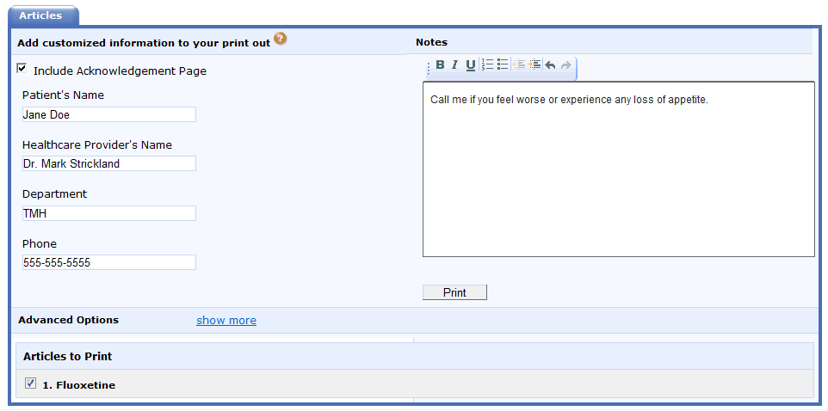
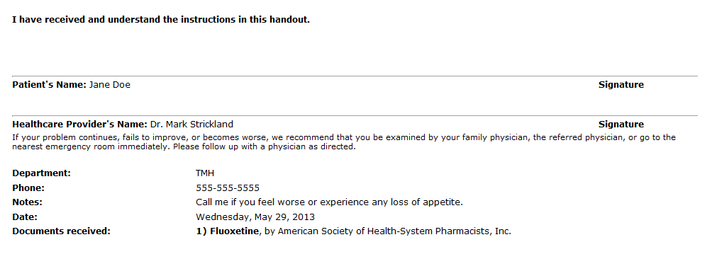
Printing from PERC
Notes:
When it prints, there is a tear off at the top for patient to sign verifying they received and understand instructions

Slide 58
Access Medicine
McKesson Handouts:
Adult, Pediatric, Medicines and Acute Adviser Modules (4000+ handouts)
Languages:
All in English and Spanish
Select handouts in other languages like French
Adult and Peds only
5th-8th grade reading level
Notes:
McKesson is an EMR company that purchased a company that produced Relay Health: Clinical Reference Systems handouts to include in their Practice Partner EMR as well as license to other companies. Access Medicine now provides these online. In addition to English and Spanish, selected handouts come in a variety of other languages.

Slide 59
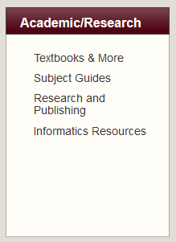
Academic and Research
Textbooks & More contains Course/Clerkship Resources
Subject Guides
Link to Informatics Resources Site
All Informatics faculty development workshop’s resources

Slide 60
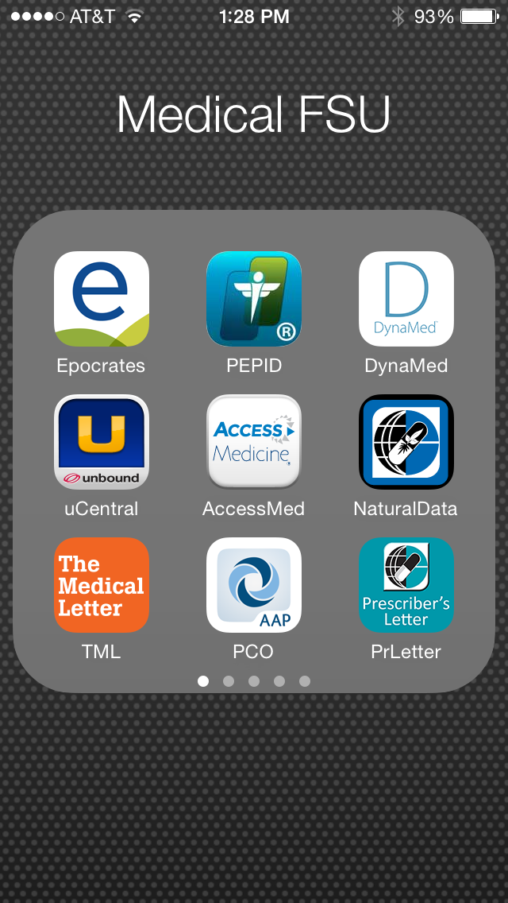
Medical Apps

Slide 61
FSU Licensed Apps FREE to You
Access Medicine
Epocrates Plus ($179/yr)
Essential Evidence Plus ($85/yr)
DynaMedPlus ($395/yr)
FirstConsult
Medical Letter ($98/yr)
Natural Medicines Comprehensive Database ($59/yr)
PEPID ($254/yr) CRC Suite and Medical Dictionary
Pediatric Care Online ($299/yr)
uCentral ($550/yr)
Savings to each faculty, resident and student > $2,000/yr
Notes:
These gives our students and faculty the essentials (no reference to ePocrates’ product name) They include a drug reference that has interactions and an antibiotics guide, a differential diagnosis generator, plenty of disease and condition quick lookup, EBM tools, guidelines and coding tools, a basic medical dictionary, and a variety of clinical calculators to aid in decision making.

Slide 62
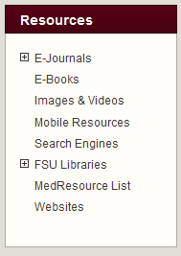
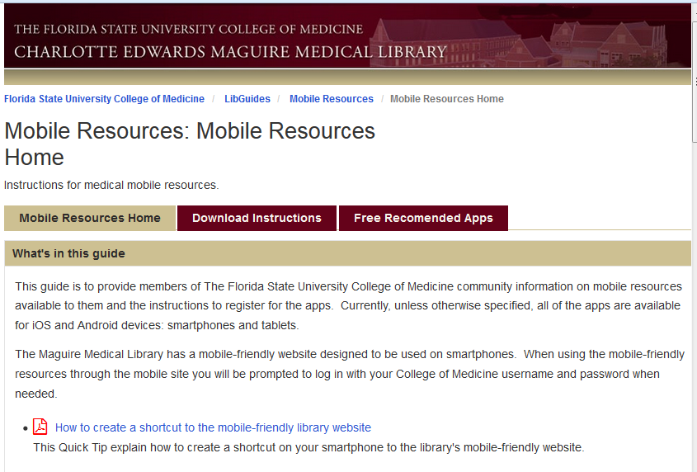
Find Mobile Resources
Notes:
The PDA websites page provides the links to the web sites where you must go to register and download the subscription products we provide to faculty and students. There are many more PDA references out there free and for a price. A list of these can be found under the PDA Software on the left side of the screen
The center column links you to the instructions for downloading free and installing. If it asks for your userID and password, precede your userID (firstname dot lastname) with med\ as shown here.

Slide 63
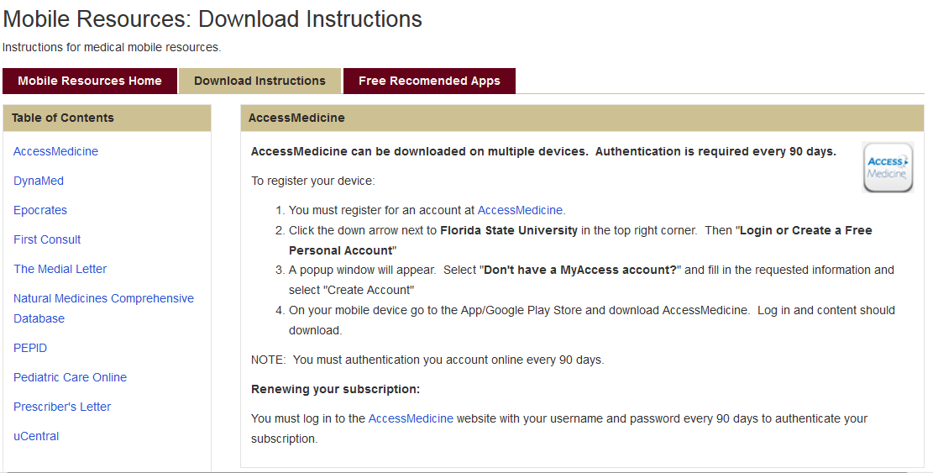
Instructions Tab
Install Instructions for iPhone and Android
Notes:
For Future Reference, all these instructions are posted so that you can renew your own resources annually, or switch devices when you get a new phone or tablet. The links on the left take you to the instructions, and the link inside the instructions takes you to the registration site for each resource.

Slide 64
Getting Help With Mobile Resources
Nancy Clark, 644-9706, nancy.clark@med.fsu.edu
Terri Johnson, 645-9812, terri.johnson@med.fsu.edu
See Syllabus for regional campus IT support people

Slide 65
Incorporate Use of Library into Teaching
As faculty, ask students to look up aspects of problems seen in clinic
Incorporate mobile resources in teaching
Look up, report, assess understanding of meaning & implications
Race to find answers
Incorporate web resources
Bring articles on…
Guidelines on …
Find a patient ed handout on…

Slide 66
In Conclusion
Fabulous resources
Access anywhere on online/mobile device
Explore with the library site
If you need help…
Include in teaching
Come to more sessions

