Slide 1
Searching and Accessing Full Text Journal Articles
Nancy B. Clark, M.Ed
Director of Medical Informatics Education
Mark Strickland, M.D.
Informatics Curriculum Director, TLH RMC

Slide 2
Objectives for Session
Learners will
Do PubMed search using primary functions on web
Locate full articles from PubMed search
Link out to full text articles within resources, mobile and online
Consider other ways to find journal articles (mobile devices, web sites…)
Save searches in NCBI

Slide 3
Handouts
PowerPoint
Worksheet for activity
Evaluations – Please complete Pre- Workshop Assessment

Slide 4
How do I get to the med library?
3 Easy Steps:
Open a web browser
Type in URL for the FSU College of Medicine:
http://med.fsu.edu
Click on
Library
Notes:
Put the Powerpoint on one screen from the console computer and using a laptop, open Firefox or IE on the other screen and demo opening the CoM site and clicking Library.

Slide 5
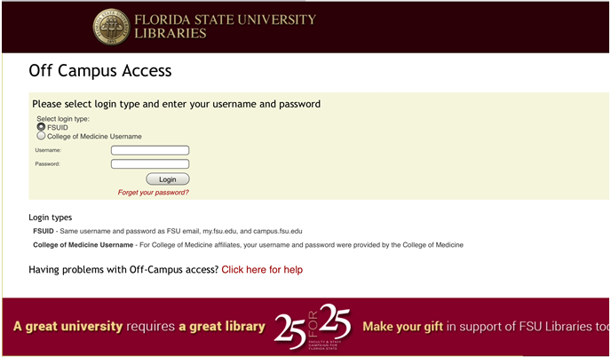
Off Campus Access
Use your ID and Password
Notes:
But if you forget to click on the Off Campus Access button before you start browsing, when you click on any subscription resource, you will be brought to this page and asked to log into the remote access proxy. Once you have logged into the proxy server, you should not have to do so again during this session. If you close your browser or reboot your computer, you will have to log in again. Just be sure you have clicked the College of Medicine button before putting in your CoM credentials.

Slide 6
Alert Regarding Off Campus Access
Starting in the Summer of 2016
Will not be able to use CoM ID to access the Library
Must use FSUID to log in
Used for Blackboard and OMNI
If you do not know your FSUID, contact your regional campus IT support person.
Call the Central Campus IT Office to get password (850)644-3664, 7:30 AM to 6:00 PM Monday – Friday
See Handout
Notes:
Starting sometime this summer, you will no longer be able to use your CoM username and Password. You will have to start using your FSU ID and password. Full time faculty have to know this to do their time in OMNI and to access Blackboard to get course materials. However clinical faculty to not usually know their FSU ID. In some cases, your username may not have been set up or password created. We have a handout that covers how to do this. You can call your regional campus IT support person to get help doing this.

Slide 7
What is MEDLINE?
Database of biomedical journals (medical, dental, nursing, veterinary, …)
Old Index Medicus database
Service of National Library of Medicine (NLM)
5,600 biomedical journals, most are peer reviewed
Nearly 18+ million citations (around 70,000 new/month)
Indexing terms are assigned to the articles that come from a controlled vocabulary (Thesaurus) called MeSH (Medical Subject Headings)
Notes:
Let’s make sure you know what MEDLINE is. MEDLINE is the primary medical research periodicals database compiled by the National Library of medicine and published in electronic format. For every medical journal article printed in over 5000 journals, there is an entry in MEDLINE. It includes dentistry, vetinerary, nursing and medicine. Some of you are old enough to remember the dreaded trips to the medical library late at night to spend hours wading thru the bound issues of Index Medicus in search of all the recent articles on a topic that your attending assigned to you to investigate and bring to rounds the next morning at 6 am. Aah, the old days…
At this time, MEDLINE covers 5271 journals, nearly 18 million articles dating back to the 1860s, with around 70K articles added each month.

Slide 8
Where to Search MEDLINE?
PubMed (NLM interface)
OVID
ClincalKey
Medscape
uCentral (mobile)
Pubmed has
Links to the most FSU subscription articles
Allows you to save searches and add articles to collections
Notes:
You can do Medline searches free on the internet at Pubmed, which is the National Library of Medicine’s interface, or use a number of other subscription and free resources such as OVID, ClinicalKey,Medscape and so forth.. Selecting the search engine to go with the search topic is an important decision.
Our librarians work with the National Library of Medicine to create links to all of the journals to which FSU subscribes. Because PubMed has the best chance of getting you straight to the 2.5 million or so full text articles that we subscribe to in as few clicks as possible, and it is free, we are only going to teach you to use PubMed tonight.

Slide 9
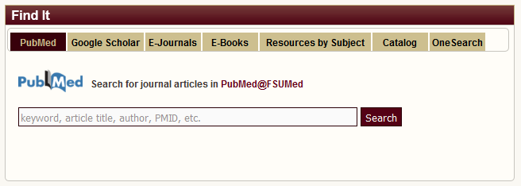
Where do you find PubMed?
Use the “Find It” to link to PubMed
OR Type in Terms and start Search
Notes:
You can start a Pubmed search by just typing your search terms in the search box on the main library page or clicking the PubMed logo to go straight to their site.

Slide 10
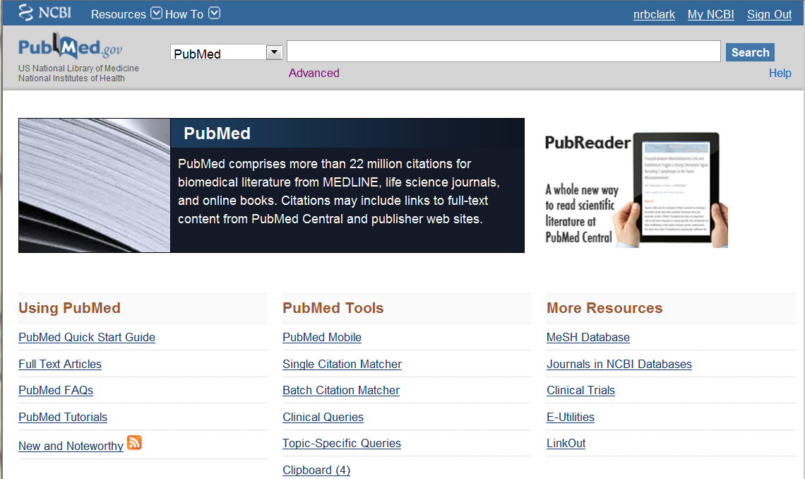
Notes:
Let’s click on the logo and look at the main page for a second.
While this interface may seem rather simplistic, it is in fact, quite sophisticated.
This page gets you to a number of tools provided by the NLM.
Point out the My NCBI, Tutorials, RSS feeds,

Slide 11
First search of the evening: Author search
Use initial(s) most frequently used by author
After 2002, full names (when included in the journal itself) may be used
May search multiple authors on one search line
Search on Hurt MM
Notes:
You might need to find a particular article from an author you know: a friend or speaker at a conference you heard. You can type in a full name or just last name and an initial or two.
After 2002, MEDLINE includes full author names when they are included in the article. These may be searched in PubMed in either order: James Smith or Smith James. However, when in doubt about which is the first name and which is the last, use a comma as in Ryan, Douglas for an author named Douglas Ryan.
Extra little tip: If you go to the “Single Citation Matcher” on the center of the PubMed screen, and type an author’s last name into the author box, you will see an index of author names.

Slide 12
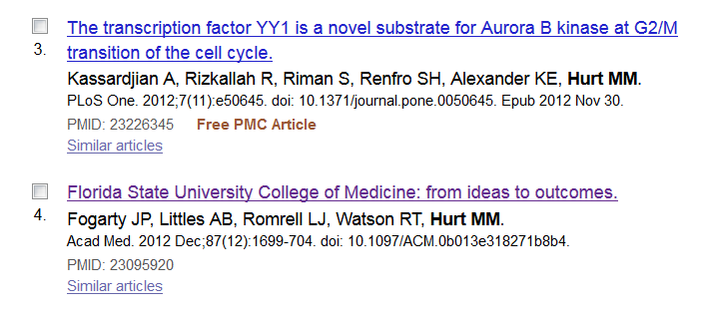
Let’s take a look at one article
Notes:
So we can have an article to play with, click on this article title to open the full citation.

Slide 13
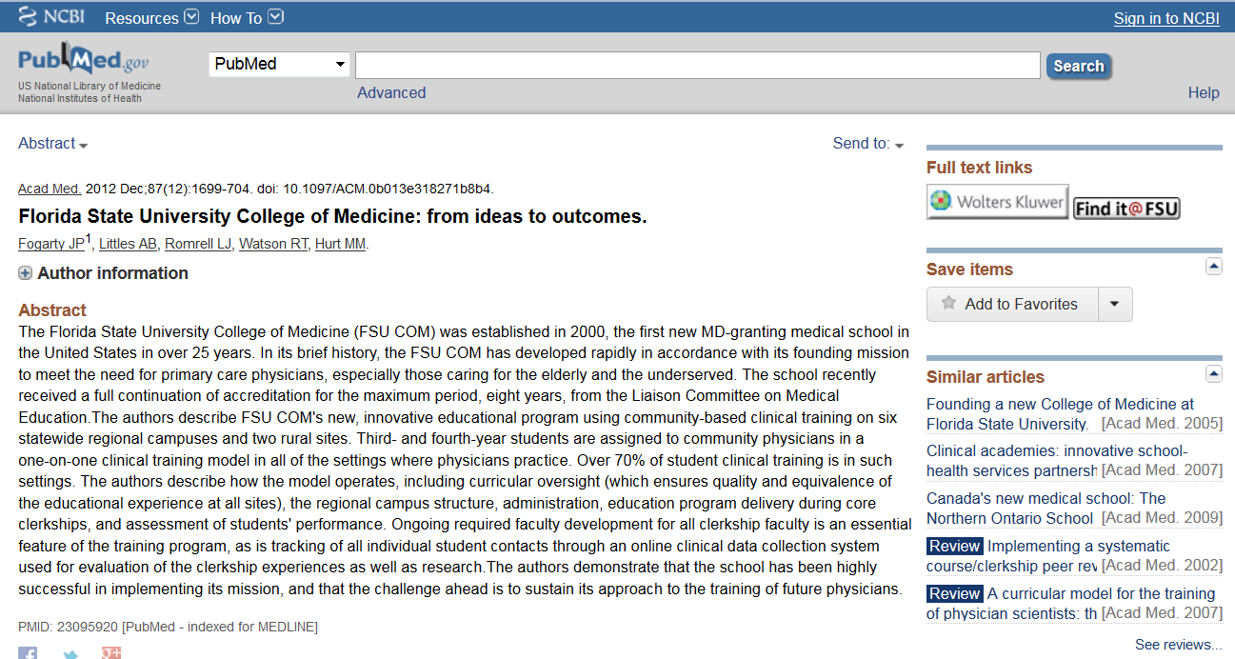
Abstract View
Notes:
This is the “abstract” display for the single article on FSU CoM. (click on the article title in the summary view of the search results to pull up this screen) Find@FSU button. This is what you click to see the complete article at the publisher’s site.
Point out the list of similar articles and the link for more related articles.

Slide 14
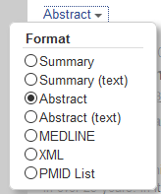
Views
Best for copy and paste into Interlibrary Loan
Contains:
Abstract if available
MeSH terms
Links to Similar Articles
Find@FSU button
Notes:
There are a number of formats for viewing these entries on either the search results screen or an individual article screen. Summary view is the bare minimum info needed to get the article. Abstract view is contains the button to get to the full text article as well as the full abstract (hence the name) and links to Similar Articles. Other views are usually only of interest to advanced users for use with 3rd party citation software.

Slide 15
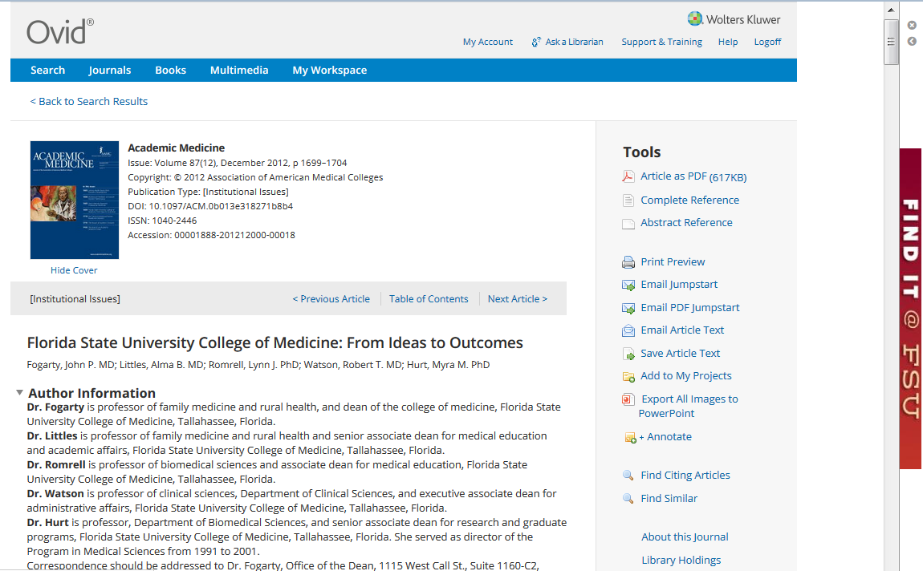
Direct Link to Full Text:
Notes:
In order to locate the full article, click on the Find@FSU icon. if you are logged into the proxy or on campus, you will be recognized as a member of the FSU community and will be allowed to read the article. If you are off campus, you will be asked to log in…. We won’t worry about that now.

Slide 16
Goal of Journal Search
A Few Good Articles
To answer a clinical question
WORKSHEET
Full text in as few clicks as possible
Notes:
Because, lets face it. What you want is a few, good articles, not 2500, not 250, not even 25, but you can live with that. You want to do a search and get about 5. Most of the time, a journal search is to address a particular clinical question. In some cases it may be a research question. Let’s use a recent clinical question you had in your practice to use for searching. To facilitate this, fill out the worksheet handout. Jot down what you wanted to look up. Advanced users will automatically in their head break this down into terms on which to search. You can’t just type the full questions. So start with the main topic, usually a disease, then add terms which may be interventions you are considering. (Yes, this is PICO, for those of you who attended an EBM session lately).
Then decide the type of question, which is another term you can add like diagnosis or treatment. The age group of the patients, gender, type of article you want, etc.

Slide 17
Steps: Clinical Question Search
Start with main topic
Add terms
Adjust Search Details
Limit (Filter) search
Combine searches (Advanced Search)
Notes:
[Speaker, don’t start working on the web yet. Just review these steps as an introduction]. Here are the steps I use to do a search and narrow it to a few good articles. We will go thru each of these steps using your terms for practice.

Slide 18
Step #1: Search
Start with main term/topic
Add additional terms
Do not worry about AND, OR, etc.
PubMed interprets your search as best it can
Notes:
Here is my clinical question:
For pregnant patients, does the consumption of large amounts of coffee, (compared to non-coffee drinkers) increase the rate of spontaneous abortion?
Terms to use? Spontaneous abortion, coffee OR caffeine, consumption. We don’t really need pregnancy.

Slide 19
Step #2: Look at Search Details
Check PubMed interpretation of your search
Hints: Put phrases in quotes “…”
Check AND, OR, NOT, parentheses
Adjust - taking out unnecessary or incorrect interpretation of your question
Notes:
The Search Details on the right, show the PubMed translated your query into search syntax including MeSH terms which are terms assigned by the NLM to an article based on the content of the article. Now you see the ANDs, ORs and such.
Details are also listed on the right side of the screen in the search results page.

Slide 20
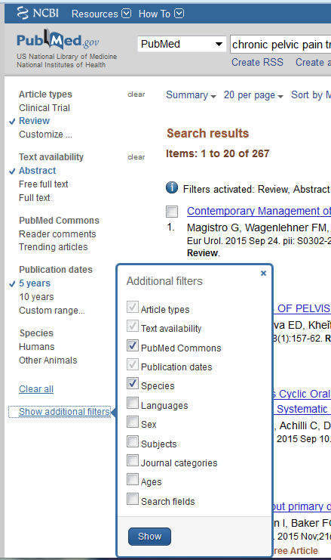
Step #3: Limit Search (Filters)
Left side – show additional filters
Filter by
Article Type
Publication date
Species
Type research
Language
…
Notes:
Pubmed has put the filters/limits on the left side of the screen like many commercial shopping sites. Shop for women’s clothes at JCPenney or appliances at Sears. Same concept. Show limiting to recent articles, possible Review articles. English, which will require using Show additional Filters. When you click on ones, you have to click SHOW,

Slide 21
Step #4: Check Advanced Search
Keeps a history of 24 hours of searches on this computer
Combine searches by # to limit
Can use instead of putting multiple terms in one search. Search each term individually, then combine using AND
Can add terms here
Notes:
The Advanced Search shows you the results of the last few searches you have done and lets you add additional terms to your search, This will let you combine previous searches to either reduce the number of articles found, or narrow your search. One strategy that can be used is to do searches on each relevant term you can think of to answer a specific clinical question, then combine terms using AND until you get the number down to a manageable number.
Pubmed will keep a history of your searches on this computer in this browser for 24 hours. Then it wipes these out. This is another reason to get a NCBI account. It keeps track of months worth of searches if you are signed in when doing the searches. Then you can save your searches.

Slide 22
Options for Articles
Print articles as you find them
Save PDFs as you find good articles
Add good articles found to the Clipboard
Add articles to Clipboard as you find them
Email the final list of articles to yourself
Notes:
Depending on your preferences (sometime dictated by age) you have many options for getting the articles.

Slide 23
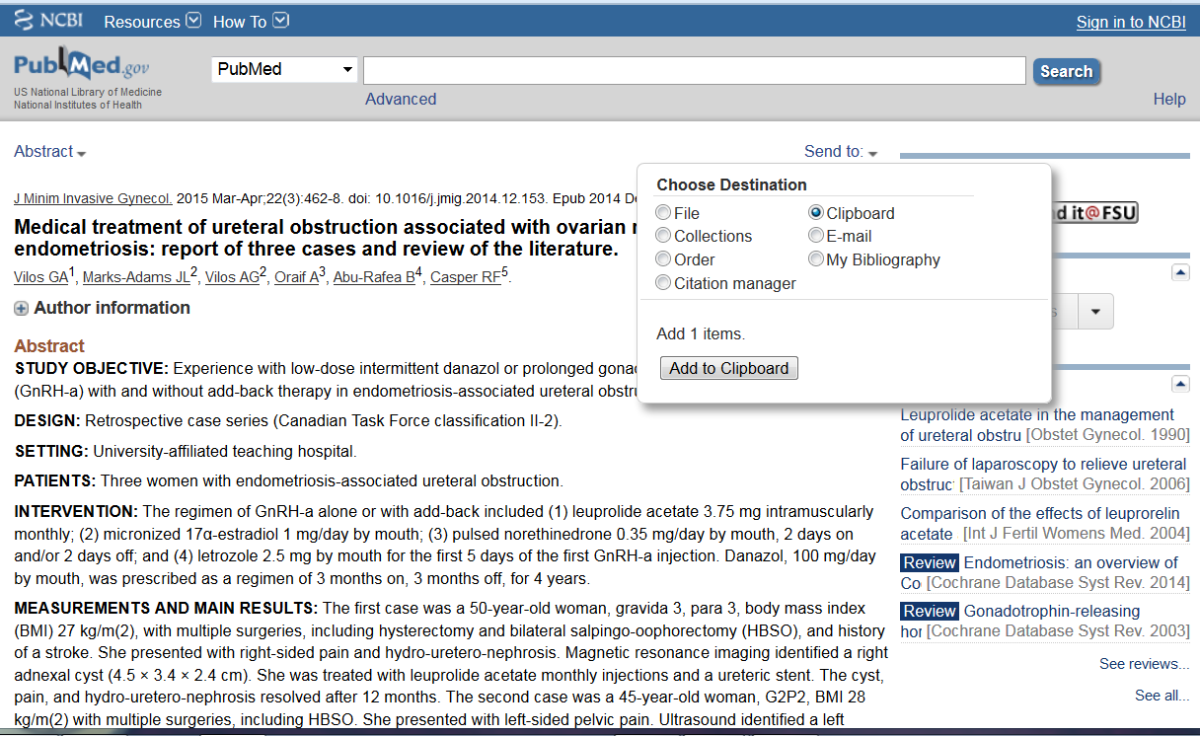
Put a reference in the Clipboard
Notes:
I am going to pick a few articles from my search results by clicking in the checkbox. Then I will add these to the clipboard. You can also add to the clipboard from the individual article abstract view.

Slide 24
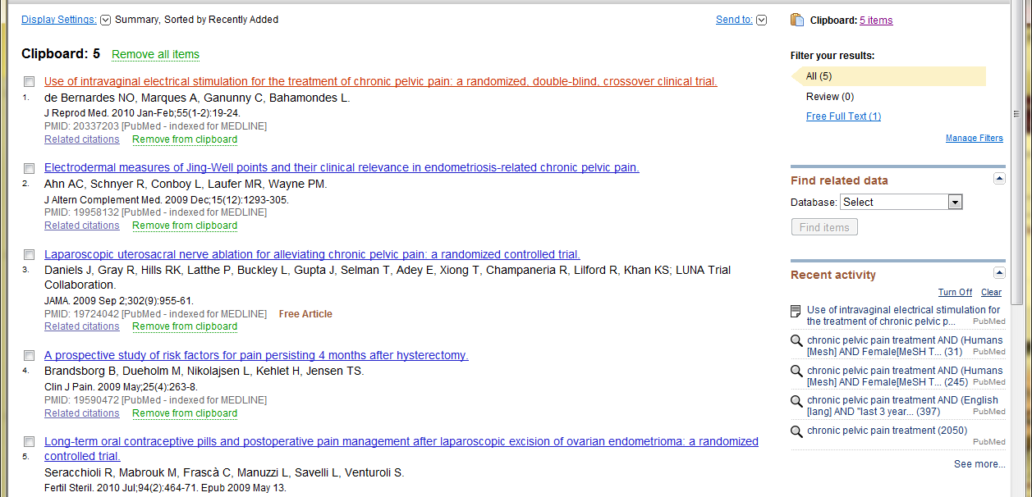
Email Clipboard
Notes:
Note the Clipboard is added to the main screen with the number of items stored in it. To go to it, click on the items. Click on Send to;
You have the option to save this list, email your self the list, Add to your collections in NCBI which we have yet to learn about, or send to a citation manager.
Email yourself your list of articles from the clipboard or export the list to a text file.

Slide 25
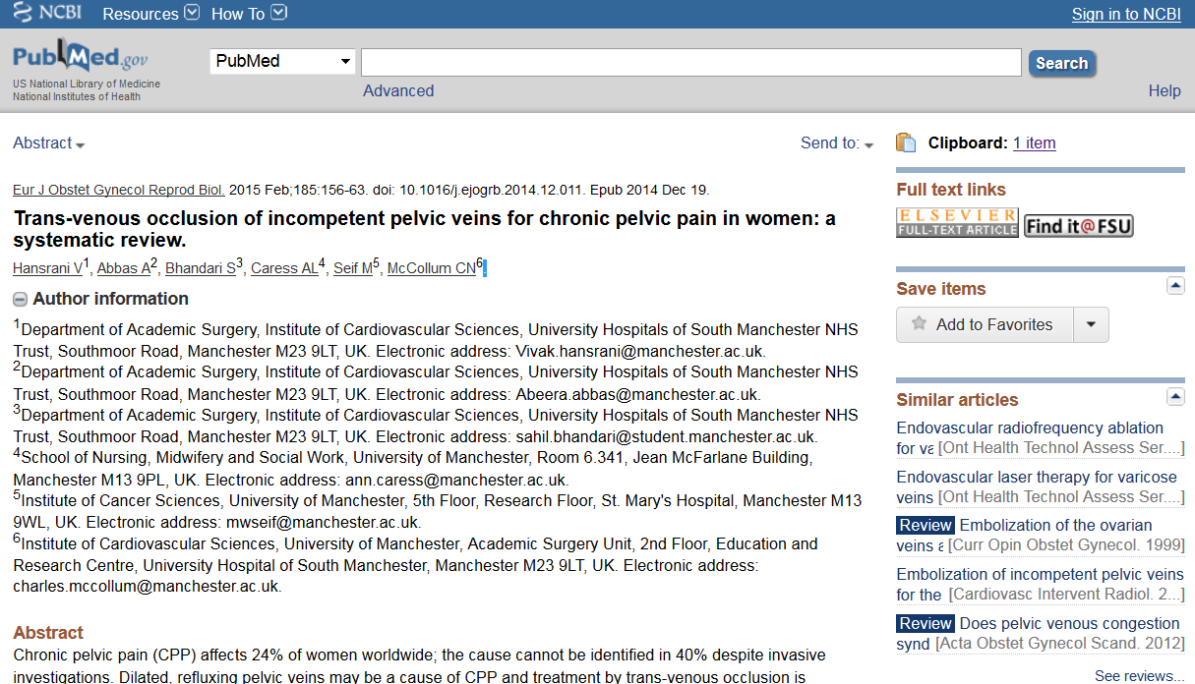
Follow the link to the article
Notes:
NOW let’s talk about getting the articles.
If you are using PubMed from the library site, all of the articles will have the Find@FSU button. It may or may not take you directly to the full text article. Just guessing 95% of the time, it will. However, sometimes it won’t

Slide 26
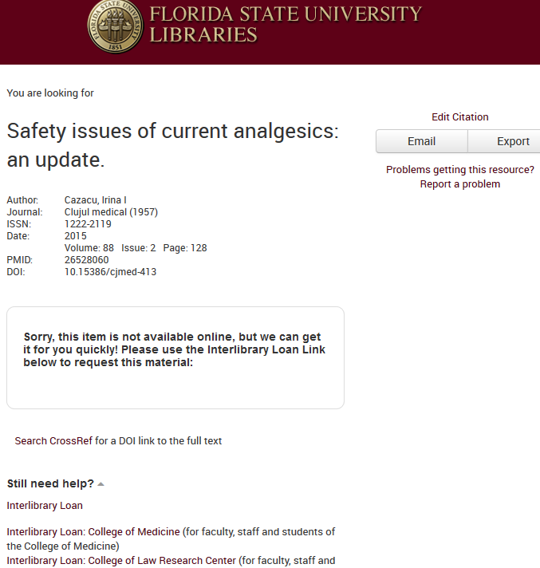
If Article Not Found
You will see this message if the article is not found with a link to the Interlibrary Loan form
Before requesting Interlibrary Loan, do the following.
Link to Interlibrary Loan
Notes:
If the Find @ FSU button does not ‘find” the article, this message will come up,
In some cases we do have the article available, and NLM and that publisher just don’t play well together. Other times, we just don’t subscribe to that journal.
We will get you any article that you need free of charge.

Slide 27
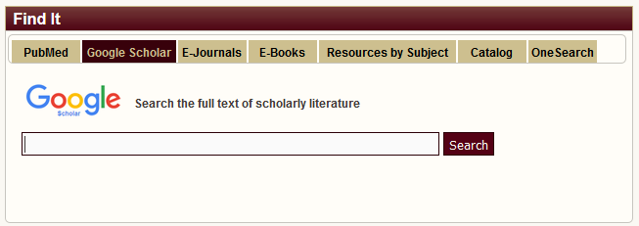
Search Google Scholar for Title
Searches PubMed, some of our content, links to full text
In Find It box. Search for article title
Click on Title
Notes:
Google scholar is another good way to find one article, if you know the name of the article. It searches Pubmed along with some other scholarly databases, and does contain links to Find at FSU. If you log into the Proxy before starting the search of GS from the library Search box, it helps get direct access to the articles.

Slide 28
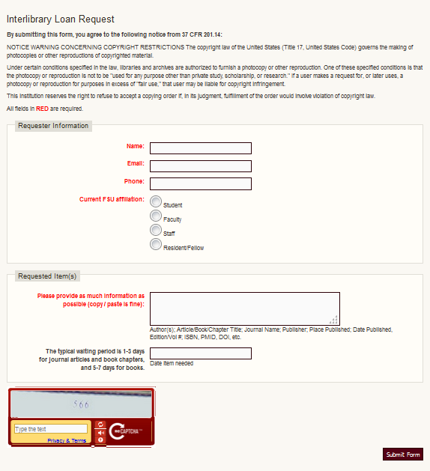
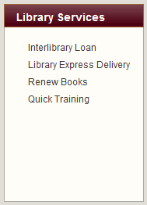
Interlibrary Loan
Notes:
Please complete all sections and let us know when you need the article if there is a date by which it will no longer be useful. Our turnaround time is very good and you should receive the article within 1-3 days.

Slide 29
Other Journal Options

Slide 30
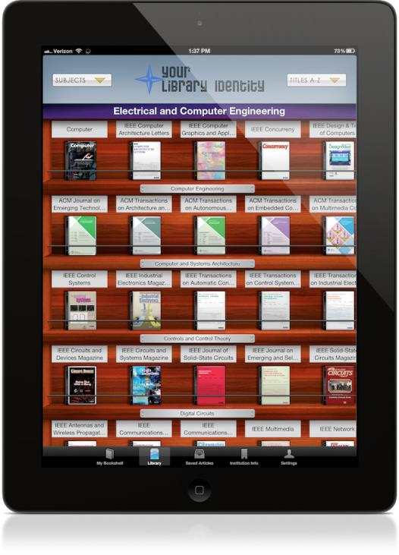
BrowZine Journal Reader
Journal e-reader, online, tablet and phone
Select most FSU COM Journals to read
Look like journals
Alert you to new articles
Allows saving articles to read offline
See Handout
Notes:
Is available online and for iPad, Android Tablets, iPhone and Android phone. You pick out the journals you want to follow/read, and put them on your bookshelf. It allows you to view journals as they are published, and read them electronically. Then sync online/tablet/phone. Must create an account first. Instructions are in a handout.

Slide 31
Follow Links to Articles in DynaMed Plus
In your default browser, Open the Medical Library
Log into Off Campus Access
Open PubMed
Minimize
In another tab, open DynaMed Plus.
Links will take to PubMed with buttons.
Notes:
The default browser is the browser (Internet Explorer, Firefox, Chrome or Safari) that starts automatically when you click on a hyperlink in any other program. Most Windows machines set IE as the default browser. If you plan to follow links to articles in DynamePlus go to the library web page and log into EZProxy, then open Pubmed from the link in Find it box. You can minimize this. Then go back to the library and open DynamedPlus. The links will take you to Pubmed and the Find@FSU button will be there.

Slide 32
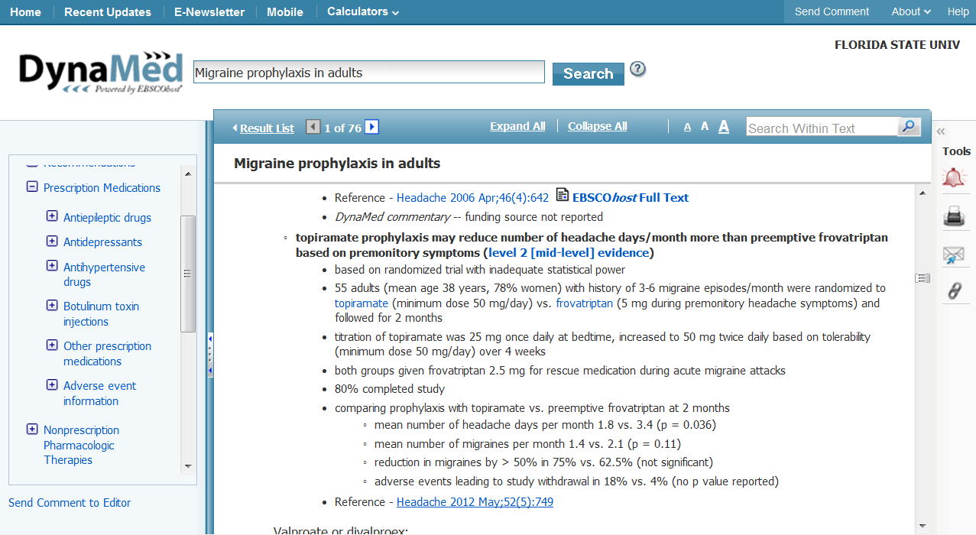
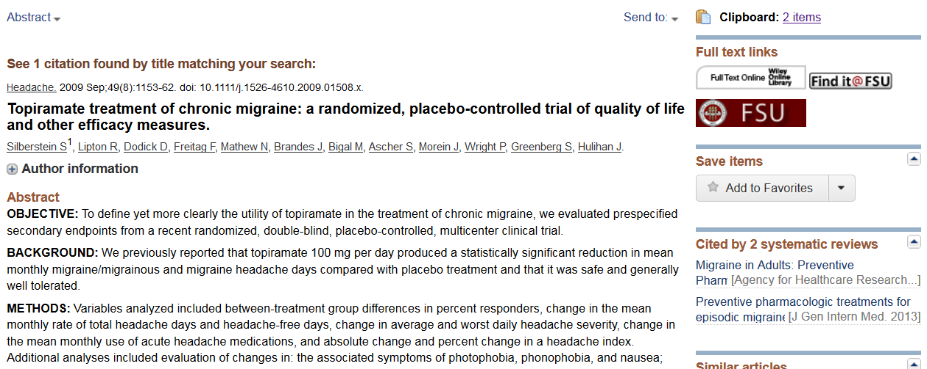
Notes:
Demonstrate with a topic in DynamedPlus. Good opportunity to show how the new interface does search results.

Slide 33
Did You Find Articles to Answer Your Question?

Slide 34
Review of Great PubMed features
Search Details
Limits/filters
Advanced Search
History (combine searches)
Similar articles linked
View in Abstract View to find full article

Slide 35
Using NCBI
Register and get a Username and Password
Notes:
If time and folks want to learn this, those that want can stay and keep going.

Slide 36
Why get NCBI Account?
Save searches
Save citations in My Bibliography
Automatically update and e-mail search results from your saved searches
Highlighting search terms

Slide 37
Get an NCBI Account
On PubMed page
Click Sign into NCBI top right
Click Register for an NCBI Account
Can use Google Acct
Complete form
Notes:
To create your account, click on the NCBI in the top right of Pubmed, then Register for a NCBI account.

Slide 38
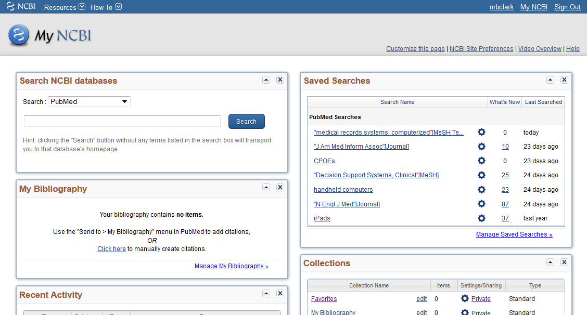
My NCBI
Notes:
Here is what it looks like with several saved searches, collections of articles.

Slide 39
My NCBI – Save Search
Develop a search.
Click on ‘Create Alerts’.
April 29, 2008
Medical Informatics Seminar Session 6
39
Notes:
39
You can modify your search by clicking on it, and modify the email preferences by clicking on ‘Monthly’.

Slide 40
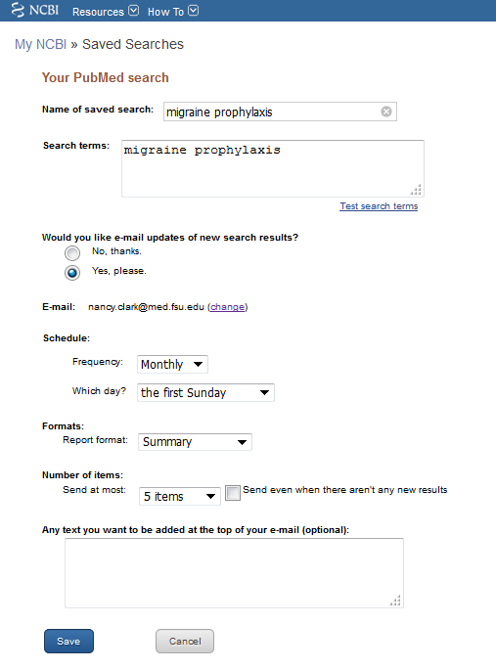
My NCBI – Creating Alerts
Give name and Save
Complete form for email notification
‘My NCBI’ puts the search in your list.
Notes:
40
You can modify your search by clicking on it, and modify the email preferences by clicking on ‘Monthly’.

Slide 41
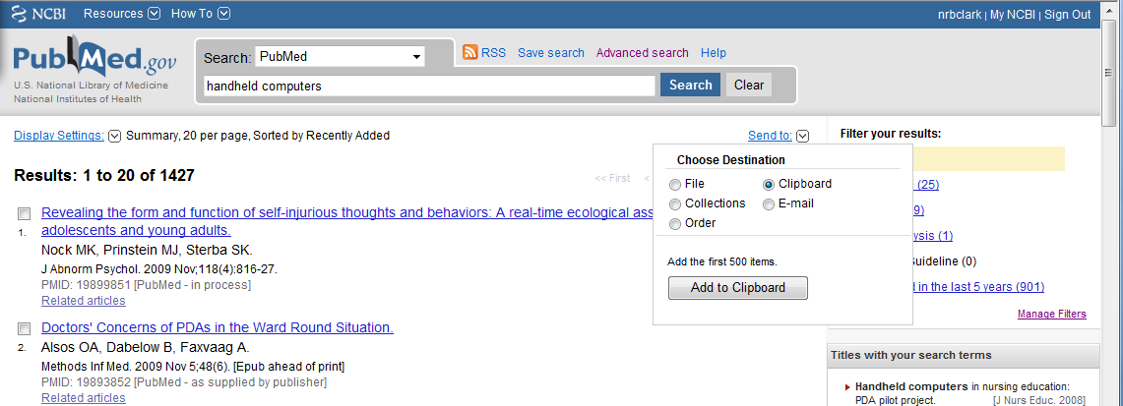
My NCBI – Saving References (1)
Develop a search.
Check the references you want to save.
Click on ‘Send To’ and select ‘Clipboard’.
April 29, 2008
Medical Informatics Seminar Session 6
41
Notes:
41

Slide 42
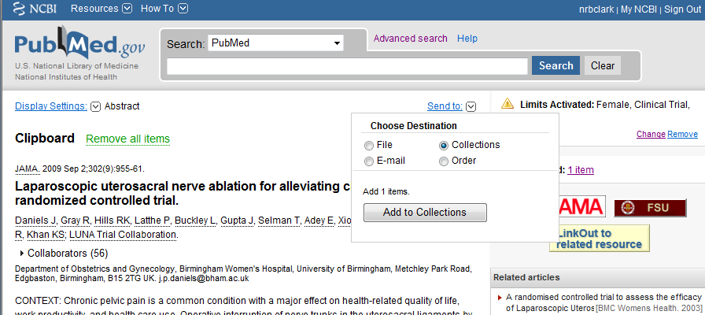
My NCBI – Saving References (2)
Go to the ‘Clipboard’
Click on ‘Send To’ and select Collections.
Notes:
42

Slide 43
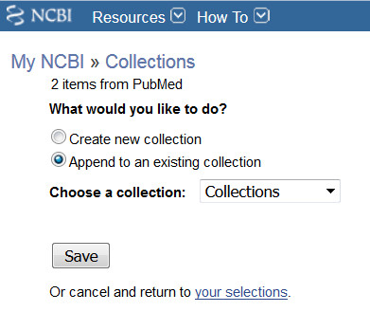
My NCBI – Saving References (3)
Tell My NCBI what to call the collection
Or Append to an existing collection
April 29, 2008
Medical Informatics Seminar Session 6
43
Notes:
43
Again, you can modify your search, or add or delete references from the collection.
Another use for clipboard is to collect references to download to a reference manager such as EndNote or RefWorks.

Slide 44
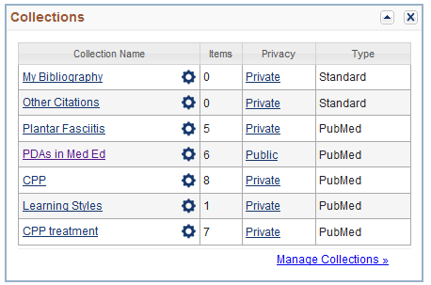
My NCBI – Saving References (4)
To see the collection or saved search, click on ‘My NCBI’ > Collections
Can download collections into a reference manager such as EndNote or RefWorks.
44
Notes:
44
Again, you can modify your search, or add or delete references from the collection.
Another use for clipboard is to collect references to download to a reference manager such as EndNote or RefWorks.

Slide 45
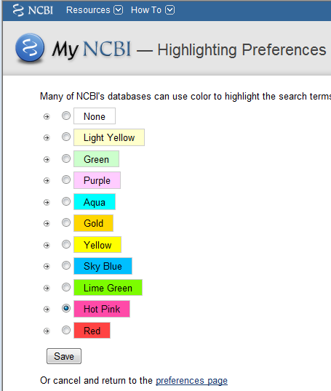
My NCBI – Setting Preferences
Summary settings
Highlighting Search terms
Click on ‘NCBI Site Preferences’.
Notes:
45
Again, you can modify your search, or add or delete references from the collection.
Another use for clipboard is to collect references to download to a reference manager such as EndNote or RefWorks.

Slide 46
Summary
Use PubMed to search for articles on your topics, My NCBI to manage
Link to artcles through DynaMed
Use “Find @ FSU” button to find articles
If no button: Google Scholar > Interlibrary loan
Any journal article you need, we will get

Slide 47
The End
Practice
Call or e-mail us for individual help
850-644-3883
MedLibrary@med.fsu.edu

