Slide 1
We need a Group, Now What
Nancy B. Clark, M.Ed.
Carol A. Painter, PhD

Slide 2
Review of Group Benefits
Everyone brings something to the party
Promotes active learning => mastery
Supports long-term memory and understanding
Allows for monitoring and assessment of knowledge
Develops problem-solving and critical thinking skills
Encourages collaboration

Slide 3
Review of Best Group Practices
Utilize the Godfather Principle
Limit the size
Members have basic similarities and preferences
They have structure and purpose
They don’t add more to your plate
Notes:
It’s business.

Slide 4
Compatible Learning Styles
Active Learners
Reflective Learners
Meet regularly to process information verbally, draw pictures on white board
Reinforce and insure ongoing mastery
Process/study individually after class
Prep for tests
Prepare before class
Summarize materials at home and read
Meet weekly with group to reinforce and assess mastery of week’s learning
Prep for tests
Notes:
Study groups should be made up of all Active learners or Reflective learners because they approach their studies differently.

Slide 5
Compatible Circumstances
Structured (Js) – Unstructured (Ps)
Morning person – Not morning person
Not Married –Married (with children?)
Need mix of sensing/intuitives, global/ sequential
Group Forming Exercise
Notes:
J’s like structure, starting on time, ending on time, and having an agenda. P’s are more comfortable with flexability. They, therefore, should have groups of their own.

Slide 6
Strategies and Process
Establish goals (personal and group)
Establish a schedule (when and how long)
Set an agenda
Establish a purpose ( reinforce learning; test preparation)
Share responsibilities and resources
Don’t add to what you’re already doing: use what you have
Notes:
Don’t add to what you’re already doing: use what you have
Don’t buy a lot of additional resources or try to use every web site you can find. You will not have time to do all of these.

Slide 7
Study Smart, Not Hard
Promote intuitive/integrated versus sensing/linear learning style
Look for connections between concepts and facts
Compare and contrast different concepts
Tend to do better on multiple-choice exams in medical school (most do not test recognition and recall of facts and concepts)
One of the best way to assess how well you are doing: evaluate yourself and each other
Case scenario – problem solving
Practice test questions…

Slide 8
Effectiveness versus efficiency
Changes to study methods must move toward effectiveness ( smart study), getting the right things done in the time available
Efficiency is the ability to get a lot done in the time available
Question analysis is effective
Focuses on exam material
Increases your chances of answering correctly

Slide 9
Questions as a Study Tool
Available from several sources
Active learning- prepare your own possible test questions from lecture objectives and content
Board review books
Library online sources
Train your brain to think in an exam mode; create the performance environment

Slide 10
Using Practice Questions to Enhance Integrated Learning
To analyze each practice question ask:
How would I have had to study to know that the right answer was right?
How would I have had to study to know that each wrong answer was wrong (integrated understanding)
Approach the practice question as a study topic; don’t worry about the correct answer
Does the question require memorization (<1/3), comparison, or deduction of cause and effect?

Slide 11
Using Practice Questions to Enhance Integrated Learning
Notice that relationships between material are not in strict linear order = change learning in a very important way
See the linkages in knowledge
Begins to see that it isn’t just memorization of facts but interconnection of facts
Begins preparation for Step 1

Slide 12
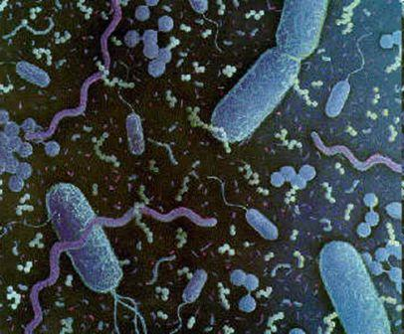
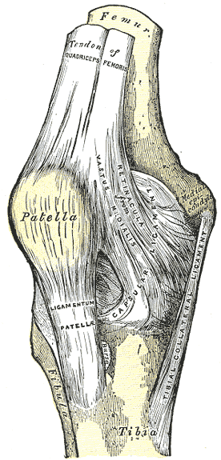
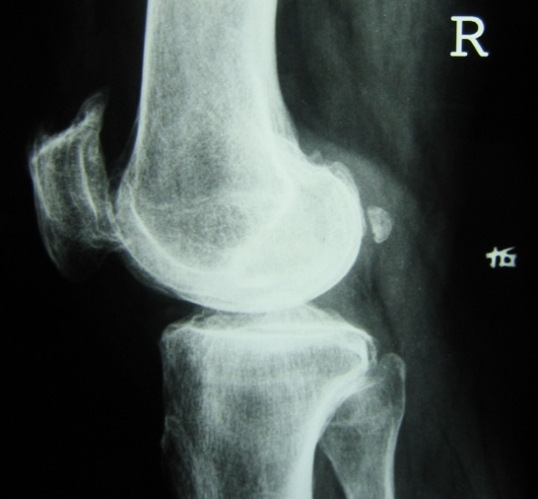
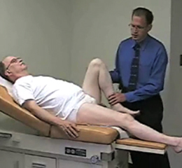
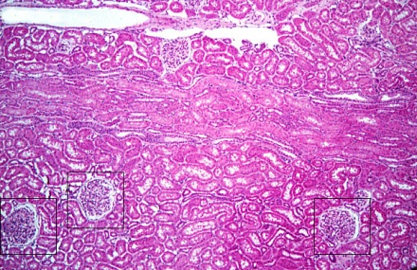
See the linkages in knowledge…

Slide 13
Sample Group Plan
Goals: reinforce class and lab learning, prepare for test, improve study methods and learning strategies
Members: five
Meeting time: Sunday, 3:00-5:00
Plan:
members summarize lectures daily; include information from objectives, readings and slides not discussed in class
Each member responsible for compiling lists of possible exam questions from one lecture and distributing to group members

Slide 14
Additional Group Plans
For exam prep, group schedule additional time for:
Practice lab practical
Practice checklists in CLC
Practice exam questions
Integrated questions from external sources
Additional review

Slide 15
Resources from Dr. Painter
In FSU Blackboard
Under My Organizations
Look for Learning and Study Resources

