Slide 1
Selecting the Best Evidence-Based Medicine Resources
Daniel Van Durme, MD, MPH Chair, Dept. of Family Med and Rural Health
Kendall Campbell, MD
Assoc. Professor, Dept. of Family Medicine & Rural Health
Nancy Clark, MEd
Director of Medical Informatics Education
Notes:
Suggestions for timing to get this done in 2 hours:
Spend only about 10 minutes on Slides 1-12. The audience came for hands on experience, not a lecture. So keep the talking part brief and to the point.
NOTE TO ICDs: 11/10/2015
Clinical Evidence has gone away. BMJ only has the UK version available, and online only, which we have not purchased.
ACP Smart Medicine going away 12/31/15 and is being absorbed into Dynamed Plus, which we will get. It will also contain something like Springer images and Micromedex drug database.
So I pared down the Hunting tools to just Dynamed and EE+ and PEPID. It should shorten the workshop and make it more manageable.
The revisions made by DVD and Kendell are done. New cases.
Contact me with questions.
NBC

Slide 2
Objectives
What is EBM?
Formulate an evidence-based clinical question
Apply levels of evidence to decision making process
Identify the major EBM databases
Include patient values in the decision making process
Find evidence-based answers to your clinical questions

Slide 3
Handouts and Resources
EBM Tutorial online http://med.fsu.edu/index.cfm?page=medicalinformatics.ebmTutorial
EBM Resources handout
Clinical Question Worksheet
Cases
Evaluations
Notes:
Let’s open the EBM Tutorial and use it as our guide thru this workshop. Start at the Library page www.med.fsu.edu/informatics/EBMTutorial.asp

Slide 4
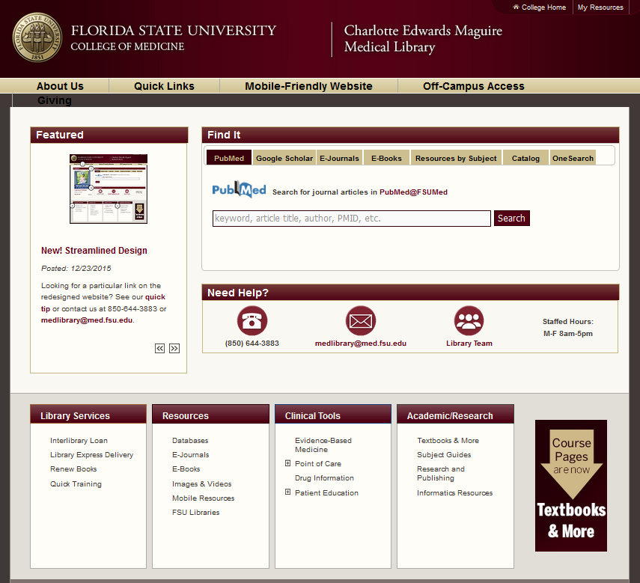
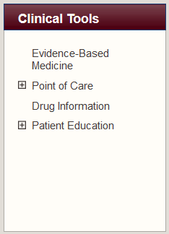
EBM Tools at FSUCOM Library

Slide 5
What is EBM?
Evidence based medicine (EBM) was originally defined as the conscientious, explicit, and judicious use of current best evidence in making decisions about the care of individual patients.
(Sackett DL, Rosenberg WMC, Gray JAM, Haynes RB, Richardson WS. Evidence based medicine: what it is and what it isn't. BMJ 1996; 312: 71-2)
Notes:
This was the original definition by Sackett in 1996 which was impossible to implement, and generated a lot of bad press for evidence based medicine as being “cookbook”.

Slide 6
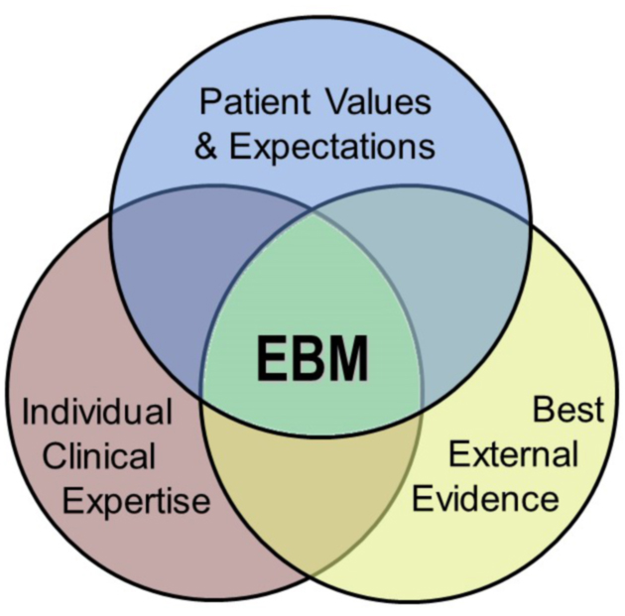
What is EBM?
The revised and improved definition of evidence-based medicine is “the integration of the best research evidence with clinical expertise and patient values”
It reflects a systematic approach to clinical problem solving.
(Sackett DL, Strauss SE, Richardson WS, et al. Evidence-based medicine: how to practice and teach EBM. 2nd Ed. London: Churchill-Livingstone,2000)
Notes:
Realizing this, Sackett revised his definition in 2000 to be the “integration of the best research evidence with clinical expertise and patient values.” This recognizes the importance of a physician’s clinical expertise as well as patient values must be considered.
Over the past 15 years, we have increasingly been able to expand the center of this venn diagram through more patient-centered research and easier access to high quality research information, and added attention to patient values and expectations – more patient-centered care. We must strive to practice at this intersection as much as possible.

Slide 7
So what is Evidence based PRACTICE?
EBM is a process
Evidence-based practice is how it is applied
Most would agree with the concepts of EBM, but putting it into real world practice, day-in and day-out, can be a real challenge.
We need practical tools to apply EBM regularly

Slide 8
EBM as Lifelong Learning
“The practice of evidence-based medicine is a process of lifelong, self-directed, problem-based learning in which caring for one's own patients creates the need for clinically important information about diagnosis, prognosis, therapy and other clinical and health care issues.”
(Bordley, D.R. Fagan M, Theige D. Evidence-based medicine: a powerful educational tool for clerkship education. Am J Med. 1997 May;102(5):427-32.)
Notes:
Lifelong learning model
The practice of evidence-based medicine is a process of lifelong, self-directed, problem-based learning in which caring for one's own patients creates the need for clinically important information about diagnosis, prognosis, therapy and other clinical and health care issues.
Instead of routinely reviewing the contents of dozens of journals for interesting articles, EBM suggests that you target your reading to issues related to specific patient problems. Developing clinical questions and then searching current databases may be a more productive way of keeping current with the literature.
Evidence-based medicine "converts the abstract exercise of reading and appraising the literature into the pragmatic process of using the literature to benefit individual patients while simultaneously expanding the clinician’s knowledge base." (Bordley, D.R.)

Slide 9
Lifelong Learning from Day to Day Encounters
Reading the articles that happen to cross the desk does not help MY PATIENTS TODAY
Finding evidence based optimal care for my patients today helps them AND helps me to stay current in my field and be an efficient and effective lifelong learner

Slide 10
EBM – A Multi-Step Process
The patient | 1. Start with the patient -- a clinical problem or question arises out of the care of the patient
The question | 2. Construct a well built clinical question derived from the case
The resource | 3. Select the appropriate resource(s) and conduct a search
The evaluation | 4. Appraise that evidence for its validity (closeness to the truth) and applicability (usefulness in clinical practice)
The patient | 5. Return to the patient -- integrate that evidence with clinical expertise, patient preferences and apply it to practice
Self-evaluation | 6. Evaluate your performance with patient & process
Notes:
Here is how it works. If while seeing patients we recognize a need for information, like which of these diagnostic tests is best in this instance, or I wonder if there is a newer and better treatment for this condition that I haven’t heard of yet, we should take advantage of this opportunity and seek an answer to this question in a current, constantly updated, high quality resource. Based on the evidence we find, we can, if applicable to this patient, take the information found back to the patient and incorporate the evidence into the encounter with the patient’s preferences and make a decision.

Slide 11
The Question
1. Construct a well built clinical question derived from a case

Slide 12
Constructing A Clinical Question
P patient | I intervention | C comparison | O outcome
Who? | What? | Alternative Intervention? | Outcomes
“How would I describe a group of patients similar to this particular patient?” | ”Which treatment, test or other intervention?” | “Compared to what other treatment, test, or perhaps compared to doing nothing” | What is the patient oriented outcome – better prognosis? Higher rate of cure? Etc.?”
Notes:
One of the fundamental skills required for practicing EBM is the asking of well-built clinical questions. To benefit patients and clinicians, such questions need to be both directly relevant to patients' problems and phrased in ways that direct your search to relevant and precise answers. In practice, well-built clinical questions usually contain four elements, summarized here. One of the benefits of careful and thoughtful question-forming is that the search for evidence is easier. The well-formed question makes it relatively straightforward to elicit and combine the appropriate terms needed to represent your need for information in the query language of whichever searching service is available to you.

Slide 13
Examples
P | I | C | O
Kids with acute otitis media -2-4 y/o | Antibiotics | No treatment except acetaminophen for pain/fever | No pain after two days?
Adult with microhematuria | IVP | CT scan | Diagnostic accuracy (Predictive value or likelihood ratio)
Adult patients <70 | TIA | No TIA | Rates of CVA within 90 days
Healthy adolescents | Routine scoliosis screen | No screening – evaluate only if problems | Pain, disability, need for intervention

Slide 14
Types of Questions Best Answered by EBM Resource
Therapy Question
In patients with migraine headaches without auras, are antiepileptics more effective than beta blockers for prophylaxis of headaches?
Prognosis Question
In diabetic patients with foot ulcers, is the diagnosis of osteomyelitis with MRI as predictive of healing as an audible pulse on Doppler examination?
Diagnosis Question
In geriatric patients with suspected carotid stenosis, is duplex ultrasound as good as magnetic resonance angiography in detecting significant carotid stenosis?
Harm Question
For pregnant patients, does the consumption of large amounts of coffee, (compared to non-coffee drinkers) increase the rate of spontaneous abortion?
Notes:
Therapy Question - A question concerning the effectiveness of a treatment or preventative measure
Prognosis Question - A question concerning outcome of a patient with a particular condition
Diagnosis Question - A question concerning the ability of a test to predict the likelihood of a disease
Harm Question - question concerning the likelihood of an intervention to cause harm

Slide 15
Question Worksheet
P - Who?
I - What?
C- Alternatively?
Outcome?
Type of Question
Therapy
Prognosis
Diagnosis
Harm/Etiology
Using the worksheet provided, construct a clinical question from your own practice.
Notes:
Patient, Population or Problem How would I describe a group of patients similar to mine?
Intervention, Prognostic Factor, or Exposure Which main intervention, exposure, prognostic factor am I considering?
Comparison (if appropriate) What is the main alternative to compare with the intervention?
Outcome What can I hope to accomplish, measure, improve, or affect?
The Question is: Type of Question How would I categorize this question?
Type of Study What would be the best study design in order to answer the question?

Slide 16
Acquire the Evidence
2. Select the appropriate resource(s) and conduct a search

Slide 17
What EBM skills do all practicing clinicians really need?
Among other skills:
Information mastery: finding the best evidence for every day practice
Have at fingertips “just in time’ information at point of care for clinical decision making
web based and/or mobile
Evaluate expert-based information, including colleagues, CME, presentations, reviews and guidelines
Slawson DC, Shaughnessy AF. Teaching evidence-based medicine: should we be teaching information management instead? Acad Med. 2005 Jul;80(7):685-9.
Notes:
Slawson and Shaughnessy propose in the article provided to you that to expect all physicians to be able to critically review research articles to practice evidence based medicine is naïve and unrealistic. They propose that these are the skills that most practicing physicians need. The emphasis here is to have good quality, “just in time” information at the point of care using the web or mobile devices.

Slide 18
EBM Foraging Tools
A high-quality foraging tool employs a transparent process that
Systematically searches and reviews literature
Identify useful, valuable, “quality” research
Synthesizes into “bottom line” recommendation
Patient oriented outcomes (POEM); not disease-oriented outcomes (DOE)
Assign level of evidence
How to apply recommendations?
(Slawson DC, Shaughnessy AF. Teaching evidence-based medicine: should we be teaching information management instead? Acad Med. Jul 2005;80(7):685-689.)
Notes:
Here is their definition of a Foraging Tool.
Uses systematic, specific, explicit method for comprehensively searching literature to find relevant and valid information
Summarizes the research into “bottom line” recommendation supported by patient oriented outcomes (POEM) when possible and, when not, specified as preliminary when supported only by disease-oriented outcomes (DOE)
Provide specific recommendations on how to apply recommendations
Assign level of evidence or strength of recommendation to key recommendations using appropriate criteria
What groups are actually doing the foraging for high quality evidence based studies that are patient oriented, and summarizing them for you?

Slide 19
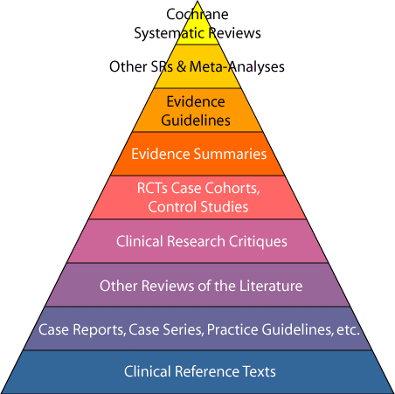
Major EBM Databases (Foraging Tools)
Cochrane
Clinical Evidence
ACP Journal Club
InfoPOEMS
Evidence Based _____
USPSTF
National Guidelines Clearinghouse
Notes:
Each of these resources conduct either systematic surveillance or systematic reviews of the research literature, and produce reviews and recommendations based on the results of those reviews. It is important that you recognize each of these so that when you land on one of these recommendations, you understand where it came from and who conducted the assessment of the research. Bear in mind this pyramid, which has the highest level of quality at the top and as you go down the pyramid, the level of evidence decreases.
Evidence Based ____ stands for a number of journals that include EB Nursing, Practice, Dentistry, etc. That all publish evidence based review articles. FPIN is a part of this in EB Practice.

Slide 20
Cochrane Library
The current resource with the highest methodological rigor
For each clinical question, all of the English literature meticulously searched for randomized trials
Large systematic reviews with valid methods + collaborative effort by Review Groups
Conclusions are based on all the evidence from valid randomized trials (treatment and harm questions)
Structured abstracts easy to digest Link to abstract
Notes:
The Cochrane Collaboration is an international non-profit and independent organization, dedicated to making up-to-date, accurate information about the effects of healthcare readily available worldwide. It produces and disseminates systematic reviews of healthcare interventions and promotes the search for evidence in the form of clinical trials and other studies of interventions. The Cochrane Collaboration was founded in 1993 and named for the British epidemiologist, Archie Cochrane.
The major product of the Collaboration is the Cochrane Database of Systematic Reviews which is published quarterly as part of The Cochrane Library.
Those who prepare the reviews are mostly health care professionals who volunteer to work in one of the many Collaborative Review Groups, with editorial teams overseeing the preparation and maintenance of the reviews, as well as application of the rigorous quality standards for which Cochrane Reviews have become known.
The activities of the Collaboration are directed by an elected Steering Group and are supported by staff in Cochrane Entities (Centres, Review Groups, Methods Groups, Fields/Networks) around the world.

Slide 21
Cochrane Library
Full text at Cochrane Library at Wiley
Abstracts in Essential Evidence Plus
Limitations
limited to English
only addresses questions amenable to randomized trials
most of medicine has not been studied enough to allow for conclusions
$$
www.cochrane.org
Notes:
On our library, the full Cochrane reviews are provided to you at Wiley. The abstracts, which are free at the Cochrane.org web site, are included in many of our subscription resources.
SPEAKER: At this point take the audience to www.cochrane.org. Browse by topic (Review groups). Let the audience pick a group that is applicable to their specialty and practice. Open that group to look at the various questions that have monographs, those that are in progress and those that are under consideration. Then open one abstract and show how the bottom line is summarized. The objective of this hands on activity is to familiarize them with what the Cochrane abstracts look like. Pick one to use to demo yourself that is of interest to you. Look around to find one that actually has a concrete recommendation. Many just say “need more research”.

Slide 22
ACP Journal Club
About 130 internal medicine journals systematically surveyed
Highest-validity articles abstracted. Link to article.
Structured abstracts to guide critical appraisal
Clinical commentary
Now published in the Annals of Internal Medicine
Alerts available (RSS feed)
Notes:
ACP Journal Club Archives is a collection of articles and editorials from ACP Journal Club published between January 1991 and April 2008 when it was a bimonthly stand-alone journal. Since May 2008, ACP Journal Club has been published as a monthly feature of Annals of Internal Medicine that summarizes the best new evidence for internal medicine from over 130 clinical journals. Research staff and clinical editors rigorously assess the scientific merit of the medical literature as it is published, and a worldwide panel of over 5000 physicians assesses the clinical relevance and newsworthiness of rigorous studies.

Slide 23
ACP Journal Club
Limitations
Limited pediatrics
individual article summaries may not account for the “big picture”
may have to read multiple items
No “control” over what is covered
$$
Notes:
SPEAKER: Take audience on a tour of the ACP Journal Club web site, purpose to find an abstract to get a feel for how they look. Links in the EBM tutorial will take them to it as well as a link to “what is the ACP Journal Club?”

Slide 24
InfoPOEMS
Patient Oriented Evidence that Matters
Journal of Family Practice and other specialty journals
Systematic surveillance of 100 journals
Reviews of recent research articles linked to Pubmed
Effect patient concerns – morbidity, mortality, quality of life
Included in Essential Evidence Plus
Daily e-mail updates available – Let us know if you would like to receive these
Link to a Daily InfoPOEM
Notes:
SPEAKER: Follow link to InfoPOEMS from Tutorial or EBM page and show what a POEM looks like. Question, Bottom line, LOE. But don’t spend a lot of time because you will get EE+ later. Links to Pubmed and full articles from there is you are signed in to off campus access and have opened Pubmed from the library prior to reading online. Most of us get these in the mail every morning.
Get a list of attendees who would like to receive the daily InfoPOEMS with their email addresses. Send it to Nancy.

Slide 25
Evidence Based Practice
Summaries: structured search, critical appraisal, authoritative recommendations, clinical perspective, and rigorous peer review
FPIN.org – Family Physicians Inquiries Network
Appear in PEPID and Family Medicine
Link to article

Slide 26
Guidelines.gov
Stored at National Guidelines Clearinghouse
Agency for Healthcare Research and Quality
Over 2365 Guidelines may be
Explicit evidence-based
Evidence-based
Research-based (highly referenced)
“expert consensus”
Multiple guidelines on one condition
Link to guideline – see Recommendations
Notes:
Show them a guideline at guidelines.gov. Have them browse by organization and see how many guidelines are there from their own specialty association.

Slide 27
US Preventive Services Task Force
First convened by the U.S. Public Health Service in 1984
Since 1998 Agency for Healthcare Research and Quality
Leading independent panel of private-sector experts in prevention and primary care
Conducts rigorous, impartial assessments of the scientific evidence for effectiveness of broad range of clinical preventive services, including screening, counseling, and preventive medications
Its recommendations considered "gold standard" for clinical preventive services

Slide 28
USPSTF Tool
Free mobile and online tool (ePSS)
Enter age, gender
Get recommendations
Filter level of recommendations
http://epss.ahrq.gov/ePSS/ Search for Recommendations
Free app (App Store)
Notes:
Show them the ePSS tool online. From this link, hit ePSS on the Web. Then Search for Recommendations. Have them put themselves into the search. Look at additional information for each recommendation. They are moving from an A, B, C, to High, Medium and Low rating scale. But only as each recommendation is updated.

Slide 29
EBM Hunting Tools
A high-quality Hunting tool employs a transparent process that
Searches multiple EBM databases (several foraging tools)
Organizes results to make them easy to find
Provides levels of evidence
(Slawson, et al)
Notes:
The definition of a Hunting tool is:
A high-quality foraging tool employs a transparent process that
filters out disease-oriented research and presents only patient-oriented research outcomes,
demonstrates that a validity assessment has been performed using appropriate criteria,
assigns levels of evidence, based on appropriate validity criteria, to individual studies,
provides specific recommendations, when feasible, on how to apply the information, placing it into clinical context,
comprehensively reviews the literature for a specific specialty or discipline, and
coordinates with a high-quality hunting tool.

Slide 30
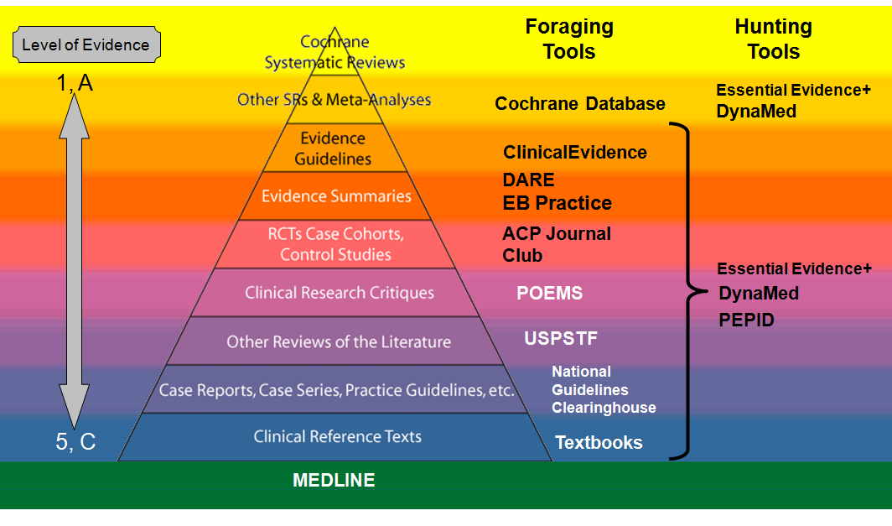
EBM Pyramid
5, C
InfoRetriever DynaMed
MEDLINE
Notes:
Here is the EBM pyramid labeled with the Foraging tools that we have reviewed, and a list of the Hunting tools which contain those resources. The Pyramid can be found on the EBM Tutorial linked to each resources. All of the EBM resources are on the Library Web Page under Clinical Resources. This diagram is also available there.

Slide 31
Major EBM Hunting Tools
Tools | Cochrane | ACP Journal Club | Guide-lines | US-PSTF | LOE
Essential Evidence +* |  |  |  |  | 
Dynamed Plus |  |  |  |  | 
PEPID
Web and Mobile
Summaries
* Mobile Formatted Websites
Notes:
Here are the four major EBM hunting tools that we have on our library, with a list of the resources they contain. We will go thru using each of these resources, I will demo how to use them, then you will practice using each resource with a practice question provided.

Slide 32
Essential Evidence Plus (EE+)
POEMS -- JFP
>104 journals surveyed
Over 3500 article synopses
Link out to PubMed
Cochrane abstracts
Selected NGC evidence-based guidelines
Decision support tools (calculators/prediction rules)
Notes:
Essential Evidence contains a huge variety of clinical prediction decision support tools which can be used as patient decision tools to show patients their options.
Demo the Framingham tool

Slide 33
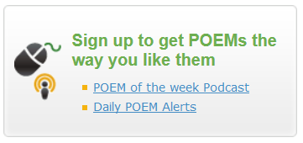
EE+ Features
EBM Guidelines
Levels of Evidence explained
Essential Evidence Topics (quick reference)
E/M coding tool
Immunization Guide
Derm Expert
Notes:
There is a link on the main page to sign up to receive the daily InfoPOEMS.

Slide 34
Essential Evidence Plus
Comes in mobile friendly web site, no app. Link is on Mobile Library page.
Daily POEMS are available in mp3 podcast version
Limitations
individual article summaries may not account for the “big picture”
may have to read multiple items
$$
Notes:
At this point, take them to EE+ and demo how to use it online. Stress that the site is mobile friendly, and easily used from the mobile library site.
Example Question: How useful are follow-up urine cultures in children hospitalized with febrile urinary tract infections?
Search for UTI, then pick Diagnosis and see what you get.
The handout on EBM resources is excellent for this. Walk them thru the part on the EBM Process and using EE+page 12 and page 13, then 14 and 15. Be sure to point out the linkout feature to PubMed. If you run PubMed and minimize before you open IEE+, theoretically, the FSU buttons will show up when you hit the LinkOut buttons.

Slide 35
Do EE+ Case

Slide 36
DynaMed Plus
New design and content January 2016
Intuitive clinical organization for diseases, drugs, procedures
Brief summarized information presented first
Links out to articles and reviews if more details needed
ICD-9/10 codes and links to patient information handouts
Notes:
DynaMed is a huge disease reference that gives you an up to date review of the literature on hundreds of conditions organized into a logical format. DynaMed, because of the amount of information provided, may not be your best point of care resource for QUICK answers, however, if you need to put together a /LecturePresentation on a topic, DynaMed can be your best friend. It does link out well to the full text journal articles, if you are in Ezproxy.

Slide 37
Dynamed Plus
Constantly updated review of literature and guidelines organized by topic: diseases, drugs
Calculators
Micromedex drug monographs
Images
Links out to articles subscribed at CoM and reviews if more details needed
Available online and mobile app
Notes:
Describe Dynamed as the most comprehensive and current disease resource we have. The web site is mobile formatted if accessed on a smartphone browser!! Or it is available in the Skyscape app.

Slide 38
DynaMed Sources
Systematic surveillance of primary journals – e.g. BMJ, JAMA, Lancet, NEJM, Pediatrics
Major EBM resources – e.g. ACP Journal Club, Cochrane Library, InfoPOEMs, Alternative Therapies,
Drug info sources – e.g. The Medical Letter, FDA MedWatch, Micromedex
Calculators from MedCalc3000
Images from ACP and other
Notes:
Editors of multiple family medicine journals have developed a simple level of evidence/strength of recommendation rating system (see
http://www.aafp.org/afp/20040201/548.html) to be used in review articles across these journals.
The DynaMed Editors have adopted this rating system and added short phrases to make these labels easier to interpret.
Immediately following the conclusion in evidence summaries (most paragraphs in DynaMed), you will see one of the following three labels:
-- (level 1 [likely reliable] evidence)
-- (level 2 [mid-level] evidence)
-- (level 3 [lacking direct] evidence)
These labels will be added as new information is added, and after we learn how well they work (Do they make your search for information easier?), we will add them to our reviewer and author instructions.
As recommendations are added to the Treatment Overview and other pertinent sections, you will see one of the following three labels:
-- (grade A recommendation [consistent high-quality evidence])
-- (grade B recommendation [inconsistent or limited evidence])
-- (grade C recommendation [lacking direct evidence])

Slide 39
DynaMed Plus
Limitations
variable quality if not Cochrane or review
areas with a lot of research can get hard to navigate. Lot of information-slower to wade through. Use “Search Within Text” to find answers to your question.
$$$ for individual subscription
Notes:
Demo looking up something in DynaMed, then let them to the provided DynaMed case.
Example to demo: In children with acute abdominal pain requiring surgical consultation, is immediate analgesia effective and does it impede the diagnosis of appendicitis?
Look under Acute Abdominal Pain: > Treatment > Drug:
You can also show them the CTRL-F (Find) function that will take you down to the words you are looking for.

Slide 40
Do DynaMed Case
Use CTRL-F to Find words in articles

Slide 41
PEPID
We provide the Clinical Rotation Companion (CRC) module. Compares favorably with Epocrates, 5MCC
EBM Content includes:
Clinical Inquiries
FPIN Evidence Based Practice Journal Entries
PURLs: Priority Updates from the Research Literature
United States Preventive Services Task Force (USPSTF) Recommendations
Mobile device app and Online
$$$ for individual subscription

Slide 42
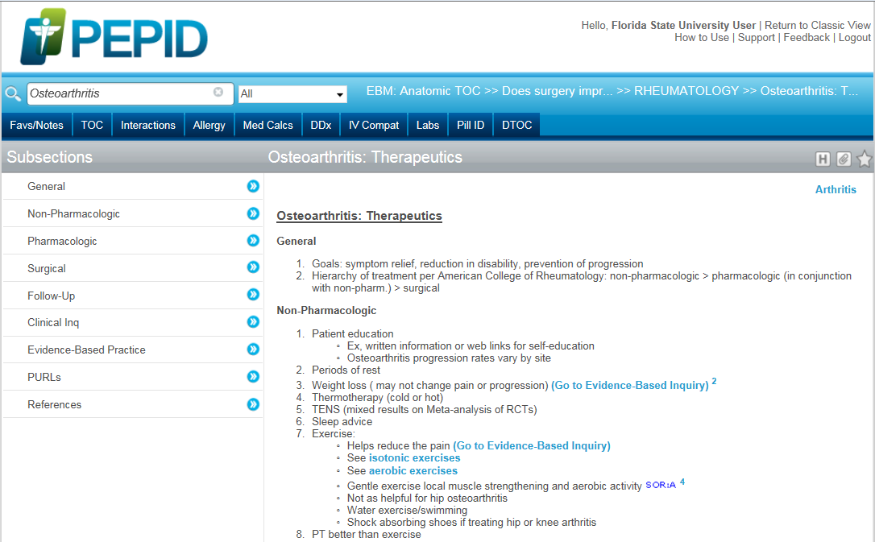
Links to Evidence Based Summaries
Exercise: Helps reduce pain.
Go to Evidence Based Inquiry
Notes:
There are two ways to get to the EBM content. The most logical is to search for the disease topic and within the content is a link to the clinical inquiries and other reviews.

Slide 43
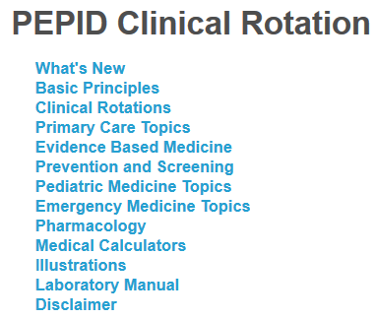
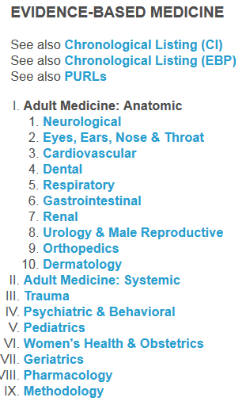
Links to Evidence Based Summaries
Search for Evidence Based Medicine
Notes:
You can also go directly to the EBM summaries from the main table of contents. However, these are presented chronologically. It is better to Search for EBM, then use the topic organized list.

Slide 44
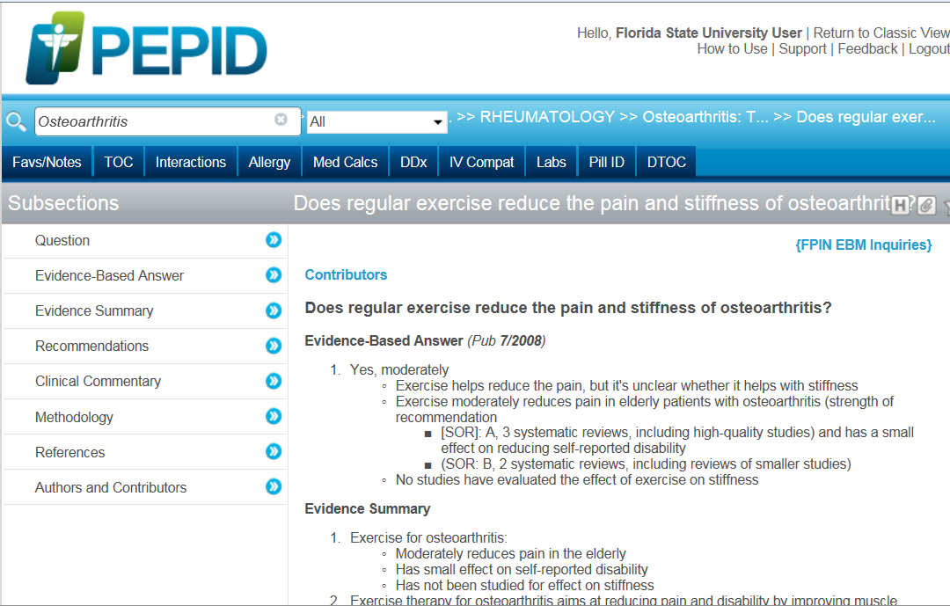
Example Clinical Inquiry
Notes:
Here is one of the FPIN reviews.

Slide 45
Do PEPID Case

Slide 46
Summary
CTRL-F
Need | Resource
Broad and basic overview organized by rotation (especially for med students) | PEPID
Need for detailed and/or latest info on topic – new content makes this a go-to resource | DynaMed Plus
Answers to clinical questions, use a clinical decision support calculator | Essential Evidence Plus

Slide 47
Find the Answer to Your Question
Group exercise

Slide 48
Appraise
3. Appraise that evidence for its validity (closeness to the truth) and applicability (usefulness in clinical practice)

Slide 49
Advanced EBM Skills
Only a small percentage of clinicians need to be able to do the following
Critical Appraisal and Interpretation of Research on:
Therapies, Diagnostic Tests, Prognosis
Critical Evaluation and Interpretation of:
Systematic Reviews, Including Meta-analysis, Decision Analysis, Practice Guidelines, Pharmaceutical Advertising, Including Pharmaceutical Representatives
Assigning Levels of Evidence to Research Findings
Teaching Level 1 Skills
Produce written Communication of Research Findings
Physicians
Patients (Slawson, et al)
Notes:
Talk about possibility of an advanced EBM workshop on interpreting diagnostic and therapy articles.
Only a small percentage of clinicians need to be able to critically appraise the primary literature. These are the people that should be writing the review articles and putting together evidence based references for us to use at the point of care.

Slide 50
Assessing Validity
Definitions
Level of Evidence (LOE): usually one study
Strength of Recommendation (SOR): recommendation based on multiple studies
A value of the confidence in the recommendation based on the quality of research
Assigned by experts using specific criteria
Ebell MH, Siwek J, Weiss BD, et al. Strength of recommendation taxonomy (SORT): a patient-centered approach to grading evidence in the medical literature. Am Fam Physician. Feb 1 2004;69(3):548-556.

Slide 51
Levels of Evidence
Centre for Evidence-Based Medicine, Oxford
Level 1: Systematic Review (with meta-analysis) of Randomized Clinical Trials
Level 2: Cohort Studies
Level 3: Case-Control Studies
Level 4: Case-series
Level 5: Expert Opinion
Notes:
Now, what do we mean by Level of Evidence. There are a number of scales for assigning levels of evidence. The Center for EBM at Oxford uses a 1-5 scale with 1 being the highest, representing systematic reviews or meta-analyses of randomized control trials. Notice that level 5 the lowest level, which we used to consider “golden”, refers to a consensus of expert opinion. Unlike the evaluation forms for this workshop, on which 5 is the HIGHEST. Please do not confuse this scale with the workshop evaluations.

Slide 52
Strength of Recommendation
A: There is good research-based evidence to support the recommendation.
B: There is fair research-based evidence to support the recommendation.
C: The recommendation is based on expert opinion and panel consensus.
X: There is evidence of harm from this intervention.
Notes:
AHRQ has a new rating system.
AHRQ assigns their own level of evidence which can be somewhat easier to understand if you are not as comfortable with study designs. A is the highest, C is expert opinion, and X actually says that there is harm in this intervention.

Slide 53
Bottom Line on LOE or SOR
Level 1 A Highest level
Level 2
Level 3 B
Level 4
Level 5 C Lowest Level
But still evidence
Notes:
Bottom line take home message here is that 1 or A is the highest and the lowest level is 5 or C, but even the lowest is still the best evidence we may have until more research is conducted and evaluated.

Slide 54
The Patient
4. Return to the patient -- integrate that evidence with clinical expertise, patient preferences and apply it to practice

Slide 55
EBM as Patient-Centered Care
To employ evidence-based practice—integrate best research with clinical expertise and patient values for optimum care
To provide patient-centered care - identify, respect, and care about patients’ differences, values, preferences, and expressed needs; relieve pain and suffering; coordinate continuous care; listen to, clearly inform, communicate with, and educate patients; share decision making and management; and continuously advocate disease prevention, wellness, and promotion of healthy lifestyles, including a focus on population health.
IOM Report– Core Competencies Needed for Health Care Professionals
http://www.ncbi.nlm.nih.gov/books/NBK221528/
Notes:
To truly integrate patient values into the decision making process of evidence-based practice, one must practice patient centered care, which is defined above by the IOM.
Chapter 27 of the Users Guides to the Medical Literature in JAMA Evidence provides three approaches that attempt to ensure decision consistent with patient values and preferences.

Slide 56
Patient Centered EBM Approaches
“Clinician-as-perfect-agent” approach: Clinician ascertains patient's values and preferences, makes decision on behalf of patient
Informed decision making: Clinician provides patient with the information; patient makes the decision
Shared decision making: Patient and clinician both bring information/evidence and values and preferences to the decision
Montori, VM, et al. Decision Making and the Patient. In: Users Guide to the Medical Literature. JAMA Evidence. http://jamaevidence.mhmedical.com/content.aspx?bookid=847&sectionid=69031507
Notes:
The point is that there are many approaches to this. Good question here is: which approach are audience members most comfortable with? What should we model to the students? What should we hope for students?
Montori VM, Elwyn G, Devereaux P, Straus SE, Haynes R, Guyatt G. Decision Making and the Patient. In: Guyatt G, Meade MO, Rennie D, Cook DJ. eds. JAMA evidence Using Evidence to Improve Care. New York, NY: McGraw-Hill; 2014. http://jamaevidence.mhmedical.com/content.aspx?bookid=847&Sectionid=69031507. Accessed August 10, 2015.

Slide 57
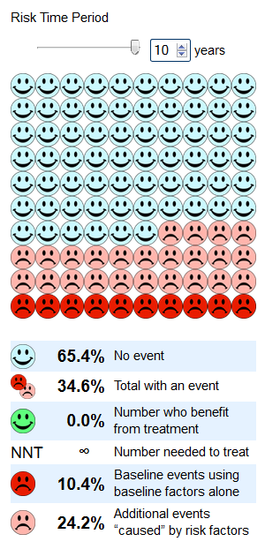
Patient Decision Aids
Example: The Absolute CVD Risk/Benefit Calculator
http://cvdcalculator.org
Shows improved outcomes with various options like statins, exercise, smoking cessation…
Cochrane review: these improve patient knowledge and reduce decisional conflict.
Notes:
From JAMA Evidence: same chapter [a shortcut to this cvd calculator can be created on an iPad that turns it into an app of sorts]
Patient Decision Aids
To effectively communicate the nature of the options, researchers have devised and tested tools called patient decision aids. These tools are an alternative to the use of intuitive approaches of communicating concepts of risk and risk reduction that clinicians may have developed through clinical experience. Decision aids present, in a patient-friendly manner, descriptive and probabilistic information about the disease, treatment options, and potential outcomes.¹⁷⁻¹⁹ A well-constructed decision aid is based on a systematic review of the literature and produces a rigorous summary of the outcomes and their probabilities. Clinicians who doubt that the summary of probabilities is rigorous can review the primary studies on which those probabilities are based and, using the principles in this book, determine their accuracy. Furthermore, a well-constructed decision aid offers a tested and effective way of communicating information to patients who may have little background in quantitative decision making. Most commonly, decision aids use visual props, such as icon arrays, to present the proportion of people who experience the outcomes of importance with and without the intervention.
What influence do decision aids have on clinical practice? A Cochrane review identified 86 randomized trials of decision aids that support screening and treatment decisions.¹⁸ Compared with usual care, decision aids increased reported patient participation in decision making (relative risk, 1.4; 95% confidence interval [CI], 1.0-2.3), improved patient knowledge (19/100 points in knowledge surveys; 95% CI, 13-24), and reduced decisional conflict (−9.1/100; 95% CI, −12 to −6). The systematic reviewers concluded that decision aids did not, however, consistently improve satisfaction with the decision-making process, health outcomes, or adherence to treatment, or reduce health care use or costs.
Like guidelines, decision aids may be problematic when conflicted developers fail to present the evidence, options, and outcomes fairly. As in guidelines, standards are being developed to try and ensure that decision aids are safe for patient use and do not mislead patients and clinicians.^{20,21}
In summary, decision aids increase patient knowledge and improve measures intended to reflect the quality of the decision-making process and its outcome. The use of decision aids in routine clinical practice remains rare, and many implementation barriers exist.²² Simple decision aids that clinicians can integrate into regular patient care could improve adoption.²³ Randomized trials have found that simple tools for use during the clinical encounter can increase the extent of patient participation in decision making and, in turn, affect the extent to which informed patients' values determine health care decisions.²⁴⁻²⁸ This evidence has not revealed consistent effects of using decision aids on treatment choice, adherence, clinical outcomes, or health care use or costs.

Slide 58
Decision Aids
Can be handouts or online. Examples:
Mayo Clinic Handouts
http://shareddecisions.mayoclinic.org
Directory of online aids from Canada
https://decisionaid.ohri.ca
Can be used with patient during the encounter or given to patient to use
Notes:
The directory is at the Ottawa Hospital Research Institute. Attempt to find a similar list in a US group was unsuccessful.
Give the audience time to find a decision aid to use in their practice.

Slide 59
Do Decision Aid Case

Slide 60
Self-evaluation
5. Evaluate your performance with patient & process

Slide 61
Evaluation
Performance in asking answerable questions
Performance in searching and appraising
Performance in integrating evidence and patients’ values
Efficiency of your efforts
Ask yourself
Is practice improving?
Is practice evidence-based?
Straus, SE, et al. Evidence-based Medicine: How to practice and teach it. (4th Edition) 2011. Churchill Livingstone. Edinburgh.

Slide 62
Teach Evidence Based Medicine

Slide 63
Three Modes of Teaching EBM
1. Role modeling evidence-based practice:
a. Learners see evidence as part of good patient care
b. Teaching by example: “actions speak louder than words”
c. Learners see us use judgment in integrating evidence into decisions
2. Weaving evidence into clinical teaching:
a. Learners see evidence as part of good clinical learning
b. Teaching by weaving: evidence is taught along with other knowledge
c. Learners see us use judgment in integrating evidence with other knowledge
3. Targeting specific skills of evidence-based practice:
a. Learners learn how to understand evidence and use it wisely
b. Teaching by coaching: learners get explicitly coached as they develop
c. Learners see us use judgment as we carry out the five EBM steps with them.
© Straus, Glasziou, Richardson, Haynes: Evidence-Based Medicine, 4 th Edition.
Notes:
1. Role modeling evidence-based practice:
a. Learners see evidence as part of good patient care
b. Teaching by example: “actions speak louder than words”
c. Learners see us use judgment in integrating evidence into decisions
2. Weaving evidence into clinical teaching:
a. Learners see evidence as part of good clinical learning
b. Teaching by weaving: evidence is taught along with other knowledge
c. Learners see us use judgment in integrating evidence with other knowledge
3. Targeting specifi c skills of evidence-based practice:
a. Learners learn how to understand evidence and use it wisely
b. Teaching by coaching: learners get explicitly coached as they develop
c. Learners see us use judgment as we carry out the fi ve EBM steps with them.

Slide 64
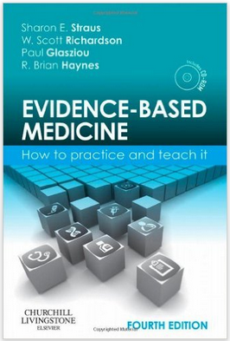
Questions

