Slide 1
Big Pharma and Evidence-Based Medicine: An Oxymoron?
Kenneth Brummel-Smith, MD
Charlotte Edwards Maguire Professor of Geriatrics
Florida State University College of Medicine

Slide 2
Special Thanks
Marcia Angell
John Abramson
No Free Lunch

Slide 3
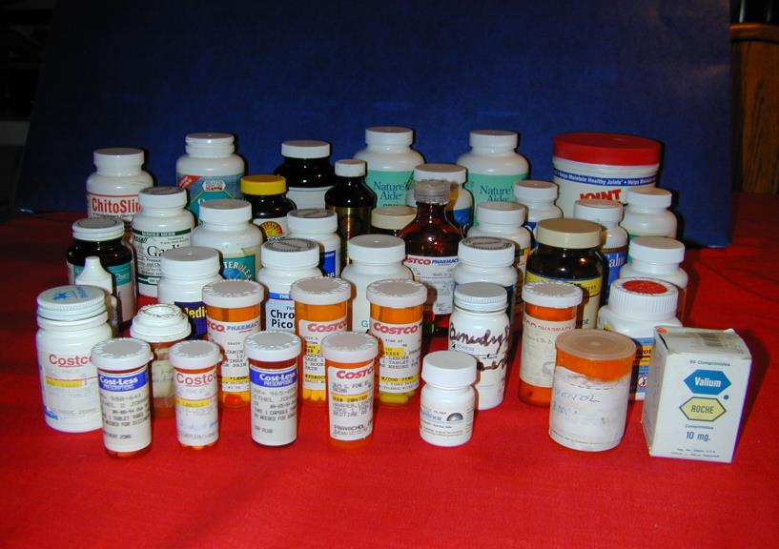
One person’s drugs

Slide 4
Prevalence of the Problem
Medication errors each year:
  7000 deaths
  95,000 hospital admissions
  700,000 emergency visits
  3,000,000 office visits
30% more money spent on treating errors than on medications themselves
5th most common cause of death in US
IOM, To Err is Human, 2000

Slide 5
Problem of New Drugs
In last 10 years 16 name-brand drugs have been withdrawn for safety reasons
  50% of withdrawals happen in the first 2 years
In 20 years, 2 generic drugs have been withdrawn for safety reasons
Half of all “Black Box” warnings occur within 7 years of release of a new drug
FDA Medwatch, 2006
Lasser KE, JAMA 2002
Notes:
One problem facing doctors is the number of new drugs introduced each year. The problem is compounded by direct-to-consumer advertising (DTC) which has been shown to increase patients asking for medications for which there is no indication. Physicians often worry that they will lose the patient if they don’t meet their requests.

Slide 6
Drugs Withdrawn
FDA, 2006
Notes:
This graph shows the number of drugs withdrawn in each decade since the 1950s. Although part of the reason there were so many in the 2000s was simply the increase in the number released, the rate of withdrawal was still higher than in the previous two decades. Tis also reflects a loosening of the approval process by the FDA (under pressure from the pharmaceuticals) leading to quicker release of new drugs. For example, rofecoxib was released after RCTs involving less than 2000 patients. Over 23,000,000 patients were using it 2 years later when it was taken off the market. It was a “me-too” drug.

Slide 7
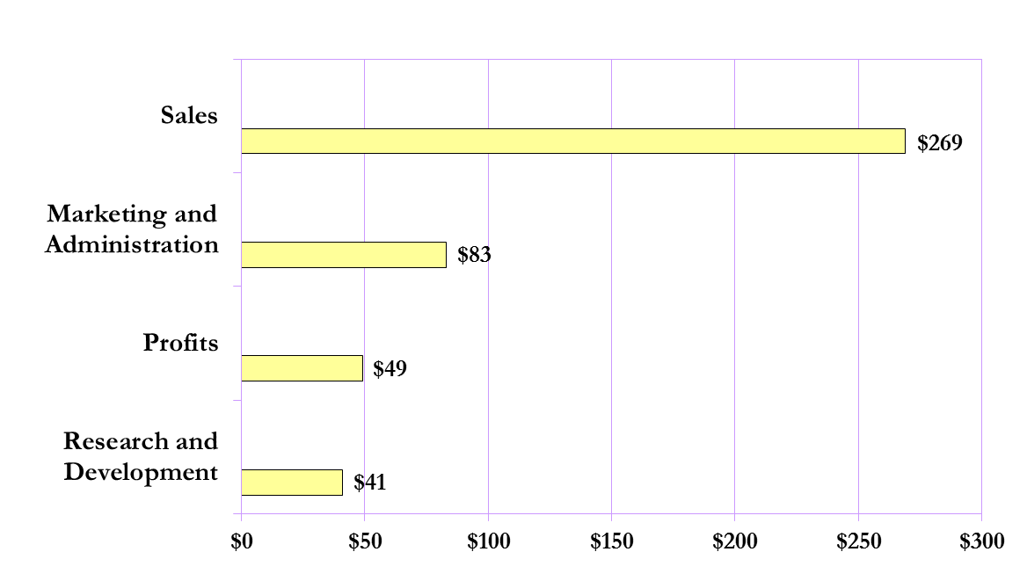
*FORTUNE 500 U.S. DRUG COMPANIES 2008 SALES AND EXPENSES
(31%)
(18%)
(15%)
Billions
Average drug company profits 18% v. 0.9% for all Fortune 500 industries
*Johnson&Johnson, Pfizer, Abbott, Merck, Wyeth, Bristol-Myers Squibb, Lilly, Schering-Plough, Amgen, Gilead Sciences
Source: Fortune 5/4/09; company annual reports
Notes:
*Pfizer, Johnson&Johnson, Abbott, Merck, Bristol-Myers Squibb, Wyeth, Lilly, Amgen, Schering-Plough

Slide 8
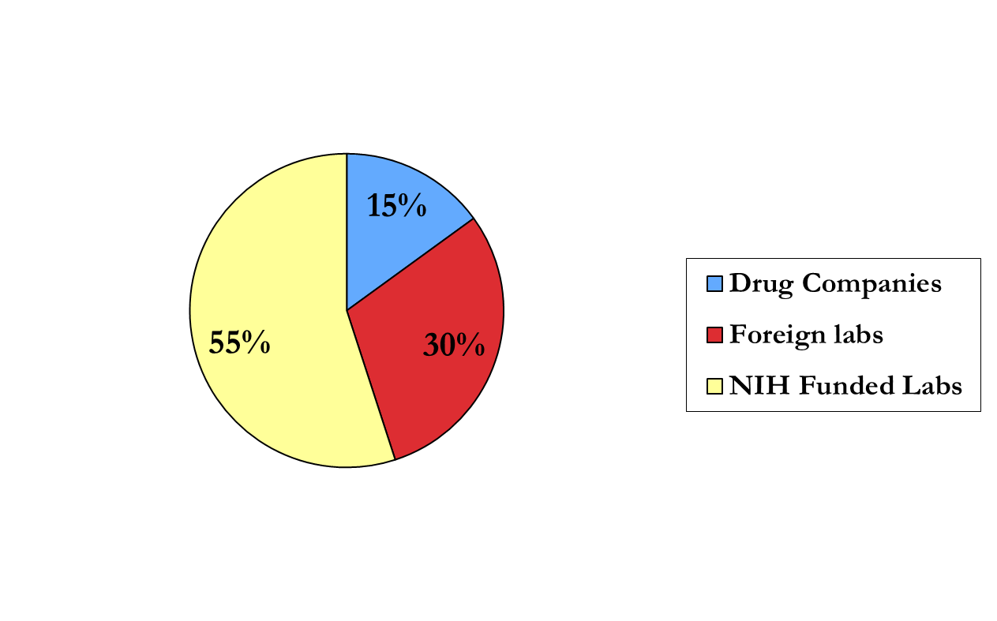
Innovation:
Published Research Leading to Drugs
Sources: Internal NIH document available from Public Citizen;
also Zinner, Health Affairs, Sept-Oct 2001; also Boston Globe 4/5/98

Slide 9
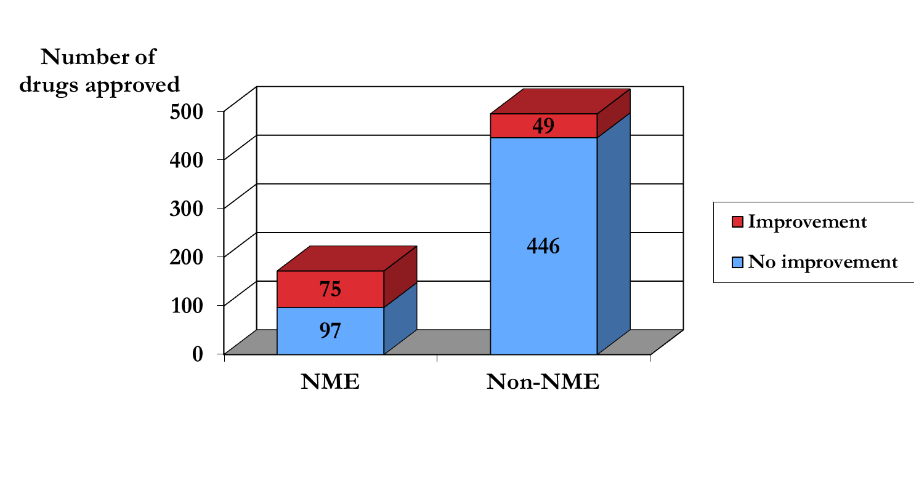
New Drug Approvals 2000-2007 (8 years)
667 new drug approvals
Only 75 (11%) were both Novel Medical Entities (NME)
and improvements over existing drugs

Slide 10
Tricking Us With “New Drugs”
Nexium (AstraZenica) – esomeprazole, for heartburn (GERD) – the “purple pill”
  2001 – came on market
  Same time Prilosec (omeprazole) was going off patent
  Not chemically different than omeprazole
  Marketed it as better by comparing it to lower doses of omeprazole

Slide 11
Other Tricks
Clarinex and Claritin
  loratidine (Claritin) – ($15 for 30 pills – OTC)
  Clarinex (desloratidine) – ($133 for 30 pills)
Prozac and Serafem
  Prozac ($122 for 30 pills)
  fluoxetine ($14 for 30 pills)
  Sarafem ($67 for 7 pills) – “premenstrual dysphoric disorder”
95 of 170 contributors to DSM-IV had drug company ties
– Cosgrove, Psychother Psychosom 2006:75:154-160

Slide 12
Study Design Tricks
Comparing the new drug to placebo when there are good drugs for the problem
  Therefore, it is possible to get a drug approved by the FDA that is less effective (or more problematic) than existing drugs!
Comparing new drug to an ineffective dose of the other drug

Slide 13
Academic Medicine Ties
2/3 hold equity interest in companies that sponsor research in their institution
Faculty (and community physicians) are often paid consultants and on speakers bureaus
Practice guidelines – 200 guidelines had more than 1/3 of the “experts” on the Pharma payroll
Taylor R, Nature 2005;437:1070-1071

Slide 14

Conclusions The reporting of trial outcomes is not only frequently incomplete but also biased and inconsistent with protocols. Published articles, as well as reviews that incorporate them, may therefore be unreliable and overestimate the benefits of an intervention.
Chan A-W, Hrobjartsson A, Haahr ME, et al, JAMA. 2004;291:2457-2465

Slide 15
Association of Funding and Conclusions in Randomized Drug Trial
…trials funded by for-profit organizations were significantly more likely to recommend the experimental drug as treatment of choice (odds ratio, 5.3) compared with trials funded by nonprofit organizations.
Als-Neilsen B, Chen W, Gluud C, Kiaergard LL, JAMA, 2003; 290:921-928

Slide 16
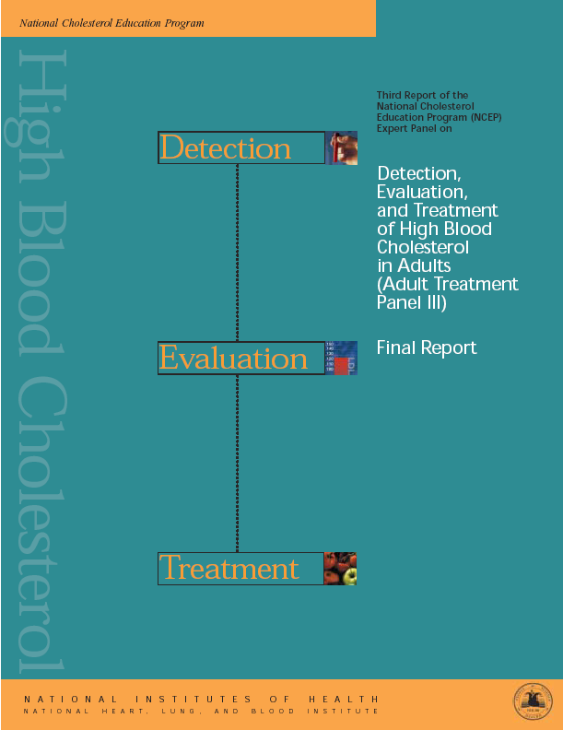
8 of 9 panel members
had financial ties to the
makers of statins

Slide 17

In recent trials, statin therapy reduced risk for CHD in…women, in those with or without heart disease…
(Table II.2–3)
Adapted from NCEP Report, 2001

Slide 18
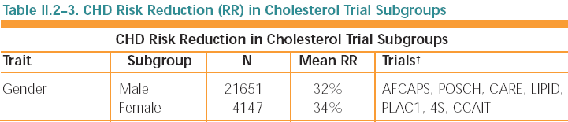
Adapted from NCEP Report, 2001
Notes:
POSCH: Ileal bypass surgery for secondary prevention. CARE, LIPID, 4S, PLAC1, and CCAIT are all secondary prevention.

Slide 19
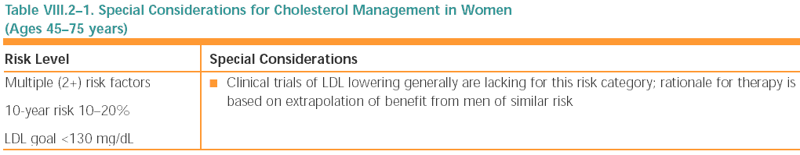

Slide 20
Selection of older persons for short-term, primary
prevention
Approximately two-thirds of first major coronary events occur in persons ≥ 65 years…Recent clinical trials have revealed that aggressive LDL-lowering therapy is effective in reducing risk for CHD (see Table II.2–3).
Adapted from NCEP Report, 2001

Slide 21
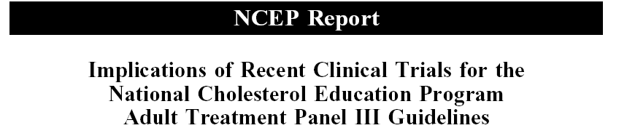
Older Persons at High Risk Without
Established CVD
The results of PROSPER…support the efficacy of statin therapy in older, high-risk persons without established CVD.

Slide 22
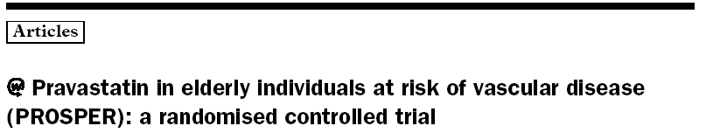
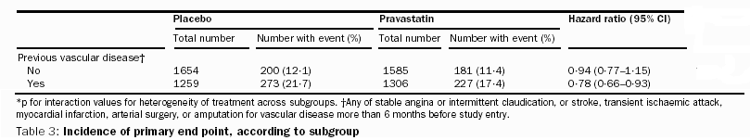
Incidence of Coronary Death, Non-Fatal MI,
Fatal and Non-Fatal Stroke

Slide 23
Incidence of Coronary Death, Non-Fatal MI,
Fatal and Non-Fatal Stroke
Notes:
0.7% over 3.2 years = 0.2% , or 450 people would have to be treated for one year to prevent a single cardiovascular event

Slide 24
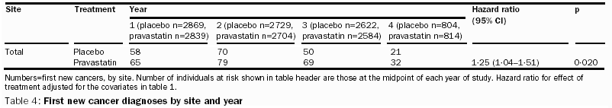
First New Cancer Diagnoses by Site and Year

Slide 25
First New Cancer Diagnoses by Site and Year

Slide 27
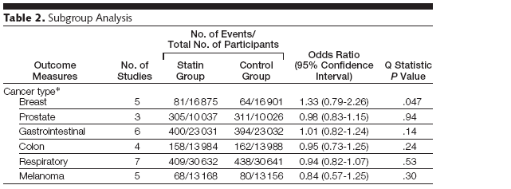

Slide 28
Cholesterol Levels and Age.
RESULTS: The relationship between total cholesterol level
and all-cause mortality was positive at age 40 years,
negative at age 80 years, and negligible at ages
50 to 70 years. The relationship with CHD mortality
was significantly positive at ages 40, 50, and 60 years
but attenuated with age until the relationship was positive,
but not significant, at age 70 years and negative,
but not significant, at age 80 years.
Framingham data
Kronmal RA, Cain KC, Ye Z, Omenn GS. Arch Intern Med. 1993 May 10;153(9):1065-73.

Slide 29
Expanding Statin Use to Help More
At-Risk Patients Is Causing Financial Heartburn
[Medical News & Perspectives]
Percentage of Eligible Patients Taking Statins
Country
United States | 56%
United Kingdom | 23%
Germany | 26%
Netherlands | 36%
Italy | 17%
Switzerland | 29%
Mitka, Mike
Volume 290(17) 5 November 2003 p 2243–2245
Notes:
Data from 2000, “eligibility” defined by criteria in 1993 guidelines

Slide 30
Selling “Evidence” to Drs

Slide 31
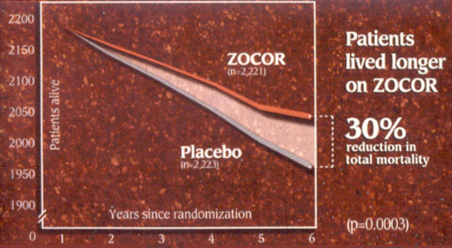
Notes:
Ads use relative risk reductions almost exclusively (Can Fam Phys.1999; 45;
1213-16), as do media reports.

Slide 32
Risk (Rx) = 8/100 = 8%
Risk (Pl) = 12/100 =12%

Slide 33
Relative Risk(RR) = Risk (Rx)/ Risk (Pl) = .08/.12 = .67
Relative Risk Reduction (RRR) = 1 - RR = 1- .67 = .33 or 33%

Slide 34
Absolute Risk Reduction (ARR) = Risk (Pl) - Risk (Rx) = .12 - .08 = .04 or 4%

Slide 35
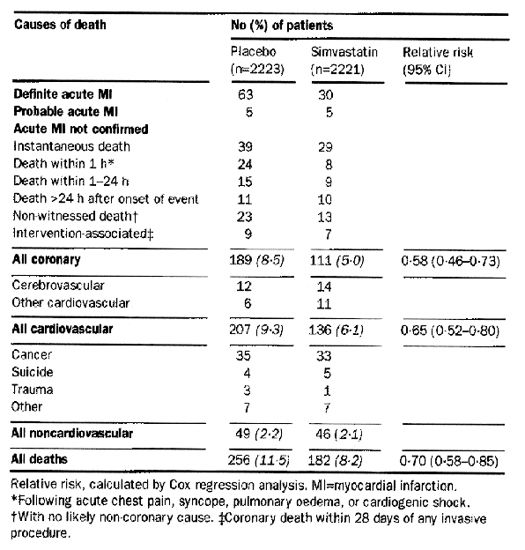
Notes:
The absolute risk reduction in total mortality in the 4S study (Lancet 1994;344:1383-89) was 3.3%. (bottom row)

Slide 36
Notes:
Note that very few patients were followed longer than 5 years in the 4S study. This is apparent in the report of the study, but not in the ad.

Slide 37
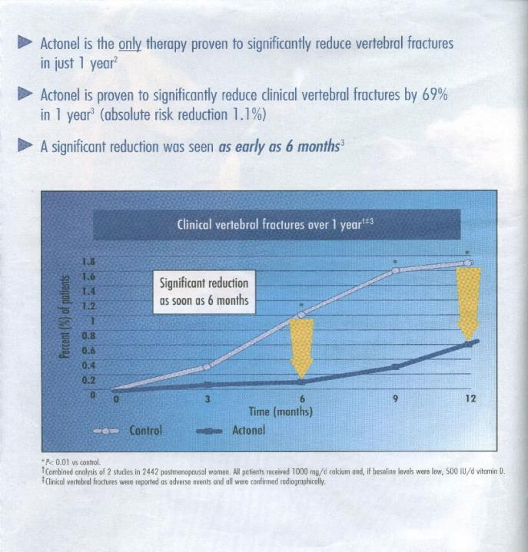
Notes:
What might appear to be a large difference between treatment and control group becomes quite small if one takes a look at the y-axis. Note the phrase “significant reduction as soon as 6 months;” this would seem to be an example of statistical but not clinical significance. Also an example of a large RRR (69%) but very small (1.1%) ARRR,

Slide 38
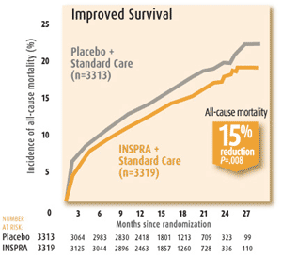

Slide 39
The Fifth Report of the Joint National Committee on Detection, Evaluation, and Treatment of High Blood Pressure (JNC V)
“Because diuretics and β-blockers have been shown to reduce cardiovascular morbidity and mortality in controlled clinical trials, these two classes of drugs are preferred for initial drug therapy.”

Slide 41
How Did This Happen?
Calcium channel blockers were the most detailed anti-hypertensives in the 1990s.
NorvascTM (amlodipine - a calcium channel blocker) was the most prescribed anti-hypertensive in 1998.

Slide 42
I N S T I T U T E O F M E D I C I N E
Shaping the Future for Health
THE FUTURE OF THE PUBLIC’S HEALTH
IN THE 21ST CENTURY
There is strong evidence that behavior and environment are responsible for over 70 percent of avoidable mortality, and health care is just one of several determinants of health.
Institute of Medicine
Notes:
PARADIGM OF BIOMEDICINE IS TRANSMITTED IN MEDICAL SCHOOL
KUHN DID NOT MENTION ECONOMIC PRESSURE IN HIS ANALYSIS OF THE EFFECT OF PARADIGMS, BUT CAN’T BE NAÏVE ABOUT ECONOMIC PRESSURES

Slide 43
Determinants of Health in the U.S.
McGinnis JM, Williams-Russo P, Knickman JR. The case for more active policy
attention to health promotion. Health Affairs. 2002;21(2):78-93.
Notes:
Where does all the money go?

Slide 44
Allocation of Health Care Resources in the U. S.
McGinnis JM, Williams-Russo P, Knickman JR. The case for more active policy attention to health promotion. Health Affairs. 2002;21(2):78-93.

Slide 45
What You Can Do
Keep a list of your drugs – show it every visit
Use only one pharmacy
Don’t ask for any drug that is advertised on TV or in magazines
Ask how long the drug has been on the market
  Don’t take any drug until it’s been out for at least 2 years
Ask if there are other things besides taking a drug you can do
Ask if you should stop any current drugs
Look for signs of drug company influence

Slide 46
What Society Can Do
Free standing, nongovernmental drug effectiveness center (like the IOM) (Abramson)
NIH Institute for Prescription Drug Trials (Angell)
Demand doctors no longer accept gifts, serve on speaker bureaus, or publish articles written by industry

Slide 47
Great Books
The Truth About The Drug Companies, Marcia Angell, MD, Random House, 2004
Overdosed America, John Abramson, MD, Harper Collins, 2004
Worst Pills, Best Pills, Sidney Wolfe, MD, Pocket Books, 2005

Slide 48
Helpful Sites
Worst Pills, Best Pills
  https://www.worstpills.org
Therapeutics Education Collaborative
  http://therapeuticseducation.org
OHSU Drug Effectiveness Review Project
  www.ohsu.edu/drugeffectiveness
Evidence Based Drug Therapy
  www.ti.ubc.ca

