Slide 1
Making Wise Choices
Kenneth Brummel-Smith, MD
Charlotte Edwards Maguire Professor of Geriatrics
Florida State University College of Medicine

Slide 2
Important Concepts
Risk factors
Not a disease (doesn’t cause change in life)
Risk is usually 1-7 years away
Measured using “surrogate” or “treatment targets”
Examples – blood pressure, cholesterol
Benefits - A belief, perception, or goal
Harms – A negative experience

Slide 3
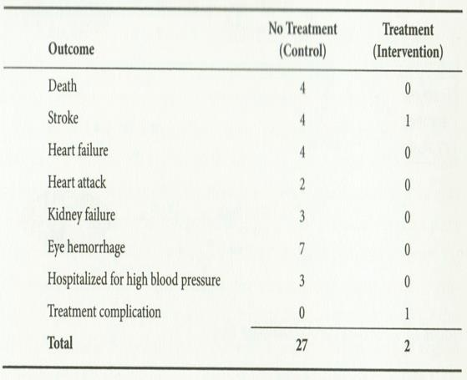
A Story
Veterans Administration study in the early 1960s
Diastolic BP of 119 - 129
RCT of 140 patients, 1.5 years
NNT = 1.4
Notes:
Pres. Roosevelt had BP 300-119 – he died of a cerebral hemorrhage

Slide 4
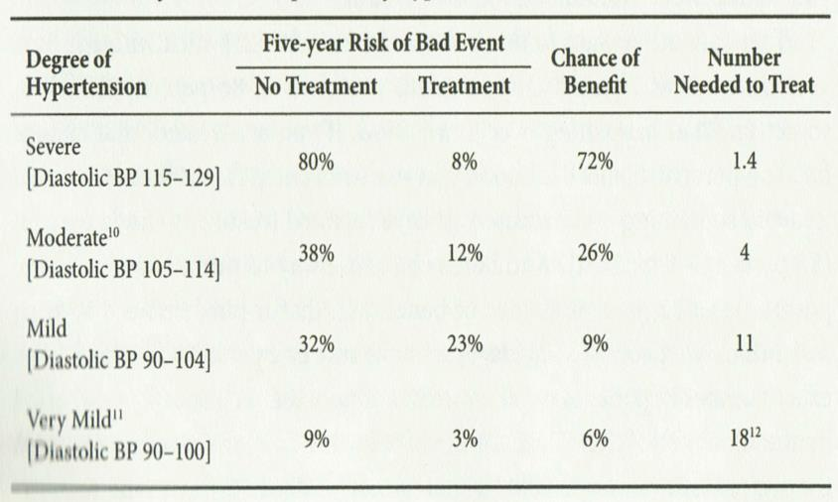
What About Lower BP?
“Prehypertension”
4 RCTs – JAMA

Slide 9
What About Diabetes?

Slide 15
What About Cholesterol?

Slide 22
What About Weight?

Slide 24
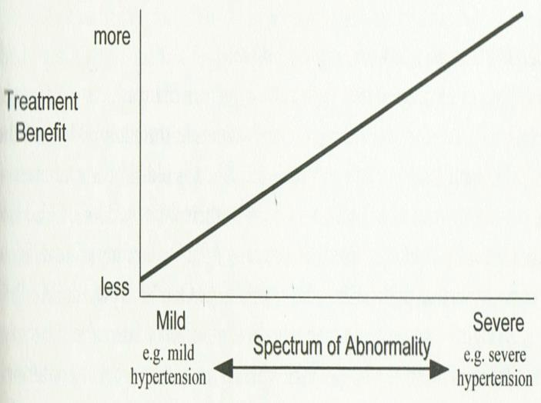
Bottom Line
Notes:
Story of hernias and NHS
Most people with mild problems get no benefit

Slide 25
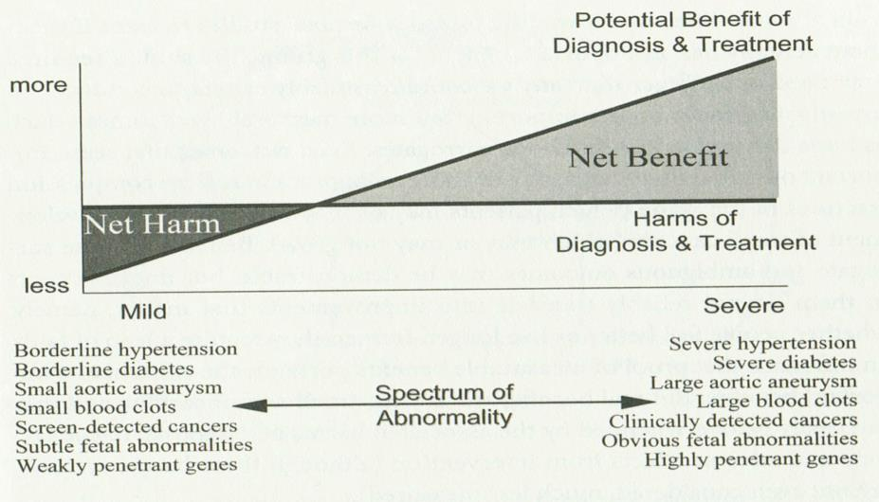
Is Medicine Worthless?

